Slide 1

Nahum:
The Lord Comforts

Slide 2
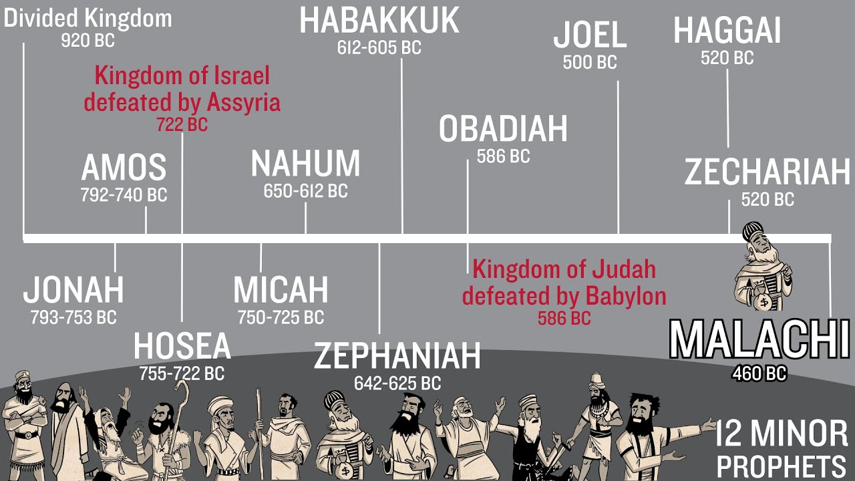

Slide 3
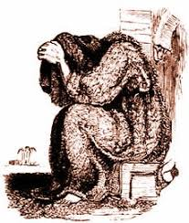
Nahum (God’s Comfort):
Jonah (Dove):
Written = 614-612 bc (168 years after Jonah)
Prophesies Assyria’s total destruction – happened in 612 by Babylon with help of Medes
Written to the Nation of Judah and to Israelites living in Judah
Assyria’s defeat becomes Judah’s comfort – remember what Nahum means…
Written = 780 bc
Sent to Nineveh – called for repentance
Assyrians, King and all, wept and repented
God forgave

Slide 4
Let’s look at the book of Nahum
(Only 3 chapters)
Very little known about the man – Nahum
We know his name means “God comforts”
Lived in Judah during King Josiah's reign same time as Zephaniah and Jeremiah
Assyria conquered Israel 722 bc now Babylonian King – Nabopolassar (father of Nebuchadnezzar) conquers Assyria in 612 bc with the help of the Medes. (Neb is very important in the book of Daniel – he defeats Judah in 586bc.)

Slide 5
Chapter 1:
V2 The Lord is a jealous and avenging God: jealous = demands exclusive devotion with zeal and passion; avenging = punishes those who oppose Him
V3 Similar as Jonah 4:2: ”The Lord is slow to anger but great in power…will not leave the guilty unpunished (righteous & just)… abounding in love…”
V8 Nineveh will fall
V14 “No descendants left to bear your name…”

Slide 6
V15 “Look, there on the mountains (place of stability), the feet of one who brings good news, who proclaims peace! Celebrate your festivals, Judah, and fulfill your vows.”
Note song – Our God Reigns:
“How lovely on the mountains, are the feet of him who brings good news, good news, announcing peace, proclaiming news of happiness, our God reigns, our God reigns, Our God reigns…

Slide 7
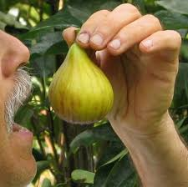
Chapter 2 – 3 Assyria’s Destruction Described:
2:1 Attackers advance against you…guard the fortress, watch the road, brace yourselves and marshal (gather) your strength!”
2:2 Jacob’s splendor will be restored!
2:5 Nineveh summons her picked troops, yet they stumble…
2:7 Nineveh will be exiled and carried away…
3:12 All your fortresses are like fig trees with their first ripe fruit, when they are shaken, the figs fall into the mouth of the eater.”
Assyria

Slide 8
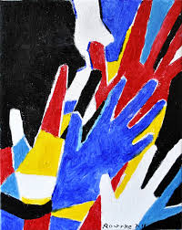
3: 18-19 “King of Assyria, your shepherds slumber; your nobles (Politian’s) lie down to rest. Your people are scattered on the mountains with no one to gather them. Nothing can heal you; your wound is fatal. All who hear the news about you clap their hands at your fall, for who has not felt your endless cruelty?”

Slide 9

Similar to our 911… 2001 – 23 years to completely forget…Assyria took 168 yrs
God is slow to anger and compassionate… still!
God restores!
God is in control of world events regardless how we feel…
Our God Reigns!
What do we see?

Slide 10
Our God Reigns:
“How lovely on the mountains, are the feet of him who brings good news, good news, announcing peace, proclaiming news of happiness, our God reigns, our God reigns, Our God reigns…”

