Slide 1
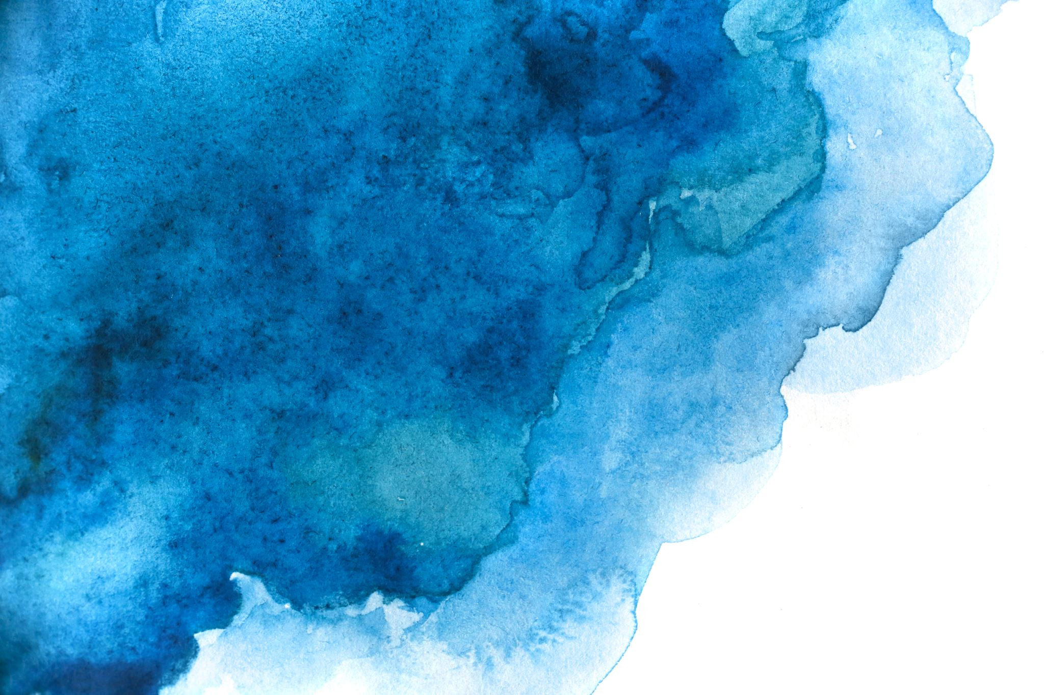
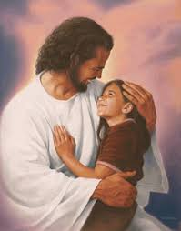
Zephaniah

Slide 2
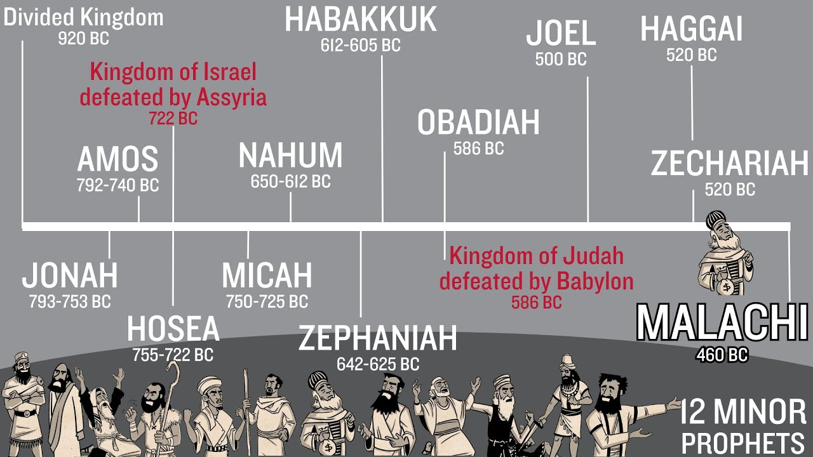

Slide 3
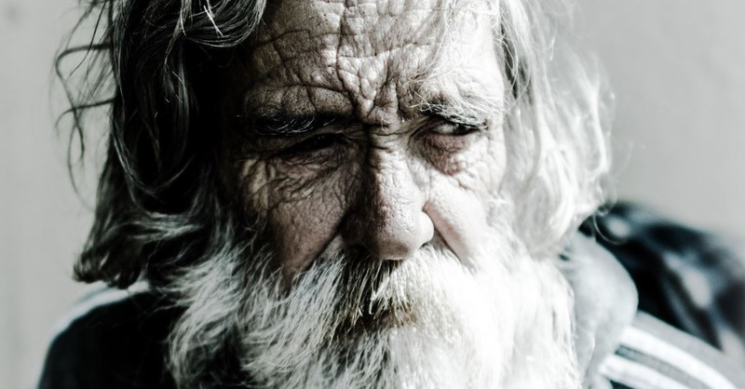
*He is a descendant of King Hezekiah…a descendant of King David and Judah
*642 bc – 609 bc
*A student of Isaiah
*A mentor of Jeremiah
*Started writing around 627bc
Sample Footer Text
3

Slide 4
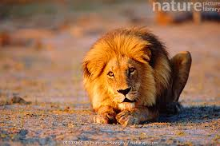
Zephaniah means “God lies in wait”

Slide 5
640 630 620 610 600 590 580
Jehoahaz
Jehoiachin
Kings of Judah
Josiah
Jehoiakim
Zedekiah
Jerusalem & Temple Destroyed
Zephaniah
Jeremiah
Nahum
Daniel
Ezekiel
Fall of
Nineveh

Slide 6
A look at Josiah – King of Judah
II Chronicles 34 & 35
Manasseh (697-642bc) and Amon (642-640bc) = extremely evil!
Amon assassinated after 2 yrs by his own leaders (he sacrificed his youngest son to an idol) and Josiah becomes King of Judah at 8 years old!
Mentioned in Matthew in the lineage of Jesus
16 yrs old starts seeking the Lord
20 yrs old he purges Judah of all idols

Slide 7
26 years old, Josiah starts repairing Solomon’s Temple (built approximately 940’s bc) now approximately 660’s bc.
Repairmen find the Book of the Laws of Moses and brings it to Hilkiah (High Priest) – who sends it to Josiah.
Josiah tore his robes in repentance and tears
Hilkiah brings Huldah (a female prophet and teacher of the Law) to verify the authenticy of scroll.

Slide 8
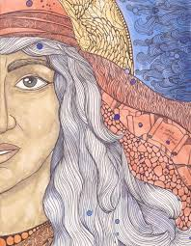
Huldah – a cousin of Jeremiah. Both descendants of Rahab
A teacher of oral traditions – a teacher the Hebrew school
Prophesied over Josiah: uses the phrases: Tell the man…tell the King…Because of your humility, God will spare you, you will not see the devastation of Jerusalem and of Judah
II Chronicles 34 & 35

Slide 9
Back to Josiah
II Chron. 34
V29 – 33: Josiah calls for the reading of the Book of the Laws to all and calls for repentance and recommitment to the Covenant.
II Chron. 35
The Passover and Feast of Unleaven Bread is celebrated
Josiah’s war against Egypt caused his death… “As long as he lived, they did not fail to follow the Lord.” (34:33)

Slide 10
Coming judgment on Jerusalem (1:1-6)
Zephaniah
Coming judgment of leaders & wealthy (1:7-13)
God’s judgment against the nation (1:14-18)
Call to repentance (2:1-3)
God’s judgment against the nations (2:4-15)
Coming judgment of leaders (3:1-7)
Coming restoration of Jerusalem (3:8-20)

Slide 11
Zephaniah and Revelation
Zephaniah
Revelation
1:2-6, “I will sweep away everything from the face of the earth…”
1:14, “The Mighty Warrior shouts His battle cry…a day of the trumpet and battle cry…”
2:1-3:11 Judgement for disobedience and evil
7 Seals
7 Trumpets
7 Bowls
Rev. 16 – The Battle of Armageddon

Slide 12
Rev. 19: 11 - 16
“I saw heaven standing open and there before me was a white horse, whose rider is called Faithful and True. With justice He judges and makes war. His eyes are like blazing fire, and on His head are many crowns. He has a name written on Him that no one knows but He Himself. He is dressed in a robe dipped in blood, and His name is the Word of God…On His robe and thigh is written: ‘KING OF KINGS AND LORD OF LORDS’.”

Slide 13
Complete
Restoration
Zeph 3:17
“The Lord, the King of Israel, the Mighty Warrior Who saves. He will take great delight in you; in His love He will no longer rebuke you, but He will rejoice over you with singing!”

Slide 14

The Book of Zephaniah goes back and forth from Josiah’s time to the end times seen in the Book of Revelation
The msg = God is a holy, just, mighty and loving God!
The remnant (the obedient), He sings over you now and through eternity!

Slide 15
Zeph 3:17
“The Lord, the King of Israel, the Mighty Warrior Who saves. He will take great delight in you; in His love He will no longer rebuke you, but He will rejoice over you with singing!”

