Slide 1
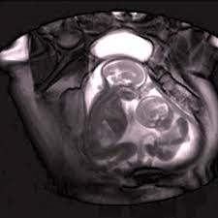
Obadiah
Edom condemned

Slide 2
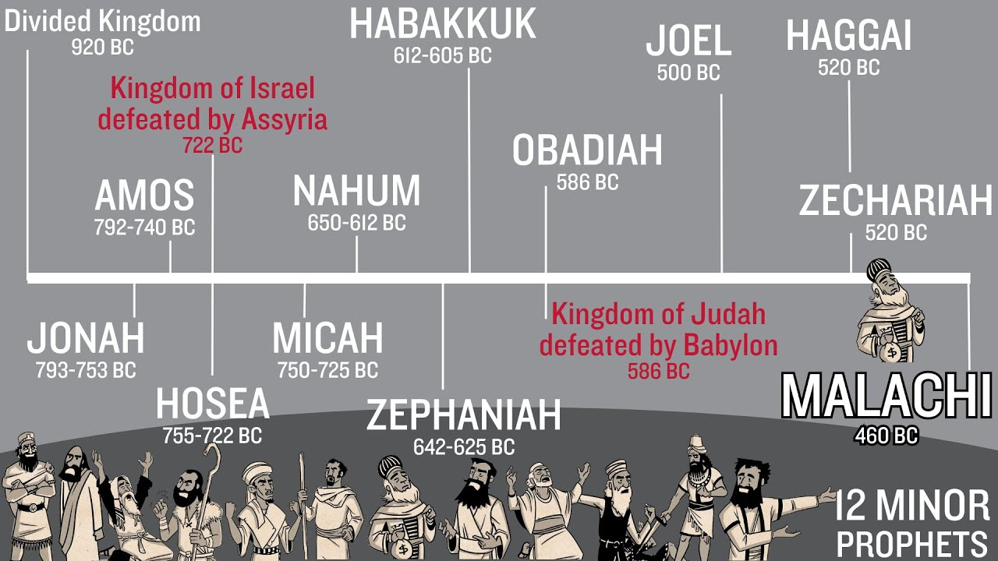

Slide 3
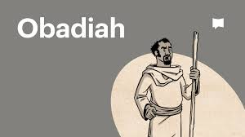
Obadiah’s name means “servant of the Lord”
Started ministry around 605 bc in Judah when Nebuchadnezzar became King of Babylon
Saw the destruction of Jerusalem and exile of the Nation of Judah in 586 bc
He ministered the same time as Jeremiah
His book is only 1 chapter with 21 verses

Slide 4
Declaration against Edom: v2 “I will make you small among the nations, you will be utterly despised” v4 “Though you soar like eagles…I will bring you down!” v6 “…Esau will be ransacked, his hidden treasures stollen” v7 “Your friends will deceive you and overpower you…” v9 ”Your warriors, Teman (1st grandson of Esau) will be terrified v10 “Because of the violence against your brother Jacob, you will be covered with shame and destroyed forever!”

Slide 5
Who is Edom? Why are they being punished?
Gen 25
*Isaac & Rebekah become pregnant with twins
*They seriously fight in the womb and Rebekah asks the Lord “why?”
The Lord said,
“Two nations are in your womb, and the two peoples from within you will be separated; one people will grow stronger than the other, and the older will serve the younger.” (v23)

Slide 6
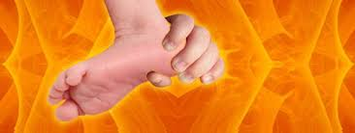
Esau was born 1st he had bright red hair all over his body – Esau/Edom means “red”
Jacob was 2nd he was clinging to Esau’s heel so he was named Jacob meaning “deceiver”
Esau became a strong hunter – Isaac’s favorite son
Jacob became a ‘homeboy’ – Rebekah’s favorite son v29-34 Esau despised his birthright and sold it to Jacob for a bowl of soup…

Slide 7
Gen 27
Rebekah helps Jacob deceive Isaac and Isaac prayers the blessings of Abraham’s Covenant with God…
The birthright:
“I (God) will make you into a great nation and I will bless you; I will make your name great, and you will be great, and you will be a blessing. I will bless those who bless you, and whoever curses you I will curse; and all peoples on earth will be blessed through you.”

Slide 8
Jacob lives with his uncle and marries Leah and Rachel
God leads Jacob to return home. He now has 11 sons and 1 daughter.
Gen 32: 1 – 21 Jacob’s name changed to Israel (one who wrestled with God and with people and have overcome)
Gen 33: Esau and Jacob reunite. They separated where they lived. Esau has 3 sons and 11 grandsons. The 11 grandsons become Kings of their own territory – this becomes the country of Edom.

Slide 9
Esau/Edom Throughout the Old Testament:
Exodus 15:15 = Edom will be terrified of Israel (Moses’ time)
Numbers 20: 14-21= Moses asked the rulers of Edom for permission to pass through their land – they denied them 3x
Deuteronomy 2: 1-6 = The Lord led them to pass through Esau’s land because God gave Edom the Mountain of Seir
Deut. 23: 7 = Do not despise an Edomite, they are family

Slide 10
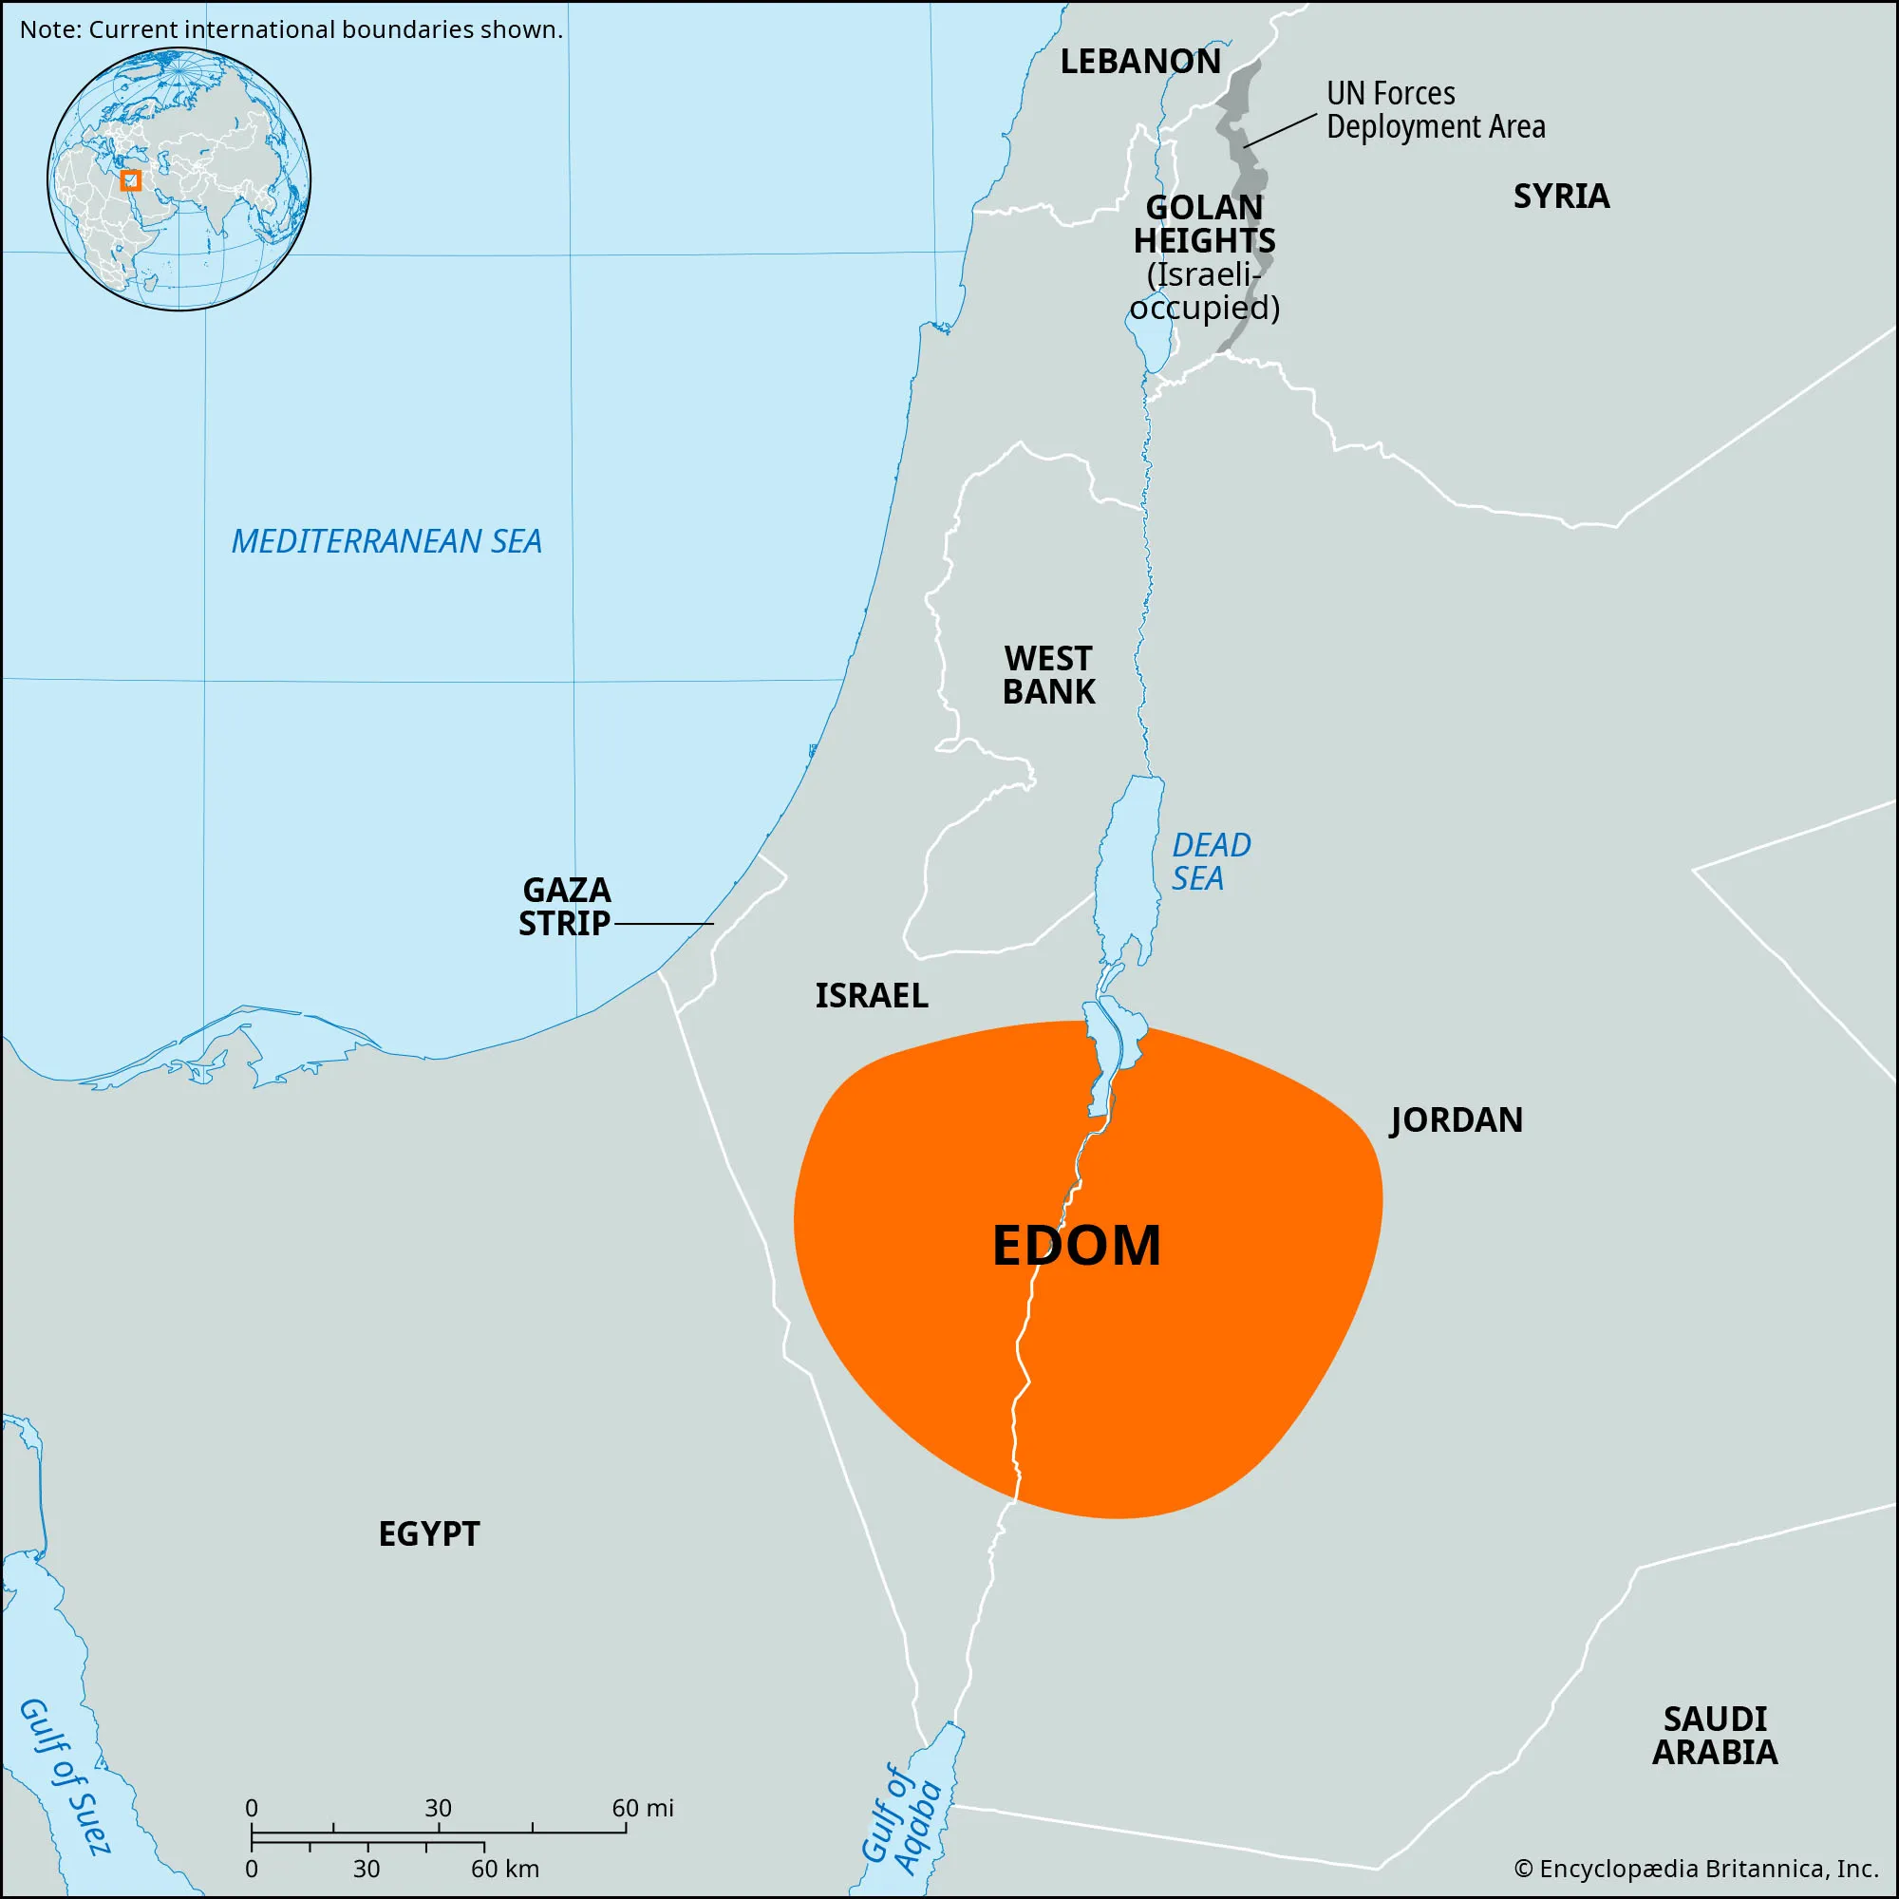
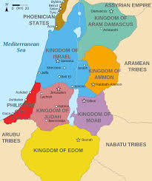
Country of Edom in relationship to Israel’s location

Slide 11
Davidic Line
I Samuel 22: Saul chasing David – trying to kill David. Doeg (an Edomite) tells Saul that David went to the temple in Nob (city) to worship. Saul went to Nob and ordered his troop to slaughter all the priests – they refused, so Doeg killed more than 85 priests and their wives and children to please Saul.
II Samuel 8: 13 & 14 – David kills over 18,000 Edomites and the survivors became servants/slaves in David’s kingdom

Slide 12
II Kings 8: 20-22 During Jehoram’s rule of Judah (848-841bc) the Edomites rebelled and set-up their own kingdom again
II Kings 14: 7 Amaziah (a positive King) defeated 10,000 Edomites and regained rule over the Edomites. Amaziah reigned from 796-767 bc
Now back to Obadiah in 586bc – approximately 200 years later!

Slide 13
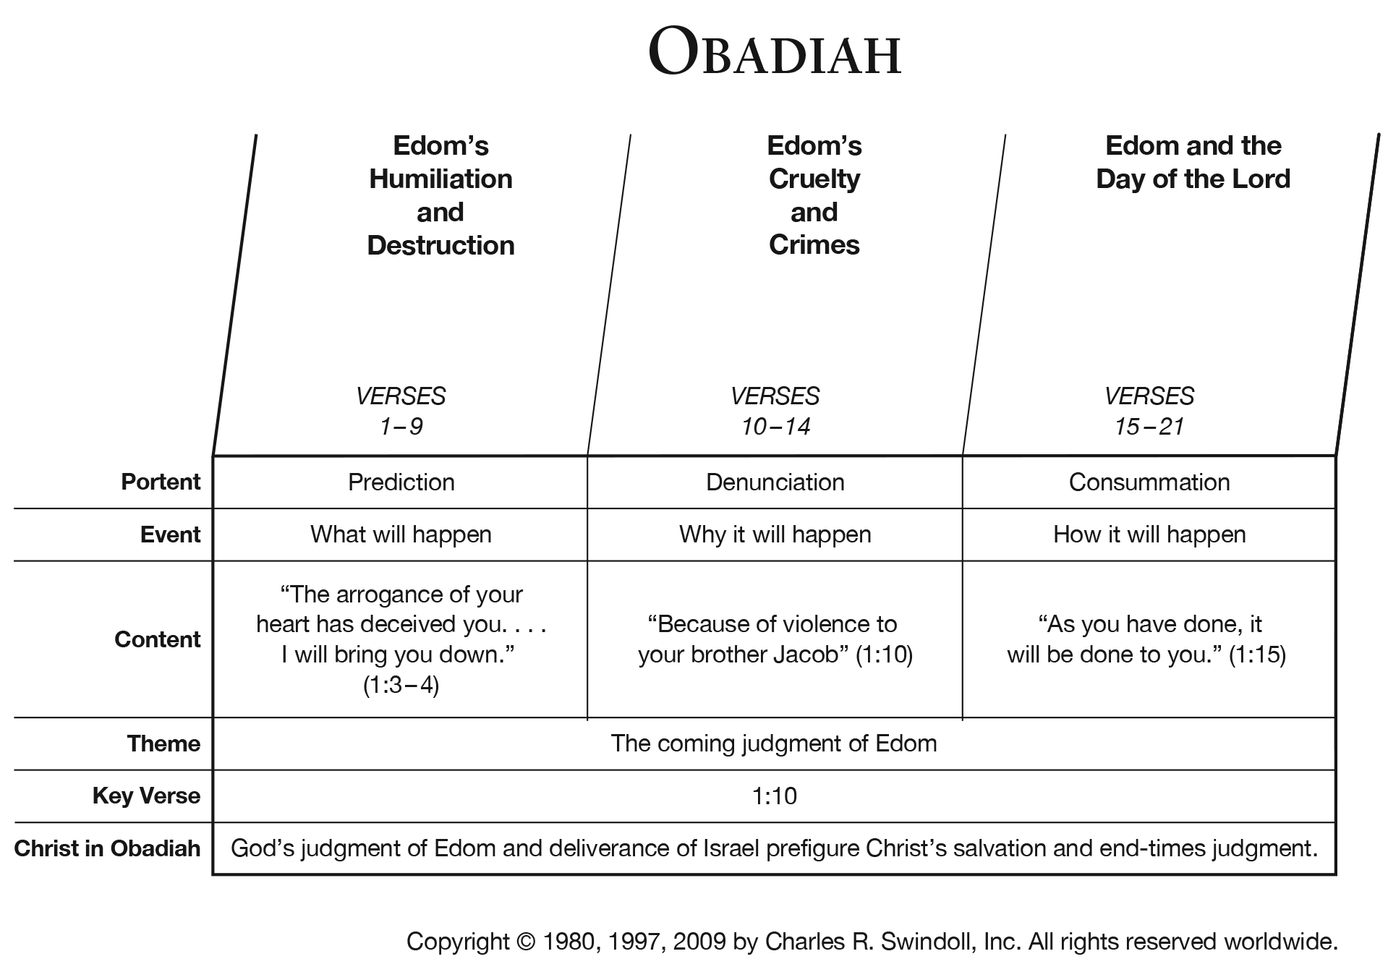
(Jer 49: 14-16 = v1-4 &
Jer 49: 9-10 = v5-6)
V. 17

Slide 14
Mercy shown!
Because Esau/Edom is Abraham’s grandson, he will be punished for his arrogance, rebellion, and sin, BUT will not be “erased” from existence!
Deliverance will come from Judah’s family line: v17 “But on Mt Zion will be deliverance; it will be holy, and the house of Judah.” v21 “Deliverers will go up on Mt Zion and to govern the mountains of Esau. And the Kingdom will be the Lord’s!”

Slide 15

What do we see?
God’s mercy is great!
Is there anything, any sin, any disobedience you have done that God will not forgive?
That His mercy will not forgive?

