Slide 1

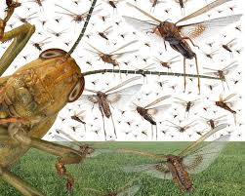
Joel
Chapters 1 - 3

Slide 2
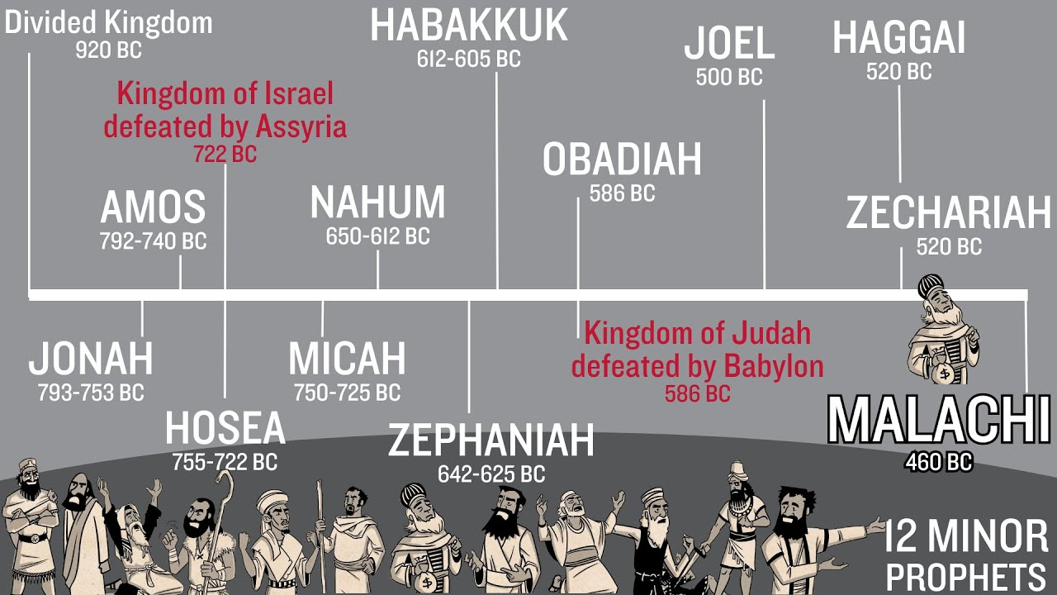

Slide 3
The Book of Joel
Joel’s name means: “Yahweh is the Lord” or “The Lord is God”
Not much is known about Joel. We know: his father is Pethuel, raised in Judah/Jerusalem, could have been from the Tribe/Family of Levi, and he does not mention who is King when he writes.
When written? Maybe during Ezra/Nehemiah’s time 500 bc as the timeline shows or 835 bc (most theologians believe) during II Kings 11: 1- 12: 21 when Queen Athaliah murdered many of David’s family line. However, Jehosheba (Joash’s aunt) hid Joash in the Temple (the rightful King from David’s lineage). Jehoiada (the High Priest) mentored Joash - King at 7 yrs old!

Slide 4

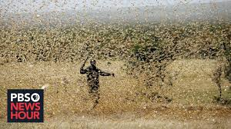


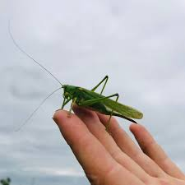

Judah was destroyed by a locust plague that Joel used to picture God’s judgement – The Day of the Lord
Chapters 1: 1 – 2: 27
This judgement by God was first to His household – to Judah who had fallen away from God.
Times past – Joel’s lifetime, ongoing – periodic throughout history, and now… He is cleaning His house…

Slide 5

God gives us how to be saved in 2: 12 – 13
“…Return to Me with all your heart, with fasting, weeping, and mourning, Rend (rip) your heart and not your garments.”
“Return to the Lord your God, for He is gracious and compassionate, slow to anger and abounding in love…”

Slide 6
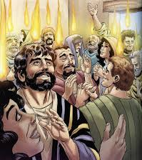
When we repent and return to obedience, He promises:
“I will pour out My Spirit on all people, your sons and daughters will prophesy, your old men will dream dreams, your young men will see visions. Even on My servants, both men and women, I will pour out My Spirit in those days…And everyone who calls upon the Name of the Lord will be saved…” Joel 2: 28-32
Acts 2 -4

Slide 7
‘The Day of the Lord’ declared 19xs in the OT by 8 different prophets (Isaiah, Ezekiel, Amos, Obadiah, Zephaniah, Zechariah, Malachi, and Joel)
Joel 3: 14 – 16b, “Multitudes, multitudes in the valley of decision/ valley of judgement…but the Lord will be a refuge (hiding place) for His people, a stronghold for the people of Israel.”
Peter said…

Slide 8
II Peter 3: 8-10,
“But do not forget this one thing, dear friends, with the Lord a day is like a thousand years, and a thousand years are like a day. The Lord is not slow in keeping His promises, as some would understand slowness. Instead He is patient with you, not wanting anyone to perish, but everyone to come to repentance. But the Day of the Lord will come like a thief. The heavens will disappear with a roar; the elements will be destroyed by fire, and the earth and everything done in it will be laid bare.”

Slide 9
Joel continues, 3:17
“Then you will know that I, the Lord your God, dwell in Zion, My holy hill, Jerusalem will be holy…Judah will be inhabited forever and Jerusalem through all generations….
The Lord dwells in Zion!”

Slide 10

What does Joel tell us?
*The Lord will judge His house (the Church) – the Valley of Decision
* He is a hiding place for those who love Him and live obediently
*He has poured out His Holy Spirit to live within us – Acts 2
*The Day of the Lord is coming! He will live in the New Jerusalem
8

