Slide 1
Haggai
Celebrate My Festivals Again!

Slide 2
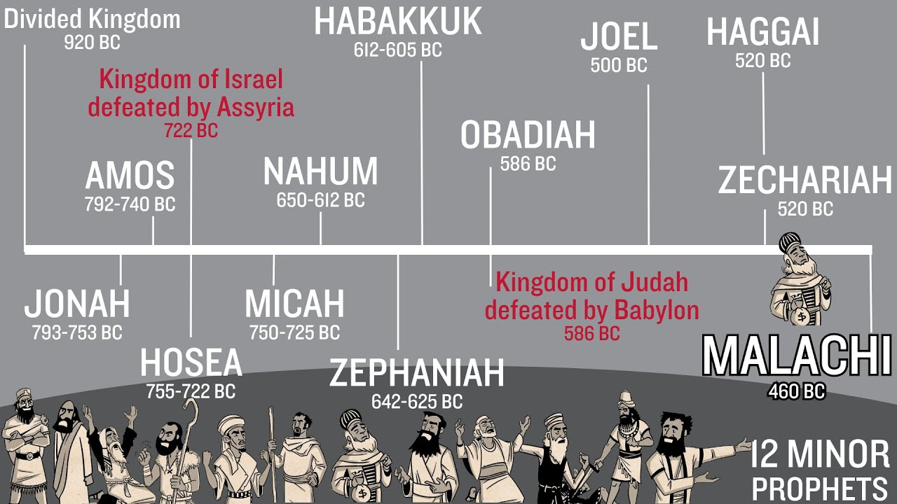

Slide 3
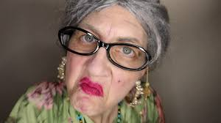
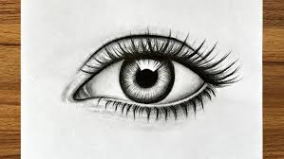
Speech training:
Hag
Eye
+
Haggai “My Festivals”

Slide 4
Background History:
586 bc Babylon destroys Jerusalem and Solomon’s Temple
539 bc Babylon falls to Persia – King Cyrus
538 bc Zerubbabel (David’s line) – Governor & Joshua – High Priest appointed by King Cyrus
535 bc Temple’s new foundation laid, feasts started again
530 bc Xerxes I (Esther’s story) stops the rebuilding – stopped for 18 years
520 bc Darius (new Persian King)
522 bc Zerubbabel & Joshua ask Darius to review Cyrus’ decrees, he blesses Israel with money and protection and encourages the rebuilding of the Temple

Slide 5
Chapter 1
God rebuked Israel’s remnant for stopping the rebuilding – they stopped to rebuild their own homes instead of the Temple
V12 - 14 Zerubbabel and Joshua gain the courage to write to Darius. They obeyed the word of the Lord in Haggai’s prophecy and the people feared the Lord. The Lord spoke again: “I am with you” … so the Lord stirred up the spirit of Zerubbabel, Joshua, and the whole remnant…”
They came and began to work on the House of the Lord!

Slide 6
520 bc The work restarted
516 bc The work was completed and dedicated to the Lord during Passover and the Unleavened Bread
Chapter 2
V1-3 “With all that you have gone through” (Egypt, divided Kingdom, constantly fighting to survive, northern Kingdom enslaved by Assyria, all 12 tribes/nations captive by Babylon, and now Persia has enslaved you)
V4 “My Spirit remains among you. Do not fear!”

Slide 7
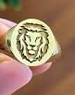
V7 “There will be a time when I will shake the nations and the Desired of Nations will come – and I will fill this house with glory – the glory of this house will be greater than all the former houses (Temples) and I will grant peace…” declares the Lord.
V23 “I will take you, my servant, Zerubbabel and I will make you My signet ring, for I have chosen you, declares the Lord.”

Slide 8


What do we see?...
5xs God said, “Give careful thought…”
When we turn to Him, He stirs our spirits with courage to act
He has been, is, and will be with you, do not be afraid
The Desired of Nations will come and bring peace
Zerubbabel (one from David’ line) will be My Signet Ring (Jesus)

