Slide 1


MODERN DAY PROPHETS
PENTECOSTALS

Slide 2

PENTECOSTALS
2ND LARGEST EVANGELICALS WORLD
EMPHASIS TODAY
HOLY SPIRIT IN OUR LIFES

Slide 3


UNITY and MATURITY in the BODY of CHRIST
INSTRUCTIONS for CHRISTIAN LIVING
EPHESIANS 4 1- 16
AND
EPHESIANS 17-32

Slide 4
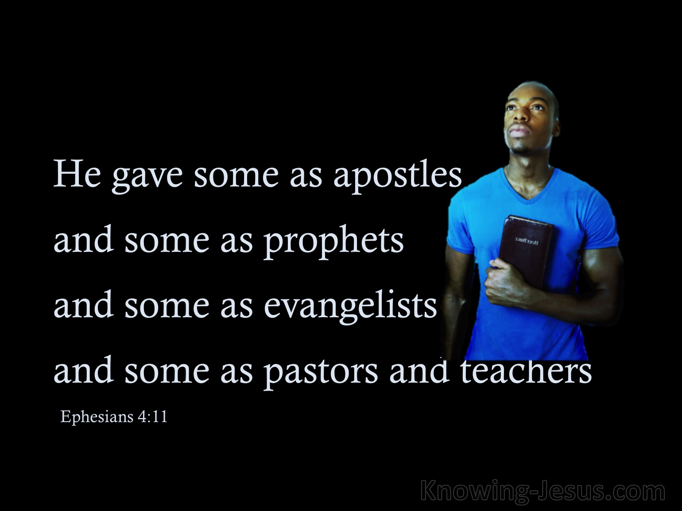

Slide 5

Ephesians 4:12 for ALL

Slide 6
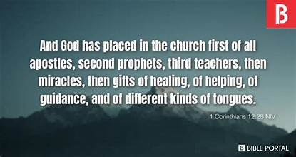
1CORINTHIANS
SPIRIT GIFTS: UNITY AND DIVERSITY

Slide 7

PENTECOSTALS
SHARE IN THE POWER

Slide 8

BE ACTIVE IN SPIRIT FUNCTION

Slide 9

PERSONAL NOTE
CHURCH CULTURE

Slide 10
COMPARE CHURCH CULTURES
MESSAGE CULTURE
WORSHIP CULTURE
PRAYER CULTURE
DISCIPLING CULTURE

Slide 11

DISCIPLING IS RELATIONSHIP

Slide 12
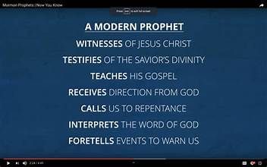
2024 PROPHET

Slide 13
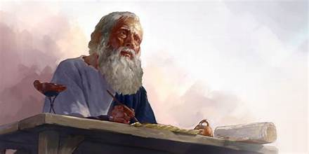
BOOK OF REVELATION
PROPHECY OF FUTURE

Slide 14
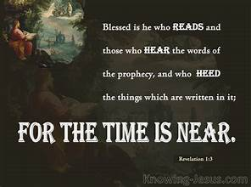
REVELATION 1:3

Slide 15
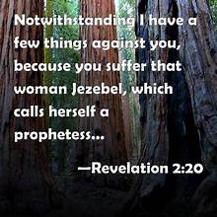
Careful of FALSE PROPHETS revelation 2:20

Slide 16

We must have DISCERNMENT
Psalm 119:125

Slide 17
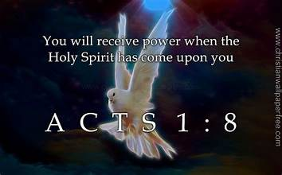
Modern day PROPHET man or woman

Slide 18
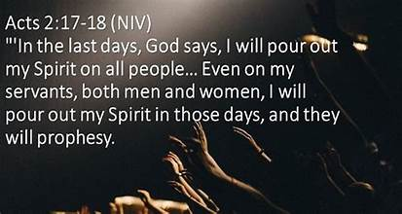

Slide 19
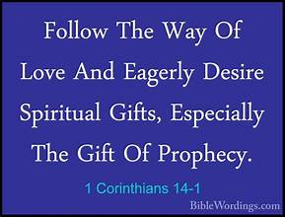
ALL US SHOULD DESIRE the gift

Slide 20

Ephesians 4:3 UNITY in the SPIRIT

Slide 21
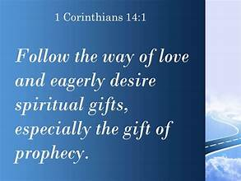
Be OPEN and sensitive to the HOLY SPIRIT

Slide 22
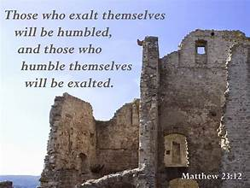
Matthew 23:12 do not seek titles

Slide 23
ENCOURAGE YOU to seek His GIFT for you
NORMAL TWO issues that stop us

Slide 24
1. Need to control the SPIRIT and not let him move freely.
2. Hardened Heart

