Slide 1

COACHING vs
PREACHING
Bethany Deaf Assembly
TEAM

Slide 2
PARA CHURCH CHRISTIAN ATHLETE HOCKEY CAMP

Slide 3
1981-1995
PARACHURCH MINISTRY
Ministries to Help the local church with certain populations
HOCKEY MINISTRIES INYERNATIONAL (Montreal)
Director: Maryland Christian Hockey Camp
FELLOWSHIP OF CHRISTIAN ATHLETES (Kansas City)
( State) Director: Maryland and Washington D.C.

Slide 4
1991 LICENSED 1999 ORDAINED (Minnesota district)
INVITED to PREACH may places:
Washington state Men’s retreat
DEAF MISSIONS in Iowa
Men’s retreats in Minnesota, Pennsylvania, Wisconsin.
LICENSED /ORDAINED I AM EXPECTED TO PREACH
NOTE: I was never invited back

Slide 5
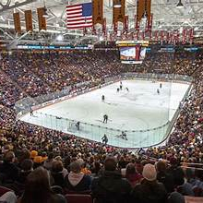
1991-1996 Coached North Central University ICE Hockey
University of Minnesota
Mariucci Arena
Our HOME ice rink
NOTE: not as many fans!

Slide 6
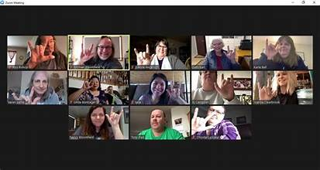
COACH BETHANY DEAF ASSEMBLY END TIME TEAM

Slide 7

AGREE: are we in the END TIMES

Slide 8
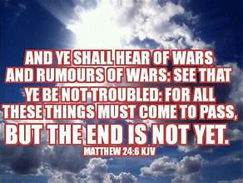
MATTHEW 24:6-7 WAR and CONFLICTS

Slide 9

#2 #3 Matthew 24:7-8 Natural disasters and Famine

Slide 10
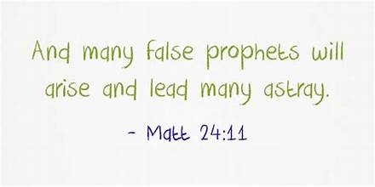
MATHEW 24:11 FALSE TEACHERS
JEHOVAH WITNESS AND LATTER DAY SAINTS

Slide 11
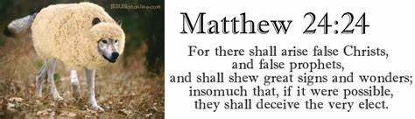
#5 FALSE TEACHERS
MATTHEW 24:24 JIM JONES /SUN YOUNG MOON

Slide 12

#6 PERSECUTION OF CHRISTIANS ( Adoption)

Slide 13

2021 Assemblies of God COACHING CERTIFICATE

Slide 14

COACH BDA TEAM: intimate relationship with HIM
Be obedient to HIS will be done in your life.

Slide 15
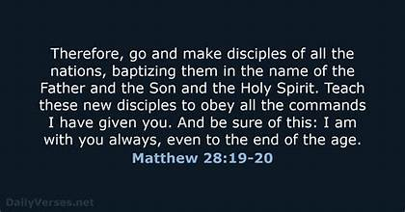
HIS WILL FOR BETHANY DEAF ASSEMBLY
MA

Slide 16
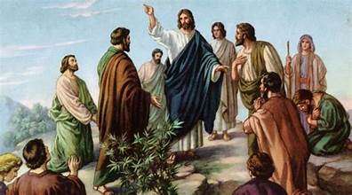
Last words Jesus said to his disciples

Slide 17
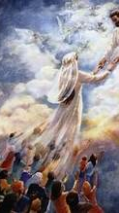
COACH YOU to be TRUE BRIDE of CHRIST

Slide 18

REMEMBER example of MARRIAGE IN JESUS TIME

Slide 19

MARRIAGE
1. THEBRIDEGROOM buys the Bride
2. He returns home to prepare a place for her
3. She waits for when He is ready and blows the trumpet.
4. She goes to Him in her new home,
Marriage SUPPER
MA

Slide 20
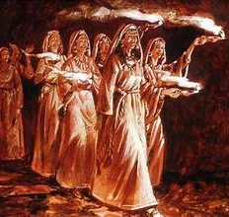
BEWARE: PARABLE OF THE 10 VIRGINS bridesmaids waiting to escort the Bride

Slide 21
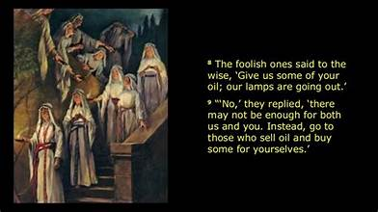
Have your light /life always filled with Holy Spirit

Slide 22
DO YOU WANT TO BE ON END TIMES BDA TEAM
1. Fully Ready for RAPTURE
2. Baptizing others
3. Coaching others t be coaches.

Slide 23

WEDNESDAY NIGHT starting SEPTEMBER

Slide 24

Starting SEPTEMBER
OUTREACH DEAF COMMUNITY CALENDAR

Slide 25

NEW END TIME BETHANY DEAF ASSEMBLY

Slide 26
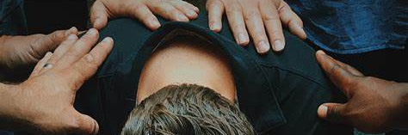
SPIRIT TOUCHING PEOPLE

