Slide 1
Zechariah
God Remembers

Slide 2
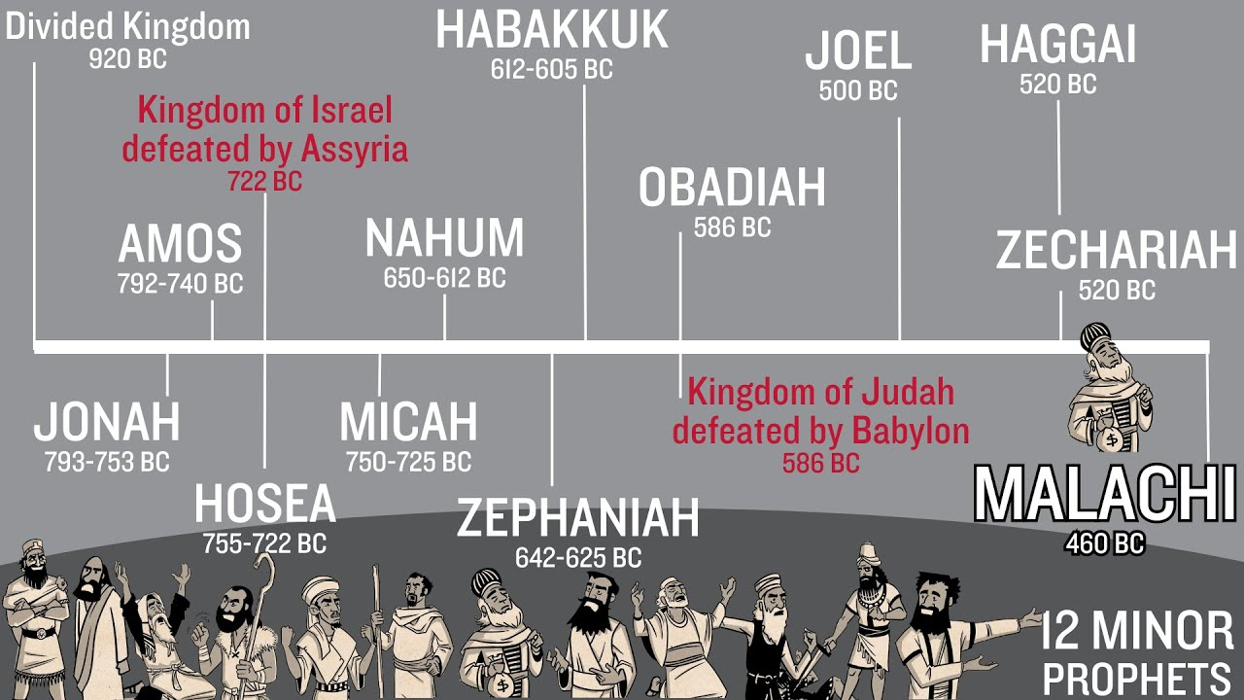

Slide 3
Background History:
586 bc Babylon destroys Jerusalem and Solomon’s Temple
539 bc Babylon falls to Persia – King Cyrus
538 bc Zerubbabel (David’s line) – Governor & Joshua – High Priest appointed by King Cyrus (Ezra – the Temple and Nehemiah – Jerusalem wall)
535 bc Temple’s new foundation laid, feasts started again
530 bc Xerxes I (Esther’s story) stops the rebuilding – stopped for 18 years
520 bc Darius (new Persian King)
522 bc Zerubbabel & Joshua ask Darius to review Cyrus’ decrees, he blesses Israel with money and protection and encourages the rebuilding of the Temple

Slide 4
Apocalyptic Literature
Apo (“from”) and Kalupto (“to cover”).
Describes an other worldly journey in which the author is taken to another place
Portrays both the author’s day and the world at the end of time
Highly symbolic
Struggle between good and evil
God intervenes in history and triumphs

Slide 5
Eight
Visions
1:1
Four Horsemen
1:18
Horns & Craftsmen: Judgment
2:1
Measuring Line: Flee Babylon
3:1
Joshua the High Priest
4:1
Zerubbabel & the Lampstand
5:1
Flying Scroll: Judgment
5:5
Woman and Basket: Shinar
6:1
Four Chariots
7:1
Two
Sermons
A Call for True Justice
8:1
A Promise of Future Restoration
9:1
Two Burdens
Judgment on Enemies of Israel
12:1
The Coming of the Lord

Slide 6
Zechariah
Revelation
Four horsemen/ chariots (1&6)
Four horsemen (6)
Man with a measuring line measures Jerusalem (2:1-2)
Man with a rod measures the temple mount (11:1-2)
Satan ready to accuse Joshua the high priest (3:1)
Satan daily accusing the brethren (12:10)

Slide 7


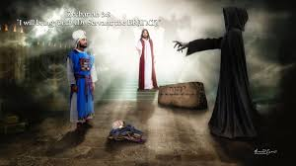
Satan accuses Joshua (the High Priest) of having dirty robes and a dirty turban
Joshua is silent
The Lord stops Satan, commands Joshua’s robes be changed and turban new
“…this man is a burning branch pulled out of the fire…”

Slide 8
Zechariah 3:8
V8 Now listen, Joshua the high priest, you and your friends who are sitting in front of you-- indeed they are men who are a symbol, for behold, I am going to bring in My servant the Branch.
Isaiah 4:2
In that day the Branch of the LORD will be beautiful and glorious, and the fruit of the earth will be the pride and the adornment of the survivors of Israel.

Slide 9
“Behold, the days are coming,” declares the LORD,
“When I will raise up for David a righteous Branch;
And He will reign as king and act wisely And do justice and righteousness in the land.
6 In His days Judah will be saved, And Israel will dwell securely; And this is His name by which He will be called,
‘The LORD our righteousness.’” (Jeremiah 23:5-6).

Slide 10
Fulfilled in Jesus
His name is Branch
He will “branch out” (6:12)
He will build the Temple (6:13)
He will rule (6:13)
He will be both priest and king (6:13).
Those who are far off will come and build the Temple (6:15)

Slide 11
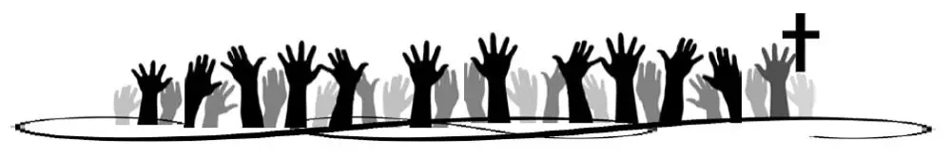
Zechariah 8:9 & 13
Thus says the LORD of hosts, “Let your hands be strong, you who are listening in these days to these words from the mouth of the prophets…”
V13 “…I will save you that you may become a blessing. Do not fear; let your hands be strong.”

Slide 12
Zechariah 9:9 Triumphal Entry Prophesied
Rejoice greatly, O daughter of Zion!
Shout in triumph, O daughter of Jerusalem!
Behold, your king is coming to you;
He is just and endowed with salvation,
Humble, and mounted on a donkey,
Even on a colt, the foal of a donkey.

Slide 13
Zechariah 11:12-13
Jesus sold for 30 pieces of silver prophesied
I said to them, “If it is good in your sight, give me my wages; but if not, never mind!” So they weighed out thirty shekels of silver as my wages. 13 Then the LORD said to me, “Throw it to the potter, that magnificent price at which I was valued by them.” So I took the thirty shekels of silver and threw them to the potter in the house of the LORD.

Slide 14
Zechariah 12:10
Jesus pierced prophesied:
“I will pour out on the house of David and on the inhabitants of Jerusalem, the Spirit of grace and of supplication, so that they will look on Me whom they have pierced; and they will mourn for Him, as one mourns for an only son, and they will weep bitterly over Him like the bitter weeping over a firstborn.”

Slide 15
The Messiah’s 2nd coming prophesied:
In that day His feet will stand on the Mount of Olives, which is in front of Jerusalem on the east; and the Mount of Olives will be split in its middle from east to west by a very large valley, so that half of the mountain will move toward the north and the other half toward the south.

Slide 16
Zechariah 14:8 & 9
And in that day living waters will flow out of Jerusalem, half of them toward the eastern sea and the other half toward the western sea; it will be in summer as well as in winter.
And the LORD will be king over all the earth; in that day the LORD will be the only one, and His name the only one.

Slide 17

What do we see?
Zechariah – God remembers: He will never leave or forsake you!
You are the branch that was pulled out of the fire!
From the beginning of time, God planned for the Logos – the Word of God to bleed, die, resurrected, and return to reign over all the earth through eternity
He remembers and keeps His promises!

