Slide 1
Malachi:
The Messenger

Slide 2
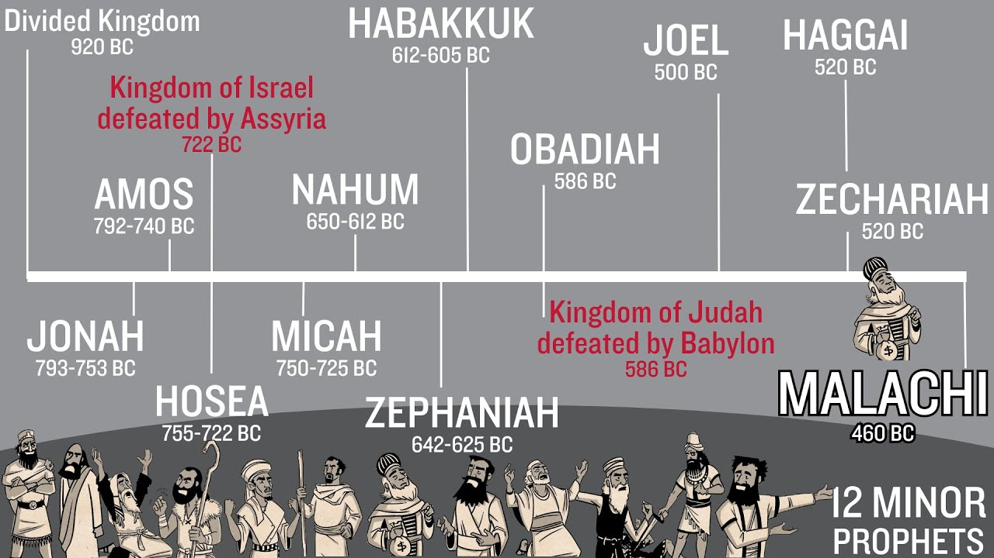

Slide 3
      Historical Look:
      Terms to know:
      Pre-Exile = The time before Babylonian Captivity 586bc
      Exile/Captivity = 70 years from 586 bc – 516 bc
      Post-Exile = After 538 bc when Cyrus let the Israelites return to Jerusalem to rebuild the Temple
      Malachi written sometime between 515 bc – 445 bc. The chart shows it was written around 460 bc. Written approximately 100 years after the new Temple was built.
      Malachi means Messenger. An individual? Or general?

Slide 4
Nothing new! Attitude same as before captivity!
6 Discussions between God and Israel’s leaders and people:
#1. (1:1-5) God said, “I have loved you!” but the people said, “How?”… God reminded them – they chose disobedience
#2. (1:6-14) God said, “You have despised Me and defile the Temple!” but the people asked, “How?” God said, “you offered me unclean sacrifices!”
(Priests’ calling defined: (V7) “For the lips/hands of the Priests ought to preserve knowledge, because he is the messenger of the Lord Almighty and people seek instruction from him…”)

Slide 5
#3. (2:1-16) God said, “You turned against Me and your wives!” They responded, “How?”. God replied, “You married foreign women after divorcing the wives of your youth and you worshipped the gods/idols your foreign wives brought with them!”
There was an attitude of careless divorce – no reason – lust for the foreign women and lust for their gods… always looking/seeking “something better”…God not enough … their first wife – not enough… no thrill in responsibility! These divorces were a betrayal of the covenants they made with God – they chose “self” and not commitment!

Slide 6
#4. (2:17-3:5) People said, “You (God) have neglected us! Where is Your justice!” God responds, “I will send a Messenger and He will come like a purifying fire…only the faithful remnant will live!” (faithful obedient believers)
#5. (3:6-12) God calls, “Turn back to Me”. People asks, “How?”. God reveals their selfishness and says they are robbing/stealing from Him – not tithing and no offerings
  Tithe: 1/10th of your income – net or gross is not the point!!! Are you giving 1/10th of His blessings back to Him? (Lev. 27:30) (I Cor, Paul talks about ‘not muzzling the ox’
  Offerings – giving above your tithe… “Just because”

Slide 7
#6. (3:13-18) People accuse God, “It is worthless to serve You! The wicked get rich and the righteous are oppressed! You, God, do nothing!” God tells them how to remain faithful – gather together and remind each other of how He answered prayer and tell stories of how He has blessed them…reflect on the past blessings to give hope for tomorrow’s blessings. *He is the same yesterday, today, and forever!

Slide 8
Conclusion: Chapter 4
God reminds them of the Messenger’s coming – the hope for the remnant – the faithful obedient believers.
“Remember My Laws” – Torah and remember the words of the prophets (Elijah = model of prophets)
The Messenger will unite the words of the Torah and prophets. He will redeem Israel, restore His people and heal their hearts.

Slide 9




What do we see…
#1. Without Jesus – people do not change…
#2. We need to learn His Word to discipline our heart’s wandering…
#3. Tithing is an act of obedience and worship – not a demand for salvation – but an act of obedience and worship
#4. He is a redeeming God Who loves us!
z

