Slide 1
The Minor Prophets
A Summary of the 12

Slide 2

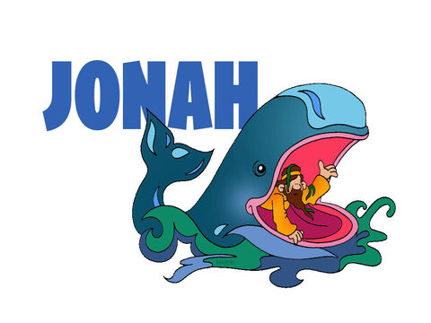
Name = Dove
4:1 “I knew that You are a gracious and compassionate God, slow to anger and abounding in love!”

Slide 3
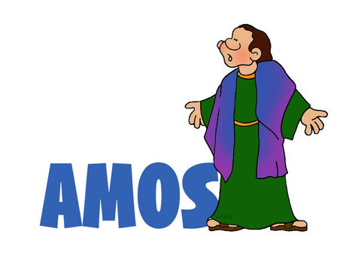
Name = Carried by God
9:14 “I will bring My people Israel back from exile.”

Slide 4
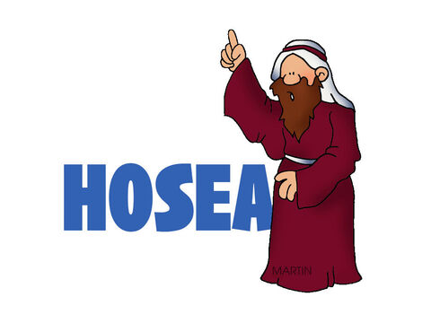
Name = Savior
2:19 & 20 “I will betroth/marry you to Me forever; I will betroth you in righteousness and justice, in love and compassion, I will betroth you in faithfulness and you will acknowledge the Lord.”

Slide 5
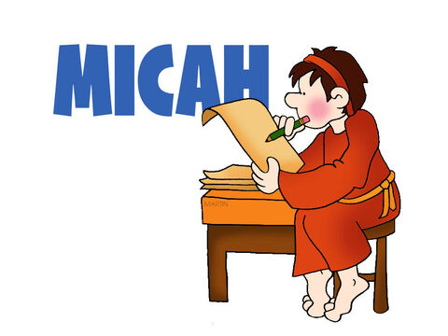
Name = Who is like You?!
5: 2 “But you, Bethlehem… will come for Me One Who will be ruler … Whose origins ‘are from of old, from ancient times’”

Slide 6
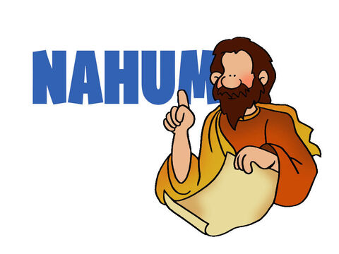
Name = The Lord Comforts
1: 7 “The Lord is good, a refuge in times of trouble. He cares for those who trust Him.”

Slide 7
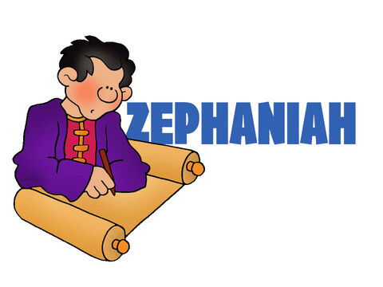
Name = He lays wait…
1: 8 & 2: 3 “…for He will make a sudden end of all who live on the earth.” and “Seek the Lord…seek righteousness, seek humility, perhaps you will be sheltered on the day of the Lord’s anger.”

Slide 8

Name = Embraced by God
3: 19 “The Sovereign Lord is my strength; He makes my feet like the feet of a deer (mountain goat), He enables me to tread on the heights.”

Slide 9
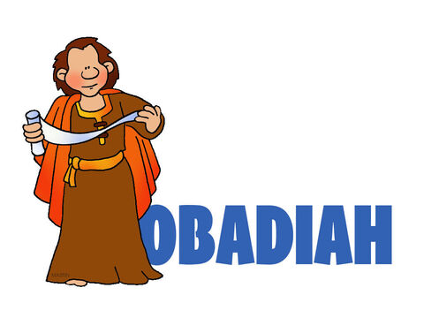
Name = Serve the Lord
1: 15 “The day of the Lord is near for all nations. As you have done, it will be done to you; your deeds will return upon your own head.”

Slide 10
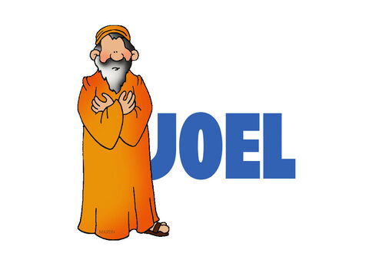
Name = Yahweh is the Lord
2: 28 & 29 “I will pour out My Spirit on all people. Your sons and daughters will prophesy, your old men will dream dreams, your young men will see visions, even on My servants, both men and women, I will pour out My Spirit…”

Slide 11
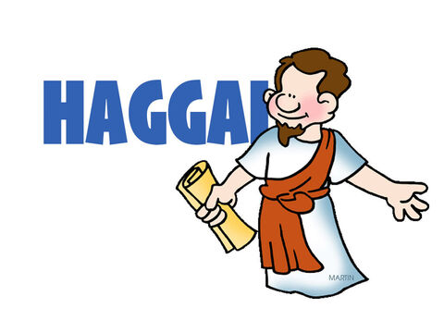
Name = Celebrate My Feasts/Worship Me
2: 23 “I will make you like My signet ring, for I have chosen you – declares the Lord Almighty!”

Slide 12
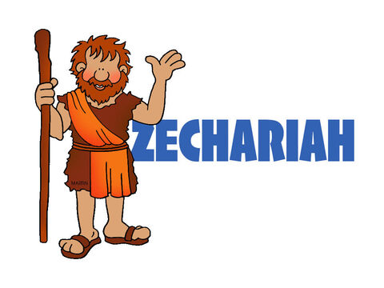
Name = God remembers
9: 9 “Rejoice greatly… Shout!...see your King comes to you, righteous and having salvation, lowly and riding on a donkey, on a colt, the foal of a donkey.”

Slide 13

Name = My Messenger
3: 1 “I will send My Messenger, Who will prepare the way for Me. Then suddenly the Lord you are seeking will come to His Temple.”

Slide 14

Major Themes:
I will always love you!
Repent and I will forgive you
A Savior is coming … Jesus Christ, born of a virgin in Bethlehem, fulfilled the prophesy of the Triumphant entry, died, rose again, is coming – suddenly to judge sin and to reign for eternity!
He continues to call us to repentance and to Himself

