Slide 1

Rooted & Established!
Ephesians 3

Slide 2
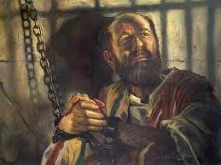
Paul – a prisoner
V1 “For this reason I, Paul, the prisoner of Christ Jesus for the sake of you Gentiles.”
v2 “…you have heard God gave me the privilege of stewarding/administrating His grace to the non-Jewish community…”
V3-6 He showed me (Paul) the mystery of God’s plan…revealed now because Jesus Christ came, died, rose again and offers salvation for all people!

Slide 3

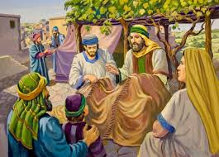
Because of his grace for me (Paul), I am a servant…
V7 A servant because of the grace of God working His power in me…
V8 Pharisee of Pharisees; taught by the best teacher (Gamaliel); served on the Sanhedrin - least of these!

Slide 4
The message:
V9 Through the Church – this mystery is to be stewarded
Stewarded/steward = take care of this precious gift; defend and protect; shared lovingly with everyone – this is God’s intent (planned purpose)!
It is God’s intent that this mystery be shared by the hands and hearts of each member of His Body/Church
Romans 10 = How will others believe if no one tells them?

Slide 5
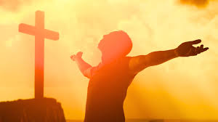
Message continued:
V11 – 13 According to His eternal purpose that He accomplished in Jesus Christ our Lord
In Jesus and through faith in Jesus … we may approach God with freedom and confidence!
Don’t be discouraged that I suffer – accomplishing His purpose is far greater than my suffering!

Slide 6
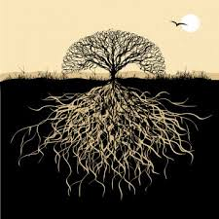
Paul’s prayer:
V14 – 19 For this reason I kneel before the Father
  I pray He may strengthen you with power through His Spirit in your inner being – so that Christ may dwell in your hearts through faith
  I pray you are rooted and established in love
  That you may have power to grasp how wide and long and high and deep is the love of Christ
  That you may be filled to the measure of the fullness of God

Slide 7
A doxology (v 20-21)
Doxology: a formal of praise God
“Now to Him Who is able to do immeasurably more than all we ask or imagine – according to His power that is at work within us,
To Him be glory in the Church and in Christ Jesus throughout all generations forever and ever! Amen!”

Slide 8

Freedom
Confidence
Rooted
Established
How is your personal relationship with Jesus?

