Slide 1
STOP!
Ephesians 4: 17 - 32

Slide 2

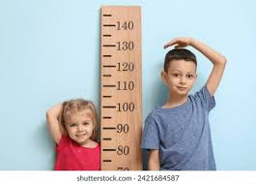
Last week: Paul taught – Jesus gives everyone - who accepts Him into their lives – gifts, skills, abilities to help each other grown mature Christians
Measuring stick = Jesus
Your gifts are to help each other to grow more like Jesus
Speak the truth in love (v15)
Jesus

Slide 3
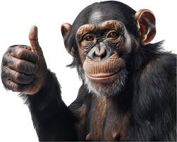
V17 “I insist in the Lord – you must (STOP) no longer live as the non-believers live!
V18 Their understanding is “clouded” – dark because they have hardened their heart – they ignore the prompting (taps) of the Holy Spirit and choose to become ignorant to the Truth
Don’t be a CHINO!
Christian In Name Only!
CINO!

Slide 4

V19 - 21 Following the non-believers cause your heart to become hard. Non-believers hearts are insensitive to the Holy Spirit
They give themselves to indulge in every kind of sensuality; willingly get involved in every kind of impurity and they are full of self-centered greed.
This is not the way of life you have learned when you accepted Jesus and His truth into your life

Slide 5
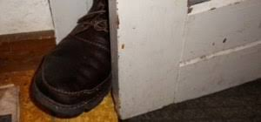
What do?
Ephesians 4: 22 – 32
Put off your old self that was corrupted by deceitful desires
Be made new in your mind’s attitude
Put on the new self…the new self is created to be like God in true righteousness and holiness
Put off falsehood and speak truthfully to each other because you are all members of Christ’s Body
In your anger, do not sin! Don’t let the sun
go down (could be ‘24-hour day’ or the
end of your life) while you are angry
and do not give the devil a foothold
Devil

Slide 6

V28 Stealing? Work! Gen 3 identifies our self dignity/value is earned when we are productive in community and work!
V29 – 31
Speak no ‘unwholesome’ talk = hurtful, dirty, insulting, and put-down talk. Our words should build up each other and benefit those who see what you say
Do not grieve the Holy Spirit = our words and actions can grieve Him
Get rid of all bitterness = rage & anger; brawling and slander; and every kind of malice (hurtful behavior and talk)

Slide 7

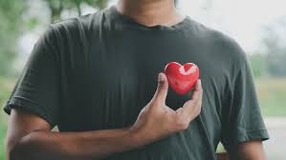
V32 Be kind and compassionate to each other; forgiving each other just as God through Jesus forgives you!

Slide 8


My attitude same Jesus’?
My talk same as Jesus’?
My actions same as Jesus’?

