Slide 1
Philippians
Chapters 1 & 2

Slide 2

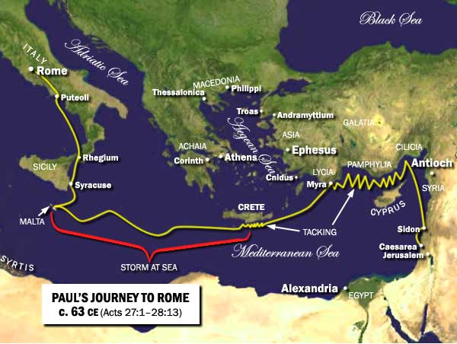
Introduction
Paul was in house arrest approximately 2 years in Rome – written 63 ad
Purpose: report how he is doing, encourage them and challenge their unity and humility, send Timothy and Epaphroditus to them, and warn them against the Judaizers.

Slide 3
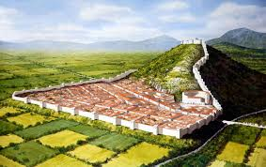
The City of Philippi
The city was named for Alexander the Great’s father – Philip
Everyone born there were automatically given Roman citizenship & many retired Roman soldiers lived there
Very small Jewish community – did not have a synagogue

Slide 4
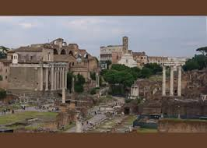
Philippians’ Characteristics:
(the book)
No Old Testament quotes
A Missionary “support letter”
Identifies the vigorous (aggressive) Christian life
Letter of joy – 16 times
Kenosis – Christ emptying Himself of His glory. Strong Christology statement – Jesus is God! (2:5-11)

Slide 5
Chapter 1
V1-8 I really love you guys! I pray for you with love & joy! I know He (Jesus) Who began a good work in you will complete it! [v6]
V9-11 My prayers for you: Your love grows more and more in knowledge and depth of insight – able to discern what is best and pure and blameless
You would be filled with the fruit of righteousness that comes from Jesus and give glory and praise to God the Father

Slide 6

Suffering is granted you…
V12-26 I am in prison for preaching Jesus (3rd time)
There are those who preach the gospel to compete with me
WHAT DOES IT MATTER? (Who cares!) People are getting saved! Christ is being preached!
It doesn’t matter how He delivers me (beheaded)! For me to live is Christ and to die is my gain!
SO, WHAT DOES IT MATTER?

Slide 7
You are citizens of heaven – live like it!
1: 27 - 30
V29 - 30 For it has been granted you on behalf of Christ not only to believe in Him but also to suffer with Him, since you are going through the same struggle you saw I had and now hear that I am still here!

Slide 8
Chapter 2 Same Attitude as Christ - Humility
V1 – 5 If being united with Jesus encourages you;
If His love comforts you;
If you sense His Christian family;
If you sense and experience His tenderness and compassion…
Then make my (Paul) joy complete – by humbling valuing others above yourself by putting others’ interests before yours.
Have the same mind/attitude as Christ…

Slide 9
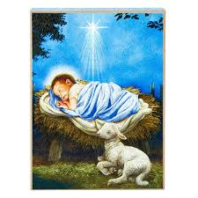
“Kenosis” statement picturing the Incarnation
“Jesus being in very nature of God, did not consider equality with God something to be used to His own advantage; rather He made Himself nothing by taking on the nature of a servant, being made in human likeness, and being found in appearance as a human being, He humbled Himself by becoming obedient to death – even death on a cross.
Therefore, God exalted Him to the highest place and gave Him the Name above every name, that at the name of Jesus every knee should bow in heaven and on earth and under the earth, and every language acknowledge the Jesus Christ is Lord to the glory of God the Father.”

Slide 10
Kenosis = emptying Himself of the Glory of God
Vv 6 - 10
Shechinah = divine presence and essence (made of/who He is).
John 1 says in the beginning was the Word of God and the Word became human – this is Christ Jesus – fully God and fully human
He became one of His own creations! Hebrew says with Christ all things were created
Jesus submitted Himself to death on the cross – He went from humility to humiliation (the cross)
That is why the Father has exalted Jesus and every knee will bow before Him (Rev 20) and every language declare Jesus is Lord!

Slide 11
Work out your salvation!
Continue to grow!
Do everything without grumbling and arguing (v14) … you will be blameless and shine like stars in the darkness!
Hold on to His Word and I will know my work is not in vain
I am poured out like a drink offering on sacrifice and service – because you are growing to be like (same) Jesus
I am glad and rejoice because of you!

Slide 12
Timothy and Epaphroditus
Vv 19 - 30
Closes chapter 2 with comments about Timothy and Epaphroditus
Timothy – his spiritual son = this is very personal to Paul
Epaphroditus – his coworker/colleague = from Philippi, almost died preaching God’s word, ministered at Paul’s side and dearly loved

Slide 13
What do we see…
Paul’s love for Jesus lead to his great love and joy for those whom God place in his (Paul’s) care. This is how you judge your pastors and spiritual leaders… do they love?
We get to suffer with and for Jesus like He did for us…
We are citizens of heaven – act like it! Live worthy of His name
Jesus is God!

