Slide 1
GOMO
Get connected with your feelings
Own the Facts of the Issue
Make your Decision
Opt for Action
Book of Philemon

Slide 2
Compassionate Example of conflict resolution
Philemon = Colossian’s Church Leader, lead to the Lord by Paul on Paul’s 3rd Missionary journey in the town of Ephesus when he stayed in Asia Minor for 2 years
Philemon means “affectionate”, a “kiss”, and “loving”
Written while Paul was imprisoned in Rome around 60-61ad
Several were with Paul like John Mark and Luke
Paul was planning to send the letter of Colossians at this time when a “situation” happened causing this letter to be written

Slide 7


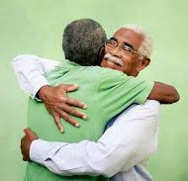
The value of this book is helping us examine our integrity and accountability
Onesimus’ salvation did not deduce his need for accountability – he was forgiven, but had to face the consequences of his choices
GOMO: Get in touch with your feelings; Own the issue – facts; Make a decision; Opt to act!
Onesimus
Philemon

