Slide 2
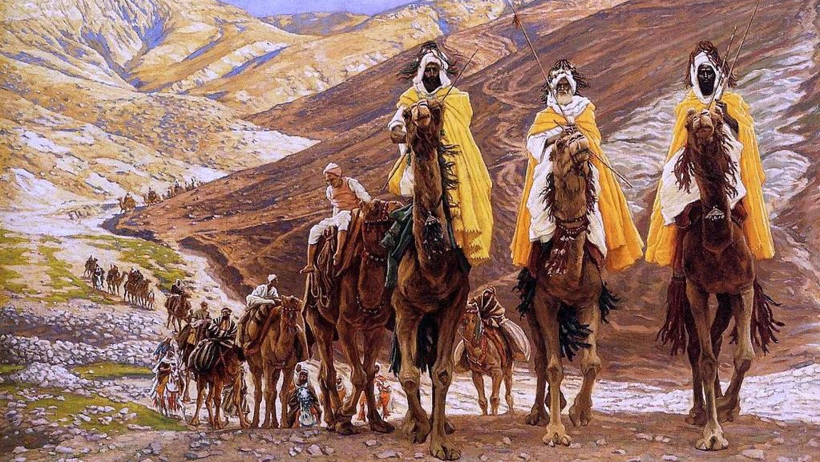

Slide 3
Matthew 2:11 NET
11 As they came into the house and saw the child with Mary his mother, they bowed down and worshiped him. They opened their treasure boxes and gave him gifts of gold, frankincense, and myrrh.

Slide 4
Matthew 2:8-11 NET
8 He (Herod) sent them to Bethlehem and said, “Go and look carefully for the child. When you find him, inform me so that I can go and worship him as well.”
9 After listening to the king they left, and once again the star they saw when it rose led them until it stopped above the place where the child was.
10 When they saw the star they shouted joyfully.
11 As they came into the house and saw the child with Mary his mother, they bowed down and worshiped him. They opened their treasure boxes and gave him gifts of gold, frankincense, and myrrh.

Slide 5
Luke 2:1-4 NET
1 Now in those days a decree went out from Caesar Augustus to register all the empire for taxes.
2 This was the first registration, taken when Quirinius was governor of Syria.
3 Everyone went to his own town to be registered.
4 So Joseph also went up from the town of Nazareth in Galilee to Judea, to the city of David called Bethlehem, because he was of the house and family line of David.

Slide 6
Matthew 2:1-3 NET
1 After Jesus was born in Bethlehem in Judea, in the time of King Herod, wise men from the East came to Jerusalem
2 saying, “Where is the one who is born king of the Jews? For we saw his star when it rose and have come to worship him.”
3 When King Herod heard this he was alarmed, and all Jerusalem with him.

Slide 7
Matthew 2:4-7 NET
4 After assembling all the chief priests and experts in the law, he asked them where the Christ was to be born.
5 “In Bethlehem of Judea,” they said, “for it is written this way by the prophet:
6 ‘And you, Bethlehem, in the land of Judah, are in no way least among the rulers of Judah, for out of you will come a ruler who will shepherd my people Israel.’”
7 Then Herod privately summoned the wise men and determined from them when the star had appeared.

Slide 8
Numbers 24:17 NET
17 ‘I see him, but not now; I behold him, but not close at hand. A star will march forth out of Jacob, and a scepter will rise out of Israel. He will crush the skulls of Moab, and the heads of all the sons of Sheth.

Slide 9
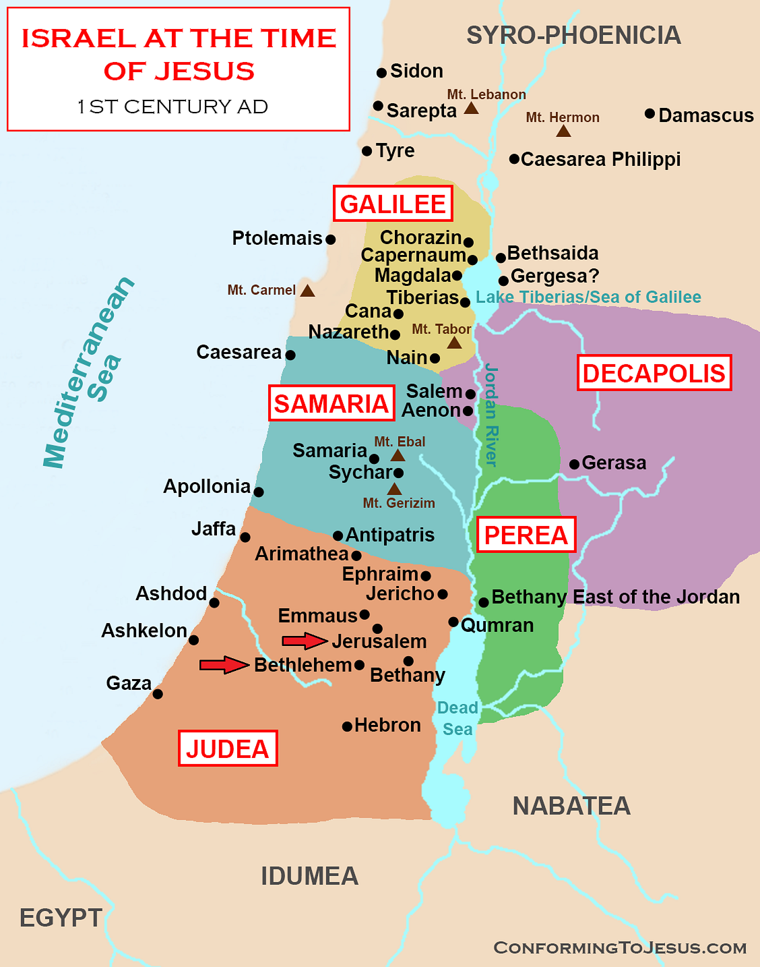
Matthew 2:8-11 NET
8 He (Herod) sent them to Bethlehem and said, “Go and look carefully for the child. When you find him, inform me so that I can go and worship him as well.”
9 After listening to the king they left, and once again the star they saw when it rose led them until it stopped above the place where the child was.
10 When they saw the star they shouted joyfully.
11 As they came into the house and saw the child with Mary his mother, they bowed down and worshiped him. They opened their treasure boxes and gave him gifts of gold, frankincense, and myrrh.

Slide 10
Numbers 24:17 NET
17 ‘I see him, but not now; I behold him, but not close at hand. A star will march forth out of Jacob, and a scepter will rise out of Israel. He will crush the skulls of Moab, and the heads of all the sons of Sheth.

Slide 11
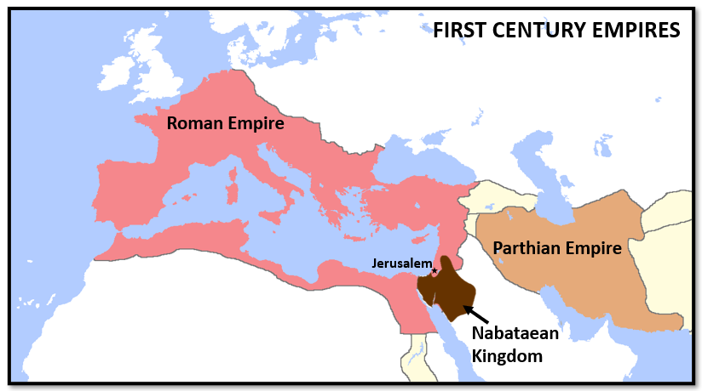

Slide 12
Parthian Empire
Jewish people (in Babylonian exile) who did not return to Jerusalem may have continued sharing prophecies about the “star” and a “new king of the Jews”.
Nabataean Kingdom
Herod’s mother is Nabataean.
Aretas IV (Nabataean) gave his daughter to marry Herod’s son, Antipas, for a wife.
Nabataean is on the trade route for frankincense and myrrh. Nabataean had gold in their land.
The wise men were granted an audience with King Herod.
Proximity to Israel gives them awareness of the prophecies.

Slide 13
1 Kings 10:2, 10 NET
2 She (Queen of Sheba) arrived in Jerusalem with a great display of pomp, bringing with her camels carrying spices, a very large quantity of gold, and precious gems. She visited Solomon and discussed with him everything that was on her mind.
10 She gave the king 120 talents of gold, a very large quantity of spices, and precious gems. The quantity of spices the queen of Sheba gave King Solomon has never been matched.

Slide 14
Isaiah 60:3, 6 NET
3 Nations come to your light, kings to your bright light.
6 Camel caravans will cover your roads, young camels from Midian and Ephah. All the merchants of Sheba will come, bringing gold and incense and singing praises to the LORD.

Slide 15
Notice the Similarities
Queen of Sheba honored Solomon, son of David, with gifts to honor the King.
The wise men honored Jesus, descendant of David, with gifts to honor the King.

Slide 16
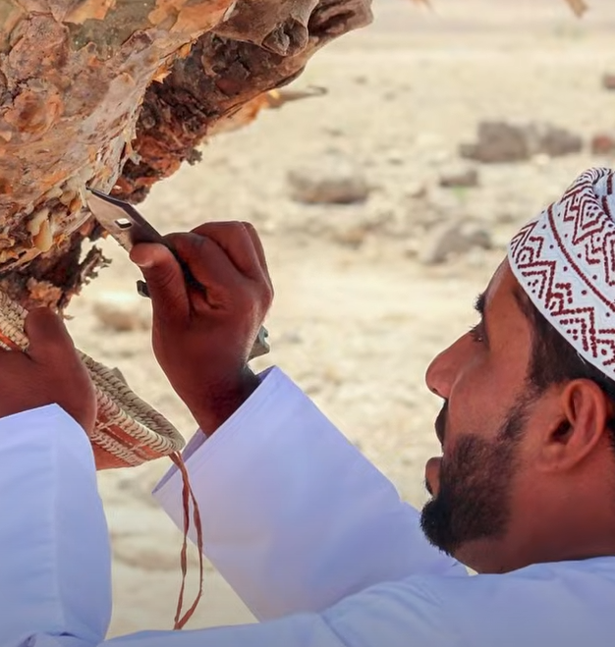
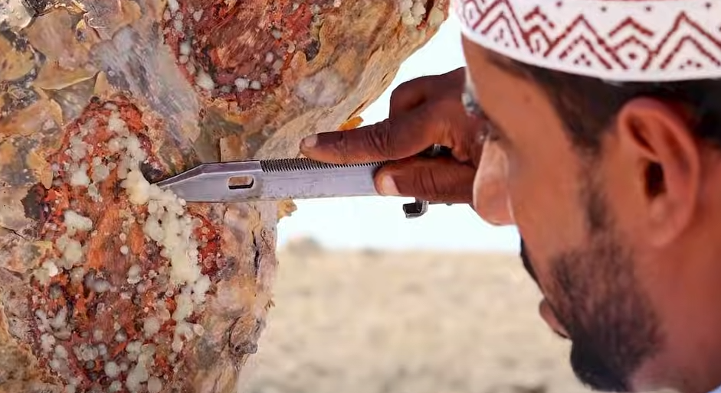
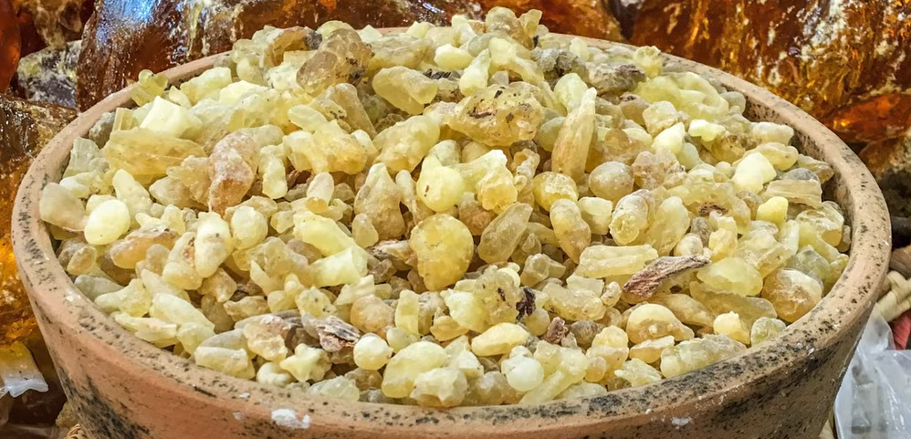
Boswellia Sacra

Slide 17
Exodus 30:34-35 NET
34 The LORD said to Moses: “Take spices, gum resin, onycha, galbanum, and pure frankincense of equal amounts
35 and make it into an incense, a perfume, the work of a perfumer. It is to be finely ground, and pure and sacred.

Slide 18
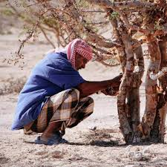
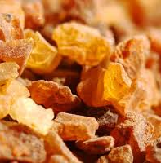
Commiphora Myrrha

Slide 19
Proverbs 18:16 NLT
16 Giving a gift can open doors; it gives access to important people!

