Slide 1
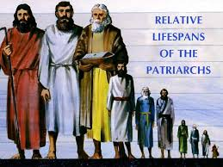
Abraham (Abram)
Gen 11: 26– 12: 9

Slide 2

The 3 Patriarchs:
2 Greek words:
Patria = father + Arche = ruler, chief, or male leader of family = Patriarch
Abraham (Abram), Isaac, and Jacob (Israel)
Jacob’s 12 sons became the 12 Tribes of Israel----becoming the Nation of Israel
Jacob Isaac Abraham

Slide 3
Terms that came from Abraham:
Hebrew/s = means ‘breath of life’ (Gen 2) also means “crossing” and “passing through”
Gen 14: 13 = Abraham first called a Hebrew
Hebron = small town 19 miles south of Jerusalem, Abraham + Sarah; Isaac + Rebecca; Jacob + Leah were buried there. Means “friend”
Jew/s = comes from “men of Judea”; first used in II Kings 16: 6

Slide 4
Our text (verses): Gen 11: 26 – 12: 9
V26 Terah had 3 sons by the time he was 70 years old: Abraham, Nahor, and Haran.
V27 - 32 Lot was the son of Haran, when Haran died, Terah took Abram (Abraham), Sarai (Sarah), and Lot away from the city of Ur to move towards Canaan. On the way, they stopped at Haran…Terah died in Harran at 205 years old. Terah’s profession was an idol maker…Abram’s role was to be Lot’s father.

Slide 5
Gen. 12: 1- 9 God’s hand on Abram
V1 God speaks to Abram and tells him to leave his country, leave his people, and leave his father’s household.
For Abram, there had to be a complete separation – consecration (separated for only holy use)
Separation = recall Paul’s prison letters (Galatians, Ephesians, Philemon, Philippians, and Colossians)…be separated from the old self
Consecration = that which is separated is now dedicated for His use and purpose

Slide 6
God makes a covenant with Abram:
Suzerian-Vassal Covenant = the King makes a promise to someone that requires no action from the recipient. This is an unconditional promise given.
V4-5 Abram had to choose to receive this promise…so, he left Haran and moved to Canaan

Slide 7
The Abrahamic Covenant:
Gen 12: 2 and 3
1. I will make you a great Nation and I will bless you and
your name will be great and you will be a blessing
2. I will bless those who bless you, and curse those who curse you
3. All peoples of the earth will be blessed through you

Slide 8

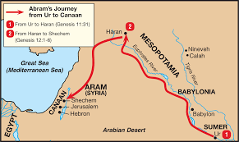


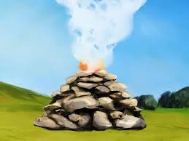

V6-9 Traveled until he could see the “Great Tree of Moreh” at Shechem
V7 The Lord appeared to Abram again – reaffirming His promise, “To your offspring (children) I am giving this land”
Abram built an altar and worshipped Him

Slide 9
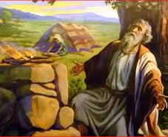
V8 Abram went towards the hills of Bethel (this town was named by Jacob – writer of Genesis was after Jacob lived)
And again, he built an altar – to call upon His name…to ask for direction and guidance…then they moved to the Negev

Slide 10
The 2 Altars
V7 to Worship God
V8 to Call upon the Lord

Slide 11
What can we learn?
Abraham followed the Lord, believed His promises, even though he did not see or directly received his promise while he lived (Heb 11: 8)
Abraham’s strength came from meeting with the Lord…he built altars – designated places and purposes to talk with God
Do we? 2025 a new year for new “habits”…

Slide 12
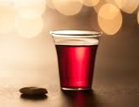
Time for Communion…
Time to call upon the Lord
Time to worship Him
Time to reset our relationship with Him

