Slide 1
Guilty or Blessed by association?!
Genesis 14: 1 - 16

Slide 2
Kings against Kings!
4 Kings
Against
5 Kings
Amraphel King of Shinar
Arioch King of Ellasar
Kedorlaomer King of Elam
Tidal King of Goyim
Bera King of Sodom
Birsha King of Gomorrah
Shinab King of Admah
Shemeber King of Zeboyim
Name? King of Bela/Zoar

Slide 3

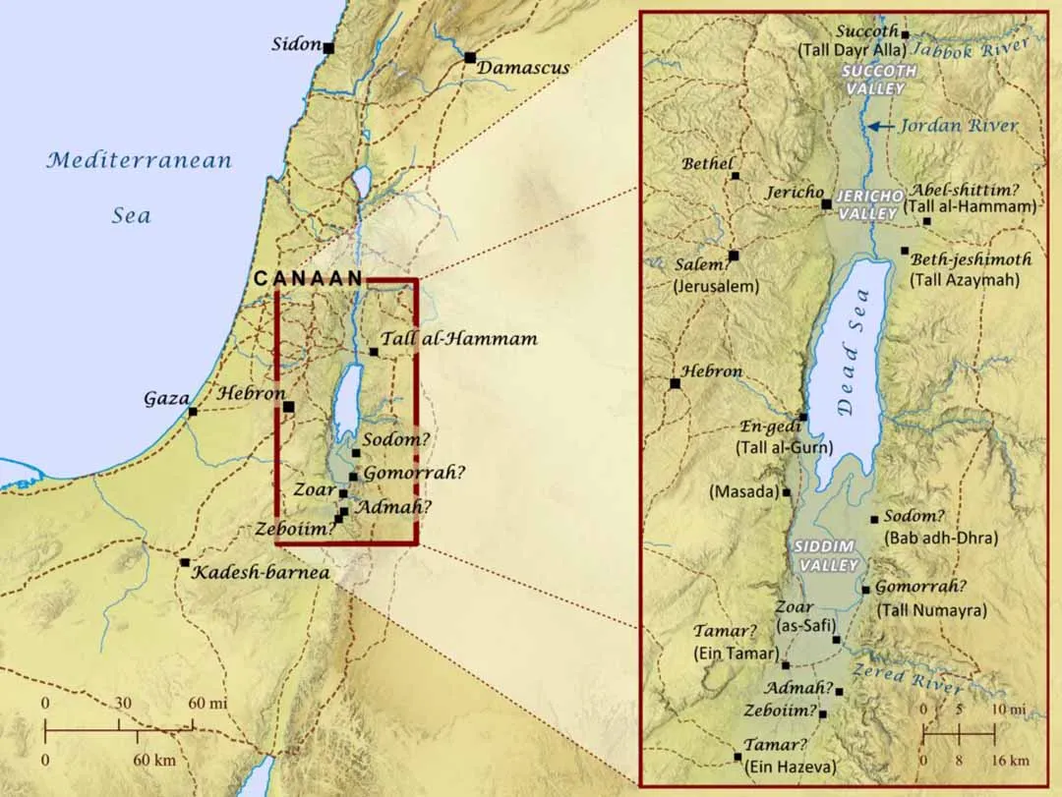
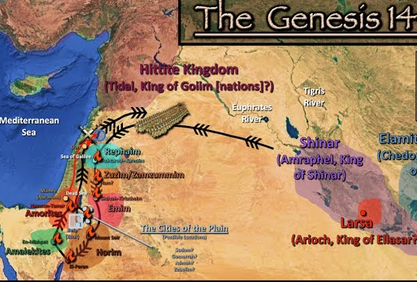
Battle lines set!

Slide 4
Background to the War…
14: 4 = The 5 Kings group were slaves of Kedorlaomer for 12 years – “Done”! They rebelled – for independence. Remember the towns were: Sodom, Gomorrah, Admah, Zeboyim, and Bela/Zoar
Battle line determined for the Valley of Shiddim

Slide 5
The 4 Kings group:
Shinar (Ancient Babylon & current Iraq) = Name means “birthplace of confusion” (former Eden?)-people were called Babylonians or Chaldeans…
Named in several places in the Bible:
  Joshua 7: 20 & 21 = Achar stole & hid the garment from Shinar’s king
  Zech 5: 5 – 11 = the basket of wickedness sent to Shinar and placed in a “house” of pagan worship – mentioned in Rev 17 & 18 as the possession of the Antichrist - until Jesus destroys all wickedness and Shinar itself
  Isaiah 11: 10 & 11 = “the root of Jesse (Jesus) shall stand as a banner for the people…gentiles shall seek Him…He will extend His hand to recover the remnant – His people”
  Rev 17 = Woman of Shinar, mother of harlots and of the abominations of the earth; drunk with the blood of the martyrs of Jesus…”

Slide 6
Other interesting City/kingdom names…
Ellasar (tasar) = center of learning – related to the center of the sun god worship
Goyim = “subhuman” “below human value” – where word “gentiles” comes from
Sodom and Gomorrah = identified as horrifically evil, known for sexual immorality, unnatural lust, and abominable things…

Slide 7
Shinar
Ellasar
Goyim
Note: Amorites

Slide 8
V10 – 12 The 4 Kings defeat the 5 Kings, the Valley of Siddim was full of tar pits and many of the Sodom & Gomorrah armies fell into these pits, and the 4 Kings carried captive Lot, his family, and all of his possesions
V13 - 15 A man escaped and informed Abram that Lot had been captured; he was living in Hebron (Amorite country) – the Amorites aliened themselves with Abram. Abram picked “318 trained men from his household”, and defeated the 5 Kings’ army in the Dan territory.
V16 Abram “recovered all the goods and brought back his relative Lot and Lot’s possessions, together with all the women and the other people.” (Lot and family returned to live in Sodom – Gen 19)

Slide 9

Take a look…
“Gentiles” come from “human with no value”
Shinar (Ancient Babylon & current Iraq) = Name means “birthplace of confusion” (former Eden?)…Rev 17-18 Jesus is victorious – conquers sin and confusion (I Cor 14:33 – God is NOT the author of confusion)
Guilty because of association/relation – Lot with Sodom was taken captive
Blessed because of association/relationship – Abram’s relationship with God gave him the victory (with only 318 men)
Check our association/relationship with the Shinar around us…

