Slide 1
“Helping God” brings ongoing agony!
Genesis 16

Slide 2


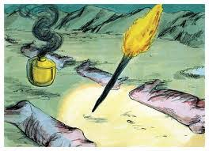

Genesis 15
God came to Abram and did the “Cut Sacrifice” Offering Himself
Declaring He was completely responsible for the Covenant
He is the Guarantor of the Covenant

Slide 3
Genesis 16
Trap set: Sarai’s conversation with Abram
Vs 1 - 6
  I still have not conceived a child/son
  Take Hagar, my Egyptian servant, as your wife and see if she will answer our prayers… This is an Assyrian Desert custom
  Abram (85 yrs old) sleeps with Hagar – Hagar gets pregnant
  Hagar became arrogant and despised Sarai
  Sarai – upset – blames Abram – he says, “Do whatever…”
  Sarai mistreats Hagar and Hagar runs away

Slide 4
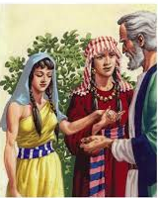
Sarai = anxious; offers a solution to the problem instead of waiting on God; becomes bitter and revengeful
Hagar = became pregnant; became arrogant; despised Sarai (female torture!); ran away
Abram = Chose the ‘natural’ cultural answer; ‘hands off’ – not responsible response…

Slide 5
Hagar runs away and meets El Roi’
V7 – 16 The angel of the Lord found Hagar – on her way to Egypt – Shur (wall) is the eastern border of Egypt –
“Where have you come from and where are you going?” He knew the answer…offers an opportunity for an honest dialogue…(same with Adam and Eve “where are you?”)
“I am running away…”
The angel tells her to return and submit because… “I will increase your descendants”…

Slide 6
The Angel of the Lord
An angel = messenger of God or
A Theophany – God Christophany – Christ = a physical appearance of God in the OT
V10 “I will increase your descendants so much that they will be too numerous to count.” – leans interpretation to this was a Theophany/Christophany

Slide 7
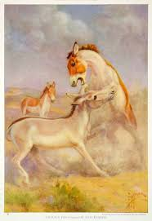
Ishmael:
Named “Ishmael” = ‘God hears’
Circumcised in Gen 17 & dearly loved by Abram
V12 “A wild donkey, against everyone and everyone against him, live in hostility with his brothers/ relatives
Gen 21: God was with him, he married an Egyptian, had 12 sons, known as an expert warrior…

Slide 8
More about Ishmael:
Gen 25: 9 – helped Isaac bury Abraham
Had 12 sons who lived in hostility with each other and became the Arabic Nation – a great (in number and power) nation – still today (Nomads)
Esau married an Ishmaelite (Gen 28)
Joseph sold to Ishmaelites (Gen 37)
Died at the age of 137 (Gen 25)
The strife/fight between Ishmael & Isaac continues today
Called the “Father of Muslims”

Slide 9
Hagar says…
V13 “You are the God Who sees me, I have now seen the One Who sees me.” The El Roi’
“I have been seen by God, have seen Him and still live…”
God’s grace and mercy shown to Hagar… she has been seen, she has seen, and she still lives!

Slide 10
Things to think about and to respond to…
Did Sarai & Abram need to help God keep His promise?
God’s blessing is still with Ishmael – the Arab Nations (not all Arabs are Ishmaelites)
God is a God of grace and mercy – He sees and is seen!

