Slide 1
Again!?!
Genesis 20

Slide 2

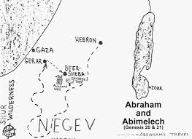
The Story…
V1 Abraham moves from Kadesh (an area in the desert of Shur) to Gerar – King Abimelek’s land
V2 Abraham tells Sarah, “If Abimelech asks, tell him you are my sister…” and Abimelech is attracted to Sarah and sends for her…
V3 In a dream, God tells Abimelech, “You are as good as dead…”

Slide 3
V4 & 5 Abimelech’s response: “They lied and I have a clear conscience!”
V6 – 8 God’s response, “Yes, I know…and I have kept you from sinning against Me, I did not let you touch her…return her to her husband because Abraham is a prophet and he will pray for you and you will live. If not, justice will come and you and your family will die…”
V9 – 10 Abimelech asks Abraham: a) What have you done to us?
b) How have I wronged you? You have brought such a great guilt upon me (Abimelech) and my kingdom…You have done these things that should never have been done!...
c) What was your reason for doing this?

Slide 4
V11 – 13 Abraham rationalizes: a) You (Abimelech) do not fear God – you’re a non-believer and b) you would have killed me to take my wife and besides, c) she really is my sister from another mother… I didn’t really lie…
V14 – 16 Abimelech pays his “penance,” - To Abraham, he gave cattle, sheep, slaves and returns Sarah to him. – To Sarah, he gave 1,000 shekels of silver (about a pound of silver) to cover his offense to her. Then tells Abraham, “My land is before you; live anywhere you want.”
V17 – 18 Abraham prays for Abimelech and his household and God healed his wife and his female slaves – God had closed their wombs!

Slide 5
Right after that… Genesis 21:1 & 2
“The Lord was gracious to Sarah, and kept His word. Sarah became pregnant and gave birth to a son (exactly the time God said she would). Abraham and Sarah called their son Isaac (meaning ‘laughter’).

Slide 6
3 Main Characters (People) in this story:
Abimelech – an ungodly non-believer – God’s mercy shown
Matt 5: 45 says, “…that you may be children of your Father in heaven (grace). He causes His sun to rise both on the evil and the good, and sends rain on the righteous and unrighteous.” (mercy)

Slide 7
Sarah
Hebrews 11: 11
“She considered Him Who made the promise faithful…”

Slide 8
Abraham - definitely not perfect, but...
Hebrews 11: 10 - 16, “For he (Abraham) was looking forward to the city with foundations whose architect and builder is God…v13 They did not receive the things promised; they only saw them and welcomed them from a distance…they were longing for a better country – a heavenly one…therefore God is not ashamed to be called their God.”

Slide 9
Mean to us, what?...
Everyone who is alive – breathes and has a heartbeat is tasting His grace and mercy – the rain falls on both the non-believer and believer…
Sarah knew God was and remains faithful! She trusted Him
Abraham did not “see the Promise Land” to claim … but he looked forward – he anticipated God’s answers to his prayers and promises

Slide 10

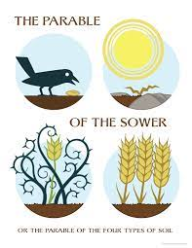
Within All of our hearts:
Path = Don’t want
Rocks = Hurts, feel “no good”, think “can’t can’t can’t”…
Thorns = Overwhelmed
Healthy ground = Whole and Healthy soul

