Slide 1
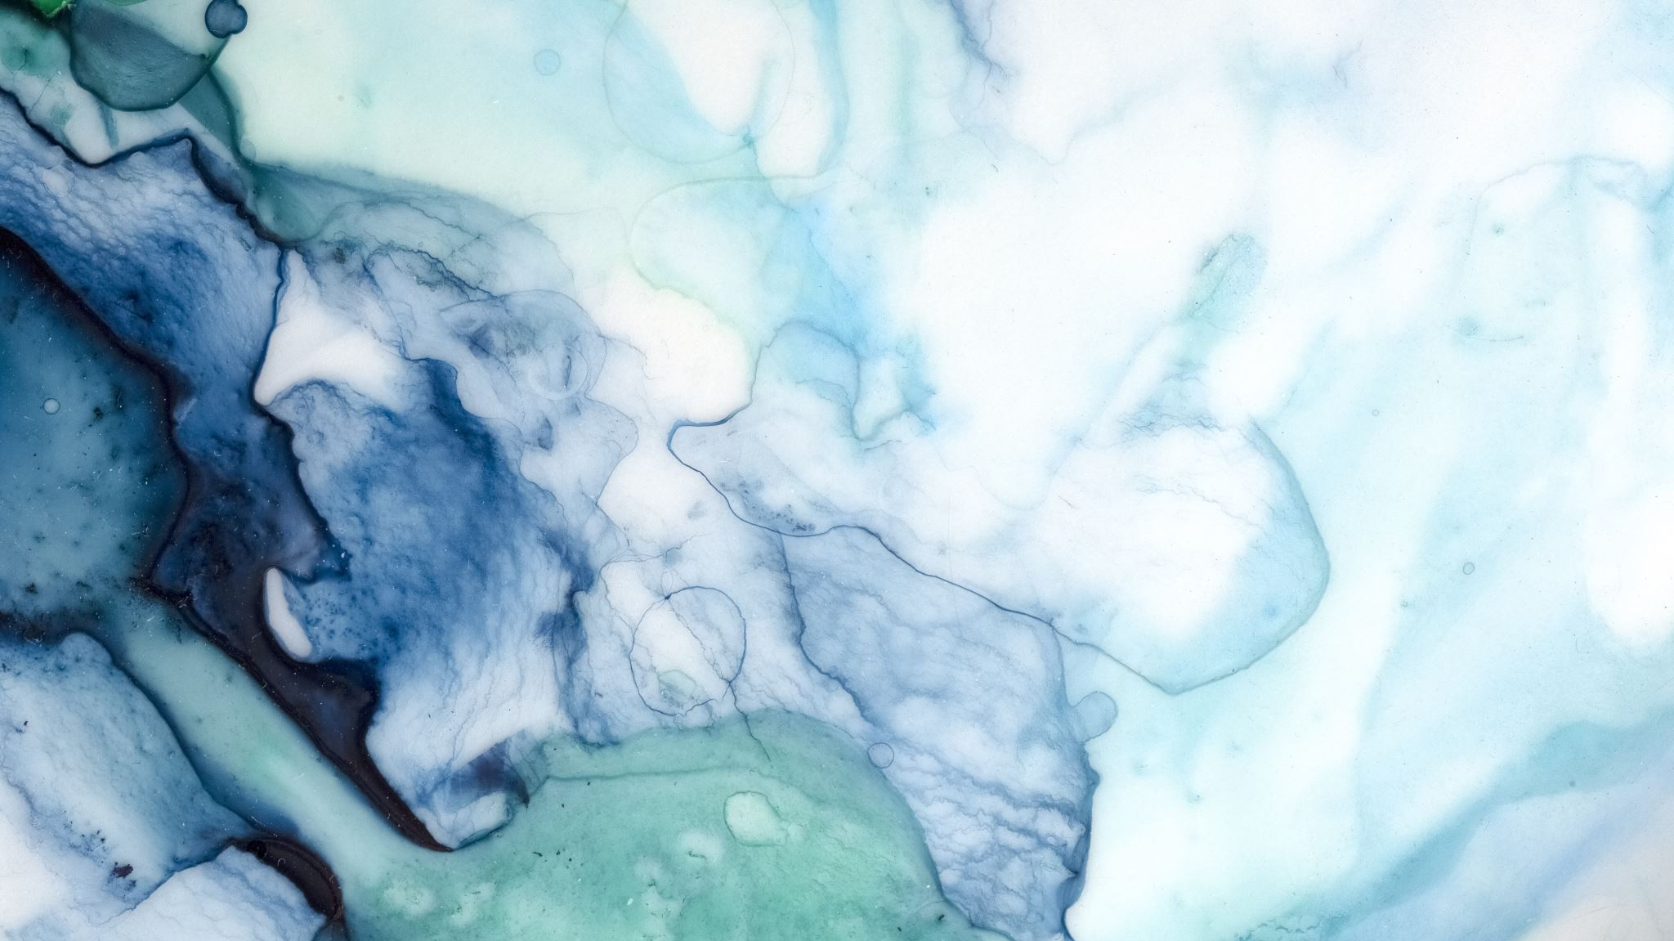
God – still engaged in our everyday lives!
Genesis 21

Slide 2
Life gets messy…
V1-8 Mountain top: Isaac is born! Abraham is 100 years old and Sarah is 90!
Abraham circumcises Isaac on his 8th day; Sarah is thrilled, “God brought me laughter and everyone laughs with me!”
Isaac is weaned, Abraham throws a huge festival – party!

Slide 3
Trouble in the Family (v9-14):
Ishmael is now 9 – 11 (still called “boy” so not yet 13 years old). At the festival, he mocks Isaac and Sarah becomes MAD!
V10 Sarah shouts, “Get rid of him (Ishmael), he will have no part of Isaac’s inheritance!” v11 Abraham is distressed and God comforts him… “Do not worry about Ishmael, do as Sarah says, My promise will be through Isaac, but because this boy (Ishmael) is your son, he, too, will be a great nation.” Abraham sends Hagar and Ishmael away…

Slide 4
God “cleans up the family mess” again…
Mercy and Grace working together!
V14 – 21 Hagar and Ishmael wander the Desert of Beersheba…moving southeast of Gerar, food and water run-out, Hagar leave Ishmael under a bush and walks away (about 30 feet+) and falls down crying, “I can’t watch my son die…”
V17 God hears Ishmael’s cry, speaks to Hagar and tells her, “lift him up, I will make him a great nation, look there is a well of water…”
V20-21 God was with the boy as he grew-up, became an expert archer, and Hagar got him a wife from Egypt, and they lived in the Desert of Paran

Slide 5
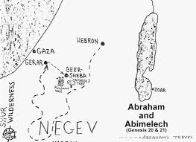
The Treaty (v22-29)
Abimelech asks for a treaty with Abraham: “Before God, promise you will not deal falsely with me, my children, and my descendants. Show me the same kindness I have shown you.”
Abraham agrees, however…
Tamarisk Tree
Abraham’s well
Desert of Paran

Slide 6
There’s an “issue”… (V25 – 30)
Abimelech’s servants have seized the water well Abraham and his men dug. Abimelech state, “I did not know, no one told me, you did not tell me”
Abraham brought cattle and sheep to Abimelech plus 7 lambs (a separate gift). The two men made an agreement…Abimelech asked, “What is the meaning of the 7 lambs?”
V30 Abraham explained that the 7 lambs were a personal gift as a witness that Abraham/family actually dug this well themselves, belongs to Abraham and family…

Slide 7
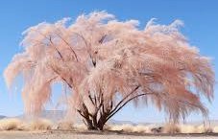
V31 The place was named Beersheba = ”well of 7” or “well of oath”
V32 Abimelech (King of Gerar) and his commander (Phicol) returned to the land of the Philistines.
V33 Abraham planted a tamarisk tree in Beersheba and then called upon the name of the Lord, the Eternal God
Tamarisk Tree: a ‘cleansing tree’
(breath of fresh air) and a symbol
of life and Abraham’s declaration
of God’s promises

Slide 8
V34 Abraham lived in the land of the Philistines for a long time…
Philistines?
Today the word labels someone as a hostile or indifferent to culture and art
“Some hearing people can be real Philistines to Deaf!”
Land is current Gaza
Enemies against Israel – constantly taunted Israel
Goliath was a Philistine
Came from the Island of Crete, called “Sea Peoples”
Nebuchadnezzar (604 bc) totally destroyed them
Today no Philistines left, no bloodline to identify heritage.
No relations to Palestinians

Slide 9
God is still engaged in our everyday lives!
Abraham’s messy family
Political happenings
Are we “planting” Tamarisk trees in our lives and for generations to come? Do you have a place to meet with Jesus daily? Is your life proclaiming your hope and trust in His promises?

