Slide 1
The Unbearable ‘Ask’…
Genesis 22 – Genesis 25

Slide 2
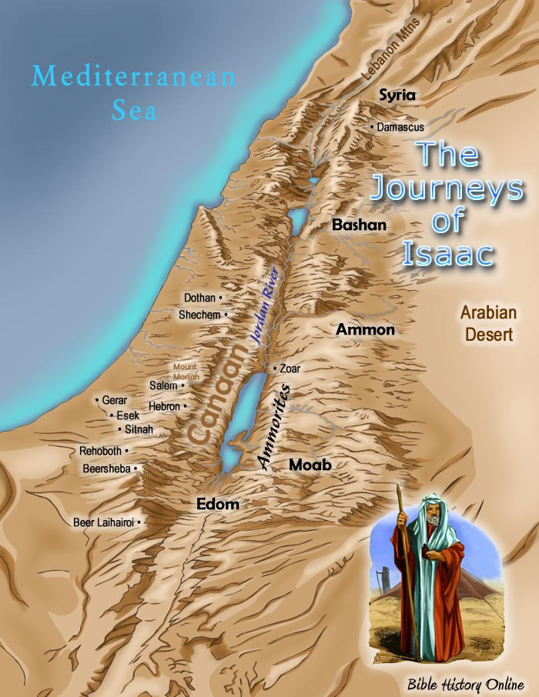
Land Look like…
Gerar – King Abimelech
Beersheba – Abraham’s “home”- capital city of Negev
Hebron – Sarah’s “home”- now Alkahalil in Palestine; David was King of Judah 7 yrs there
Beer Laihairoi – Isaac’s home
Mt Moriah – Place of the sacrifice – north of Jerusalem (called Salem at that time)
Cave of Machpelah – burial cave in the Hebron area

Slide 3
Genesis 22 The “ASK” and Response…
V1 & 2 God tested Abraham – “Take your son, your one and only son, whom you love, Isaac, and go to the region of Moriah. Sacrifice him there as a burnt offering on a mountain I will show you…”
‘Burnt offering’ = an offering for atonement for sin
V3 Abraham immediately obeyed – ‘the next morning’ he packed and took 2 servants and Isaac
V4 Traveled 3 days (55 miles) from Beersheba to Mt. Moriah. When Abraham saw the place where God was leading, he said to his told his servants
V5 “Stay here with the donkey while I and the boy (approx. 12 yrs) go over there. We will worship and then we will come back to you.”

Slide 4
Walking out his faith in God:
V6 – 10 Isaac carried the wood and Abraham carried the fire and knife v7 Isaac asked, “Father, the fire and wood are here, but where is the lamb for the burnt offering”
V8 Abraham’s response, “God Himself will provide the lamb for the burnt offering.”
V9 – 10 When they reached the place God had told him, he built an altar, arranged the wood, bound Isaac, laid Isaac on top of the wood. Then reached out his hand and took the knife to slay Isaac…
BUT God…

Slide 5
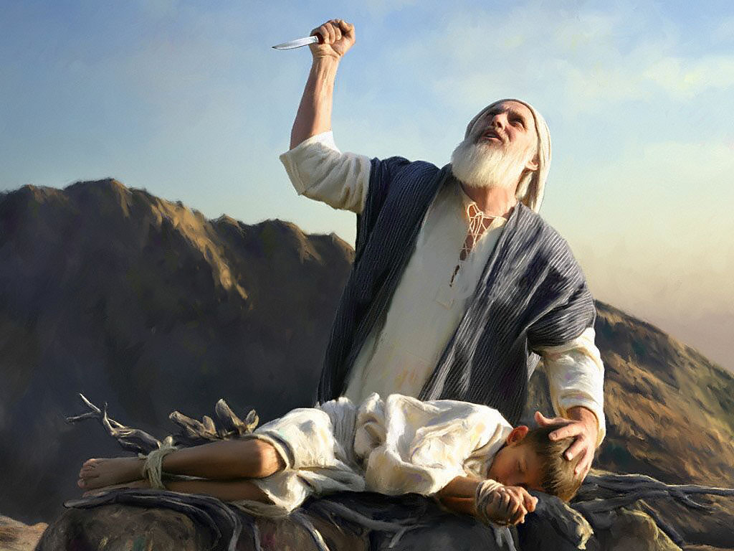
V11 God called out to Abraham – Abraham answered “Here I am Lord”
V12 God said, “Do not lay a hand on the boy, do not do anything to him. Now I know that you fear God, because you have not withheld your son, your one and only son.”

Slide 6
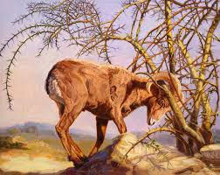
Jehovah Jireh – God provides
V13 & 14 Abraham looked up and saw a ram stuck in the thickets and called the place “The Lord will provide” – ‘Jehovah Jireh’
V15 – 18 God repeated His covenant with Abraham:
  Children more than the stars
  Anyone against you – I will be against
  All nations on the earth will be blessed through you

Slide 7
V19 Abraham, Isaac, and servants returned home to Beersheba
V20-24 Tells us the family line of Abraham’s brother Nahor. One of Nahor’s sons is Bethuel – Bethuel is Rebekah’s father – Rebekah is Isaac’s future wife…
Gen 23:
Sarah dies at 127 years old while living in Hebron
Hebron is approximately 30 miles north of
Beersheba – Abraham is living in Beersheba and at
this time Isaac is living in Beer Laihairoi. Laihairoi –
El Roi is the place where God spoke to Hagar – a place she called “El Roi” – “God sees and is seen (shows Himself) by me…”

Slide 8
An unforeseen cost of obedience…Sarah moved to Hebron, Isaac moved to Beer Laihairoi (Gen 25:11)…
Gen 23: 2- 20 Abraham negotiates with the King of the Hittites to purchase the Cave of Machpelah in Hebron - this becomes the family burial ground where Sarah & Abraham, Isaac & Rebekah, Jacob & Leah are buried. This cave is considered the 2nd holiest place to the Israelites today.
Genesis 24 is the story of Isaac and Rebekah’s marriage arrangement. In verse 62, Isaac comes to Hebron to mourn Sarah’s death – from Beer Laihairoi – approximately 80 miles away. V62 tells of Isaac standing in the fields meditating on the Lord when he sees the convoy of Abraham’s servant bringing Rebekah to him…he takes her to his mother’s tent, marries her and was comforted from his mother’s death.

Slide 9
Gen 25: After the mourning period is done – Abraham mourning the death of Sarah – he marries again (Keturah) and has 6 more sons; one named Midian – the Midianites – Jethro, Moses’ father-in-law – a priest of the Most High God… hmmmm…
Questions to ponder:
Did God require too much of Abraham, Sarah, and Issac? Sarah is one of only 3 women mentioned in Heb 11 (the faith Hall of Fame)
God knew their human weaknesses, yet He called them to intimate relationships with Him
God knows YOU … and is still calling us to His side…

