Slide 1
Point –> pah crescendo!
Genesis 25: 5 – 11; James 2: 23; Luke 19: 28 – 38 and II Corinthians 2: 14

Slide 2
Abraham, Finally at Rest! Genesis 25: 5 – 11
V5 Abraham left everything he owned to Isaac
V6 While he lived, he gave gifts to his other children and sent them east of where Isaac lived (Beer Lahai Roi)
V7 & 8 At 175 years old, Abraham died – ‘a good old age, an old man, and full of years’
V9 -11 Isaac and Ishmael buried Abraham in the Cave of Machpelah in Hebron – with Sarah. And the Lord blessed Isaac…

Slide 3
Abraham’s Life Summarized:
At 75 years old, God called Abraham to leave his homeland
God’s Covenant with Abraham: 1) you will be a great nation; 2) you will be a blessing and all who bless you, I will bless & who curses you, I will curse; and 3) ALL the people of the earth will be blessed through you.
Abraham and Lot separate, Abraham rescues Lot, meets and tithes to Melchizedek.
Sarah gives Hagar to Abraham – Ishmael is born – Abraham is now 86 years old – circumcision established – a sign of the covenant between God and Abraham (now 99 years old).
God promises he and Sarah will give birth to Isaac – he is 100 years old when Isaac is born

Slide 4
God allows Abraham to negotiate on behalf of Sodom and Gomorrah
Abraham is asked to sacrifice Isaac on Mt. Moriah – Jehovah Jireh = The Lord Provides (ram)
Abraham sends his faithful servant to his brother (Nahor) to select a wife for Isaac – Rebekah is chosen as Isaac’s wife
Dies at 175 years old and is buried with Sarah
That’s it? That’s ALL!?!

Slide 5
“For it was not through the law that Abraham and his descendants were promised that he would be the heir of the world, but through the righteousness that comes by faith.” Romans 4:13
“You see that his (Abraham’s) faith and actions were working together, and his faith made complete by what he did…he was called ‘God’s friend’…” James 2: 22 - 23

Slide 6
Here it is:
“This is the genealogy of Jesus the Messiah, the son of David, the son of Abraham…”
Matthew 1: 1

Slide 7

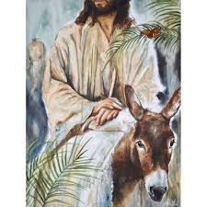
Today we celebrate the Triumphal entry…
Recorded in:
Matthew 21: 1 – 11; Mark 11: 1 – 11;
Luke 19: 28 – 38; and John 12: 12 – 16.
Zech 9: 9, “See, your king comes to you, righteous and victorious, lowly and riding on a donkey, on a colt…”
The crowd shouted “Hosannah” not “Hallelujah” (“Save us!” not “Praise You”)

Slide 8
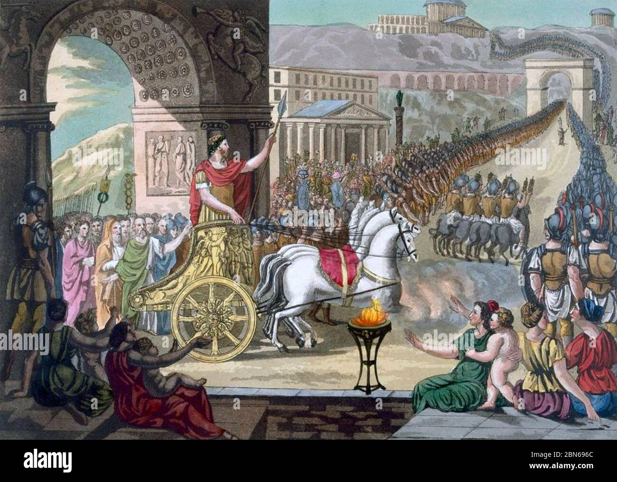
Paul’s Picture – Roman Victory Parade:
II Corinthians 2: 14
“But thanks be to God, Who always leads us triumphantly as captives in Christ’s triumphal procession and uses us to spread the aroma of the knowledge of Him everywhere.”

Slide 9

Note:
Christ led us “as captives” = every Christian is a ‘conquered captive’ – we are bought with the price of His sacrifice on the cross
We are now partakers in the triumphal parade: *to be dependent on Jesus is to be independent of everything else; *he who the Son has set free – is free indeed!; and to be overcome/conquered by Christ is to overcome the captivity of the world (sin)
His captives (believers) are His ‘trophies’ and proof of His overcoming power – we are now free to live as conquerors of sin!

Slide 10
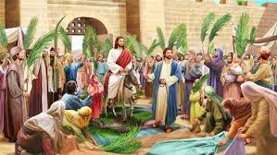
We celebrate Jesus’ Triumphant Entry today…
This starts ‘The Holy Week’
Friday is Good Friday
Next Sunday, we celebrate Jesus’ resurrection
Are you living a ‘captive life?’

