Slide 1
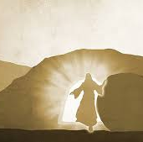
He is risen!

Slide 2

Now what do we do???

Slide 3
V 1-3 Jesus spent 40 days with the disciples and other believers putting away the ‘old ways’ and thoughts – establishing ‘new norms’… “convincing proof that He is alive and teaching them about the Kingdom of God”…
V4 On one of those days, Jesus commanded, “Do not leave Jerusalem, but wait for the gift My Father promised, which you have heard Me speak about … in a few days you will be baptized in the Holy Spirit…”
Acts 1:
1 - 26

Slide 4
Jesus was referring to His teaching in John 14:
14: 1 Do not let your hearts be troubled. Trust in God; trust also in Me…
V6 I am the Way, the Truth, and the Life. No one comes to the Father except through Me…
V15 & 16 If you love Me, keep My commands (repeated 3xs in this conversation). And I will ask the Father, and He will give you another Advocate/Paraclete to help you and be with you forever
V17 the Spirit of Truth
John 14

Slide 5
V18 – 26 I will not leave you as orphans… the Holy Spirit, Whom the Father will send in My name, will teach you all things and will remind you of everything I have said to you”…
John 16: 8 – 13
“When the Holy Spirit comes He will prove the world to be in the wrong about sin and righteousness and judgement…When He, the Spirit of Truth, comes He will guide you into all truth.”

Slide 6
1: 6 “The disciples asked, ‘Lord, are You at this time going to restore the Kingdom of Israel’”
V7 Jesus responds without a rebuke and redirects the conversation stating, “It is not for you to know…”
V8* “But you will receive power when the Holy Spirit comes on you; and you will be My witnesses in Jerusalem, and in all of Judea and Samaria, and to the ends of the earth.”
NOTE: Jerusalem, Judea and Samaria, and to the ends of the earth…perhaps, to your family, your workplace and Deaf Community, and to the Deaf around the world?...
Back to Acts 1

Slide 7
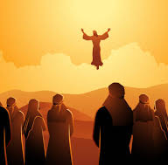
V9 – 11 “Before their eyes, Jesus ascended into heaven…Starring up, two men (angels) appeared saying, ‘Why do you stand here looking into the sky? This same Jesus, Who has been taken from you into heaven, will come back in the same way you have seen Him go into heaven.”
V12 – 14 They returned to Jerusalem and joined together in prayer (120 ppl)
V15 The 1st Business meeting – Matthias was elected to replace Judas
Back to normal…a New normal – they stayed and prayed together…

Slide 8
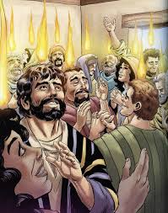
Then came acts 2: 4 Pentecost!
Questions to ponder:
Did your life “go back to normal” when you invited Jesus into your life?
Is ‘the party over’ – Christian life dull, same same same?
Have you received the Father’s gift? Have you received the baptism of the Holy Spirit – Acts 2 experience?

