Slide 1
M3 + S Women at the Cross & Tomb of Jesus
John 19 and 20

Slide 2
Mary, Mary, Mary and Salome
John 19: 25
“Near the cross of Jesus stood His mother, His mother’s sister, Mary – the wife of Clopas, and Mary Magdalene.”

Slide 3
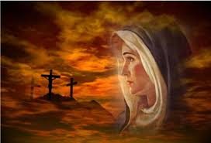
Mary – the Mother of Jesus
Introduced to her in the synoptic gospels as ‘one who has found favor with God’
Holy Spirit came upon her and as a virgin, God created life in her – the Word became flesh - Jesus
Luke 2: “But Mary treasured all these things and pondered them in her heart and thought about them often.”

Slide 4
Pondered: to weigh events/thoughts in her mind, giving each circumstance its importance, and anxiously seeking what it might mean for her child
Luke’s use of the word ‘pondered’ identifies a delicate and beautiful expression of the feelings of a mother. A mother does not forget…everything a child does, suffers and things said about them were treasured in the heart and mind of Mary. She would often think of those things and anxiously awaited what these things meant for her firstborn…
Things she pondered: Gabriel’s greeting, Elizabeth’s pregnancy, Gabriel’s conversation with Joseph (Matt1:20 says Joseph pondered also) …collecting 33+ years of events she witnessed…

Slide 5
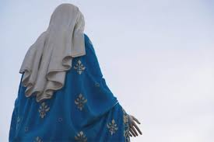
Salome – Jesus’ mother’s sister
Unnamed in John, Matthew tells us she was Salome
The wife of Zebedee and mother of James and John
Mary’s sister – Jesus’ earthly aunt
What a marvelous sister – stayed with Mary through the crucifixion, death, and burial
Was among the first to discover Jesus’ resurrection

Slide 6
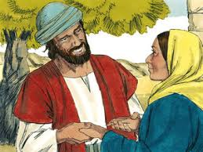
Mary – wife of Clopas (Alpheus)
Matthew 10:3
The wife of Clopas or Alpheus
The mother of ‘James the Lesser’ and Jose
History tells us that Clopas/Alpheus was Joseph’s brother; making James ‘the Lesser’ and Jose Jesus’ cousins
She was among the first to discover Jesus was risen from the dead

Slide 7
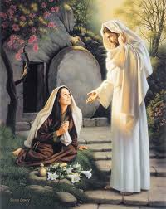
Mary Magdalene
Magdala – a town near Tiberias, Magdalene = from the town named Magdala…she may have come from a wealthy family
In Luke, Jesus healed her of demon possession (7 demons casted out)
Luke 7: 37, researchers identify her as the woman who washed Jesus’ feet with expensive oil and her hair
1st to see the risen Jesus at tomb
Lived a repentant life until she died in Ephesus – living near/with Mary – Jesus’ mother and John

Slide 8
4 Women, share same, what?
They dedicated their lives to serving Jesus with all their heart
3 of the 4 (Mary, Salome, and Mary-wife of Alpheus) were mothers who understood what it meant to ponder the lives of the children they carried within their wombs…they understood the ‘task’ of carrying their children in their hearts – their adult children…Jesus, James and John, James the Lesser…
All 4 sacrifices their lives for the care and love for the people Jesus brought into their lives…
They demonstrated the nurturing heart of God…

Slide 9

BDA Ladies – be the heart of God to a hurting and lost world!

