Slide 1
Sewing and Wineskins
Matthew 9: 16; Mark 2:21; and Luke 5: 36

Slide 2
Matthew 9:1-17 & Mark 2:21 are same…
V16 & 17 “No one sews a patch of unshrunk cloth on an old garment, for the patch will pull away from the garment, making the tear worse. Neither do people pour new wine into old wineskins. If they do, the skins will burst; the wine will run out and the wineskins will be ruined. No, they pour new wineskins, and both are preserved.”
Context:
In His (Jesus’) hometown, He healed a paralyzed man; then He went from there and called Matthew (Levi), a tax collector, to be His disciple. Matt invited Jesus to his home for dinner. The Pharisees went ballistic!

Slide 3
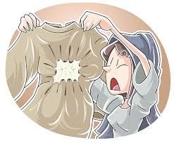
v16 “No one sews a patch of unshrunk cloth on an old garment, for the patch will pull away from the garment, making the tear worse…”
New/unshrunk patch = the Kingdom of God Jesus was teaching – fulfillment of the Law and prophesies – changes necessary
Old garment = their current practices – the Pharisees and their practices represented the old

Slide 4
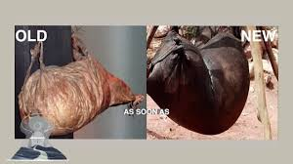
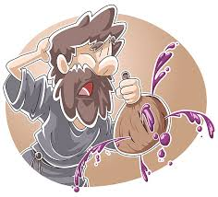
V17 “Neither do people pour new wine into old wineskins. If they do, the skins will burst; the wine will run out and the wineskins will be ruined. No, they pour the new wine into new wineskins, and both are preserved.”
The freshly crushed grapes will ferment and gases will blow-up the container (skin)

Slide 5
Jesus’ application:
Old wine and wineskins = in process of making the wine, the grapes ferment, the skins were at first flexible – pliable and expands as the gas increases, the skin after time, becomes unable to expand more.
The old wine is tasty, preferred, mellow and pleasant…
Jesus compared the old wine with the traditions practiced by the religious leaders – the Pharisees watching Jesus having dinner with Levi and Levi’s friends – other tax collectors, blew their minds!
The beauty of the Word of God (Laws of Moses, Words of the Prophets, and the Poetic Writings) was at one time fulfilling to the believer; however, it had become mellow, profane – common, and inflexible…

Slide 6
The New Wine: Jesus’ message of salvation…His sacrifice covers the sins of the world and anyone who would believe in Jesus – would be saved. Prophecy was satisfied – met; not removed but fulfilled for all people.
Ezekiel 18: 31 “Cast away from yourselves all the transgressions you have committed and make for yourselves a new heart and a new spirit. Why should you (eternally) die?”
Spiritual renewal requires a new heart and new mindset…something the Pharisees struggled with…

Slide 7
Luke’s record is a little different
Luke 5: 36 – 38 is the same as Matthew and Mark’s record – However:
V39 states, “None of you, after drinking old wine, wants the new, for you say, ‘The old wine is better!’” Researchers/Commentaries suggest that Paul influenced Luke to add this to his gospel. Matthew and Mark’s record is direct, almost ‘harsh’ to the Pharisees… Luke suggests ‘who wouldn’t prefer the old wine, it taste better, milder and more pleasant… giving the listeners a gentle push to be open to the new wine…
Consider what Paul says in II Corinthians 5: 7

Slide 8
“Therefore, if anyone is in Christ, he is a new creation. The old has passed away. Behold, the new has come!”

Slide 9
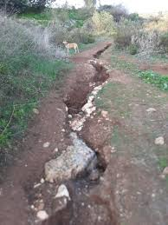
“A rut (the picture) is the same as a grave without sides…” Old habits become comfortable traps …
Ephesians 4: 22 – 24, “…put off your former way of life, your old self, which is being corrupt by its deceitful desires; to be renewed in the Spirit of your minds; and to put on the new self, created to be like God in true righteousness and holiness.”

Slide 10
Examine your heart…
What are your old wineskins?
What keeps you in a rut?
Has Jesus become your ‘hooo humm’
boring rut?
II Corinthians 5: 17, “Therefore, if anyone is in Christ, he is a new creation. The old has passed away. Behold, the new has come!”

