Slide 1
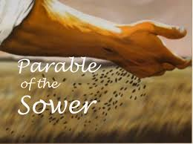
Matthew 13: 1-8 & 18-24; Mark 4: 3-9 & 13-20; Luke 8: 5-8 & 11-15

Slide 2
Context:
During Jesus’ first preaching tour in Galilee
That day, he already healed many, Pharisees called Him Beezelbul, and was ‘grilled’ by the religious leaders… withdrew from the crowd into a home, His mother and brothers came to see Him, and after a while went outside to sit by the lake
A crowd gathered and He began to teach – telling parables… this one is called the ‘parable of the sower/farmer’

Slide 3
A look at the synoptic same and differences of the parable itself:
A sower/farmer sowed some seeds and it fell on four types of soil:
The path/walkway: Matt and Mark say, “the birds came and ate it up”; and Luke state, “it was trampled on and the birds ate it up”
The rocks: Matt & Mark say, “not much soil, grew quickly because soil was shallow, sun came up – plants withered because they had no roots…” Luke says, “when it came up, the plants withered because they had no moisture.”

Slide 4
Continue:
The thorns/weeds: Matt and Luke says, “seeds fell among thorns, which grew up and choked the plants.” Mark said, “thorns, which grew up and choked the plants, so they did not bear grain.”
The good soil: Matt & Mark say, “it came up (grew) and produced a crop 100X more; Luke says, “it came up and yielded a crop 100X”

Slide 5
Jesus interprets/explains the parable:
Matt 13: 18-24; Mark 4: 13-20; and Luke 8: 11-15
Luke (only) identifies the ‘seed’ as the word of God
The path: Matt states the ‘path-heart’, “hears the word but does not understand it and the evil one comes and snatches it away”… Mark says, “as soon as it (the word) is heard, Satan comes and takes it away”… Luke states, “Satan takes away the word from their heart so they may not believe and be saved”…
The rocky soil: All three writers say, “they hear the word, receive it with joy, has no roots, ground is shallow, lasts only a short time, troubles come and they quickly fall away”…

Slide 6
Jesus’ interpretation continues:
The Thorns: Matt & Mark state, “they hear the word, but the worries of life, the deceitfulness of wealth and desires for other things choke the word and they become unfruitful”… Luke says, “they hear but as they go on their way, they are choked by life’s worries, riches and pleasures…they did not mature”…
The Good Soil: Matt said, “hears and understands the word and becomes productive”; Mark – “hears and accepts (obeys) and produces; Luke – “the noble and good heart hears the word, retains (keeps) it, preservers and produces”…

Slide 7

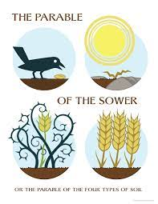
Could it be that within our hearts:
Path = Don’t want
Rocks = Hurts, feel “no good”, think “can’t can’t can’t”…
Thorns = Overwhelmed
Healthy ground = Whole and Healthy soul – area of obedience

Slide 8

What does your heart look like?
Path
Rocks
Weeds/Thorns
Good ground
The more we yield to the Lord and His word, the more our hearts are taken over by the good ground… you choose…

