Slide 1
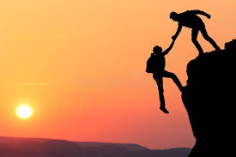
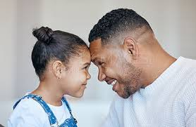

Fix Your Eyes on Jesus!
Hebrews 3: 1 – 4:1 (a)

Slide 2
Hebrews 3: 1 - 3
“Therefore, holy brothers and sisters, who share in the heavenly calling, fix your eyes/ thoughts on Jesus, whom we acknowledge as our apostle and high priest. ² He was faithful to the One who appointed Him, just as Moses was faithful in all God’s house. ³ Jesus has been found worthy of greater honor than Moses, just as the builder of a house has greater honor than the house itself.

Slide 3
Hebrews 3: 4 - 6
⁴ For every house is built by someone, but God is the builder of everything. ⁵ “Moses was faithful as a servant in all God’s house,” bearing witness to what would be spoken by God in the future. ⁶ But Christ is faithful as the Son over God’s house. And we are His house, if indeed we hold firmly to our confidence and the hope in which we glory.

Slide 4
Hebrews 3: 7 - 11
⁷ So, as the Holy Spirit says:
“Today, if you hear His voice,
⁸ do not harden your hearts
as you did in the rebellion,
during the time of testing in the wilderness,
⁹ where your ancestors tested and tried me,
though for forty years they saw what I did.
¹⁰ That is why I was angry with that generation;
I said, ‘Their hearts are always going astray,
and they have not known my ways.’
¹¹ So I declared on oath in my anger,
‘They shall never enter my rest.’ ”

Slide 5
Hebrews 3: 12 - 15
¹² See to it, brothers and sisters, that none of you has a sinful, unbelieving heart that turns away from the living God. ¹³ But encourage one another daily, as long as it is called “Today,” so that none of you may be hardened by sin’s deceitfulness.¹⁴ We have come to share in Christ, if indeed we hold our original conviction firmly to the very end. ¹⁵ As has just been said:
“Today, if you hear His voice,
do not harden your hearts
as you did in the rebellion.”

Slide 6
Hebrews 3:16 - 19
¹⁶ Who were they who heard and rebelled? Were they not all those Moses led out of Egypt? ¹⁷ And with whom was He angry for forty years? Was it not with those who sinned, whose bodies perished in the wilderness? ¹⁸ And to whom did God swear that they would never enter His rest if not to those who disobeyed? ¹⁹ So we see that they were not able to enter, because of their unbelief.

Slide 7
Hebrews 4: 1 (a)
4:1 (a) Therefore, since the promise of entering His rest still stands,…”

Slide 8
V. 1
“Therefore, holy brothers and sisters, who share in the heavenly calling, …
Holy = I Peter 1: 15 & 16, “ …just as He Who called you is holy, so be holy in all you do; for it is written: ‘Be holy, because I am holy’.”
Brothers and Sisters = we share in the heavenly calling – salvation – God’s call to salvation is to all people…responding in obedience, we become His sons & daughters

Slide 9
“ fix your eyes/ thoughts on Jesus, whom we acknowledge as our apostle and high priest. ² He was faithful to the One who appointed Him, …
He is our Apostle = the One Who looks for us, Missionary God sent to look for us
He is our High Priest = the One Who sacrifices for us and presents us to the Father – we are redeemed – bought by Jesus’ own blood
V 1 & 2

Slide 10
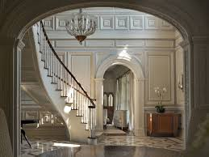
V2 – 6
² He was faithful to the One who appointed Him, just as Moses was faithful in all God’s house. ³ Jesus has been found worthy of greater honor than Moses, just as the builder of a house has greater honor than the house itself…
⁴ For every house is built by someone, but God is the builder of everything…
⁶ But Christ is faithful as the Son over God’s house…

Slide 11
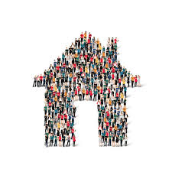
^{v6 …}And we are His house, if indeed we hold firmly to our confidence and the hope in which we glory.
*hold firmly to our confidence and hope = What is your confidence and hope?

Slide 12
V7 - 11
*When I speak to you – do not harden your heart!...as those in the wilderness with Moses for 40 years…
*They experienced My works and love…
*I was angry with them because their hearts were always going astray…
*None of them entered into My rest…

Slide 13
V12 - 14
12 *See to it = be determined
*that none of you has a sinful, unbelieving heart that turns away from the living God.
13 *But encourage one another daily,…
14 * We share in Christ, if we indeed hold firmly to our original conviction = Jesus is the Messiah, Son of God, died and rose again to forgive all our sins, is at the right hand of the Father, and will return as our reigning King!

Slide 14
V16 - 19
^{16 …}They heard and rebelled…
¹⁷ And He angry with the Israelites in the desert for forty years…
¹⁸ And God promised that they would never enter His rest because they disobeyed
¹⁹ So we see that they were not able to enter, because of their unbelief.
*They did not enter His rest = Rest = eternal life of peace in His presence

Slide 15
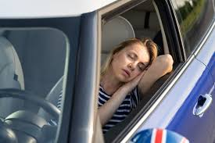
4:1 (a) Therefore, since the promise of entering His rest still stands,…”
This is how Juri found me one day in our driveway after a very hard day at work…
Deeply resting – home finally!

Slide 16
Final points to think about…
*Fix your eyes on Jesus – He is your Apostle Who looks for you
*Jesus is greater than Moses – Moses was the servant who took care of His house – He is the builder!
*We are His house! He lives in us and we collectively are His house – confident in this, this is our hope!
*Encourage each other daily! Fix your eyes and thoughts on Jesus!

