Slide 1
Choices Made Clear
Hebrews 4: 1 - 13

Slide 2
The Promise (vv1-11)
4 Therefore, since the promise of entering his rest still stands, let us be careful that none of you be found to have fallen short of it. ² For we also have had the good news proclaimed to us, just as they did; but the message they heard was of no value to them, because they did not share the faith of those who obeyed. ³ Now we who have believed enter that rest, just as God has said,
“So I declared on oath in my anger,
‘They shall never enter my rest.’”

Slide 3

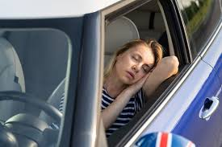
V1 = His promise of entering into His rest still stands:
“entering into His rest”= salvation!
Letting go of our sins = iniquities, transgressions, and infirmities
Freedom from the burden of carrying our weaknesses
Freedom from stress and weariness
Freedom from the fear of death
Complete release and peace
Some days – me after work, fall asleep in my car in the driveway at home…

Slide 4
This rest is for those who are obedient to the Lord’s word. That invitation still stands! Today! Still stands!
V2 = Be careful that none of you fall short of obedience!
You have had His word proclaimed to/shared with you
Yet, some people chose not to believe, His word had/has no value to them…
They did not share (accept/participate) the faith (belief that Jesus is indeed God’s Son, Who died for us, rose again and reigns with the Father and will return to reign – a new heaven and new earth). They made/make a conscience decision to NOT accept/value the gospel

Slide 5
And yet his works have been finished since the creation of the world. ⁴ For somewhere he has spoken about the seventh day in these words: “On the seventh day God rested from all his works.” ⁵ And again in the passage above he says, “They shall never enter my rest.”
⁶ Therefore since it still remains for some to enter that rest, and since those who formerly had the good news proclaimed to them did not go in because of their disobedience,
Gen 3: 15 = the plan of salvation was already in place…God rested from all His works…
This rest (salvation) STILL STANDS!

Slide 6
⁷ God again set a certain day, calling it “Today.” This he did when a long time later he spoke through David, as in the passage already quoted:
“Today, if you hear his voice,
do not harden your hearts.”
⁸ For if Joshua had given them rest, God would not have spoken later about another day. ⁹ There remains, then, a Sabbath-rest for the people of God; ¹⁰ for anyone who enters God’s rest also rests from their works, just as God did from his. ¹¹ Let us, therefore, make every effort to enter that rest, so that no one will perish by following their example of disobedience.
Today!
Make every effort to enter that rest – Choose Obedience!

Slide 7
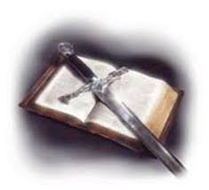
Consider… (v12)
For the word of God is alive and active.
Sharper than any double-edged sword, it penetrates even to dividing soul and spirit, joints and marrow; it judges the thoughts and attitudes of the heart.

Slide 8
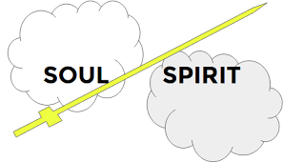
Spirit = breathe of God, life
Soul = who you are

Slide 9
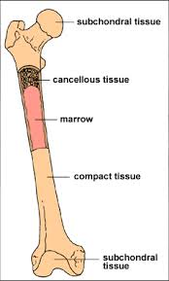
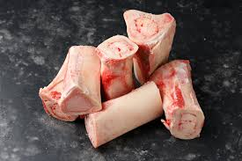
Divides joints (bones) from marrow…

Slide 10
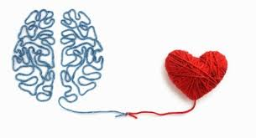
it judges the thoughts and attitudes of the heart…
Thoughts lead to values which leads to actions and attitudes
The human heart (soul) has the ability to be self-determined – has a will

Slide 11
V 13, “Nothing in all creation is hidden from God’s sight. Everything is uncovered and laid bare before the eyes of Him to whom we must give account.”
God sees everything, knows our heart, knows our thoughts
We must give an account
There is a day when we will give account of our thoughts, actions, and attitudes…

Slide 12

Consider:
*His promises still stand
*You choose
*Know we will give account

