Slide 1
A New Covenant
Hebrews 8: 1 - 13

Slide 2
The Main Point:
V1 & 2 – The main point has two parts:
a) We have a high priest, Who sat down at the right hand (position of highest power) of the throne of the Majesty in heaven
b) He serves in the sanctuary (holiest of holies) as a Mediator (Lawyer) for people
This sanctuary (sacred/holy place) is the holy place that God Himself set up – the place where He dwells

Slide 3

Tabernacle, Temple, Earthly Sanctuaries
V3 – 5, Earthly priests serve gifts and sacrifices in the earthly sanctuaries (like here in BDA) serving gifts, worship, praise, and etc. All these are “shadows” of His throne room…
The “real” = The throne room of God
The “shadow” = Tabernacle, Temple and Earthly Sanctuaries (various altars and places of worship)
Real
Reflection

Slide 4
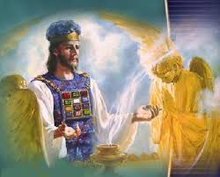
Jesus serves in the sanctuary, the throne room of God, He is superior to those of the past…v6
V8 God said, “The days are coming … when I (God) will make a new covenant…
V9 It will not be like the covenant I made with their ancestors … because they did not remain faithful to My covenant…”
*The writer of Hebrews uses “Suzerain-Vassal”/ “Royal Grant” for Covenant

Slide 5
Suzerain – Vassal Covenant
A royal grant, an unconditional promise, requiring no action from the beneficiary.
V7 “If the old covenant was working there would not have been a need for this new covenant…yet we were unfaithful…”

Slide 6
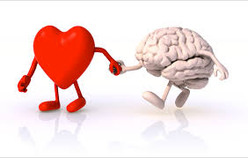
Jeremiah 33: 30 - 33 is quoted here:
V8 - 11 “The days are coming … when I (God) will make a new covenant. It will not be the same … because they did not remain faithful to My Covenant. The new covenant I will establish … will be written on their minds and written on their hearts and I will be their God and they will be My people. No longer will they have to teach others about Me because all (everyone) will know Me!”
New Covenant
Written on our heart and mind

Slide 7
Jeremiah 33: 30 – 33 continued:
V12 “I will forgive their wickedness and will remember their sins no more.”
V13 “By calling this new covenant “new” – the old is obsolete and outdated and will soon disappear.”

Slide 8
4 points to grab…
We have an eternal High Priest – Jesus, TODAY, is representing us before the throne, declaring we are His because of faith, obedience, and His blood
The Tabernacle, Temple, Houses of Worship is only a shadow of the Throne room and His glory
The New Covenant is written on our heart and mind – “I will be their God and they will be My people”
Our sins are forgiven and removed as far as the east is from the west (Psalms 103:12)…NEVER to be held against us!

Slide 9
