Slide 1
Culmination – Paid In Full!
Hebrews 9

Slide 2
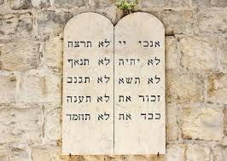
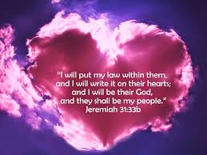
V1 The first covenant (‘suzerainty’ treaty = the Creator unconditionally provides for the receiver) designed with regulations and an earthly sanctuary
(Tabernacle & Temple)
Now the law is the law of love and the sanctuary is in each heart and we, as believers, are the sanctuary of praise and worship. As we gather together, the believers create the ‘church’ – sanctuary of worship to the Lord Jesus

Slide 3
V2 – 5, “A tabernacle was set up. In its first room were the lampstand and the table with its consecrated bread; this was called the Holy Place.
Behind the second curtain was a room called the Most Holy Place, which had the golden altar of incense and the gold-covered ark of the covenant. This ark contained the gold jar of manna, Aaron’s staff that had budded, and the stone tablets of the covenant.
Above the ark were the cherubim of the Glory, overshadowing the atonement cover.”

Slide 4
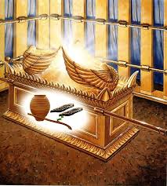
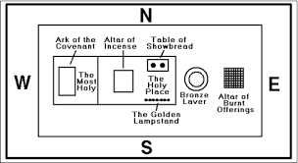
V 2 - 5
Lamp stand, Table of Bread & Altar of Incense
Tabernacle
*The Ark of the Covenant & Mercy Seat of God: Manna = His provision; Laws = guidance to right living; and Aaron’s blooming rod = life rising from the dead and dry branch
*Cherubim & Mercy Seat = God’s glory
Jesus: Light of the world, bread – His body and the New Covenant, Incense = our worship & praise

Slide 5
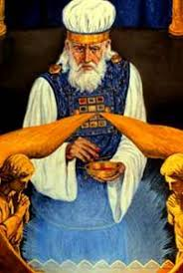
V6 – 10: The High Priest would enter the Holiest of Holies with blood to cleanse his and the people’s sins ... Sins done often in ignorance...
These gifts and sacrifices could not clear the worshipper’s conscience...external regulations ... Until the new covenant came...
Conscience: the inner feeling/sense/voice acting as a guide to the rightness or wrongness of one’s behavior

Slide 6
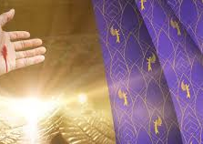
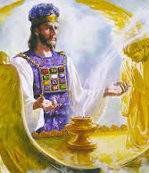
v 11 - 15
Jesus enters the eternal Tabernacle
Because of this...Jesus is the Mediator of a New Covenant.He died as a ransom to make us free!
Jesus enters by His own eternal blood, obtaining eternal redemption. Cleansing our conscience from sin & guilt

Slide 7
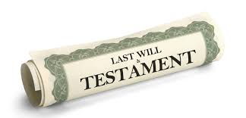
Example of a Will - v16 – 23
A will does not become ‘active’ until the owner of the will dies...
V22, “Without blood shed, there is no forgiveness”
*Without the death of the owner of the will, the will remains closed!

Slide 8
V24
- 28
“For Christ did not enter a sanctuary made with human hands (made as a copy of the true one); He entered heaven itself, now He appears for us in God’s presence.
High Priests enter the Tabernacle yearly, Christ now enters ONCE and FOR ALL!”
V26 - 28, “...He appears (in Heaven) once for all the culmination of the ages to do away (take away) with sin by the sacrifice of Himself... to bring salvation to those who are waiting for Him.”
Culmination: the highest point of something – especially as attained after a long time (from Adam & Eve on...)

Slide 9

3 Major Points:
The Tabernacle/Temple and High Priests’ duties were a ‘shadow’ of the real – the spirit world is REAL
A Will requires the death of whose will it is
Jesus entered the ‘real’ Tabernacle (the presence of God) once and for all offering His cleansing blood for the culmination of sins – the conscience is cleansed and set free! Guilt free!

