Slide 1
“Thow off everything that hinders...”
Hebrews 12: 1 - 3

Slide 2
Hebrews 12: 1 - 3
V1 – 3: “Therefore, since we are surrounded by such a great cloud of witnesses, let us throw off everything that hinders and the sin that so easily entangles. And let us run with perseverance the race marked out for us, ² fixing our eyes on Jesus, the pioneer and perfecter of faith. For the joy set before Him He endured the cross, scorning its shame, and sat down at the right hand of the throne of God. ³ Consider Him who endured such opposition from sinners, so that you will not grow weary and lose heart.”

Slide 3
“The cloud of witnesses surrounding us...” Bad hermeneutics (bad interpretation of Bible): picture of believers living in a football stadium and the believers who finish died are watching us live on earth. They see everything we do...
Let’s put it back in context (Heb 11): We are not the first to live by faith, look at Abel, Enoch, Noah, Abraham, Sarah, Isaac, Jacob, Joseph, Moses, Israelites crossing the Red Sea on dry ground, the fall of Jericho, Rahab...
“What shall I (writer of Heb) say!?!”
“Look at Gideon, Barak, Samson, Jephthah, Samuel, David and all those who died before”...even today: Charlie Kirk, Nigeria, China, Indonesia... These are all witnesses determined to live by faith through obedience.

Slide 4

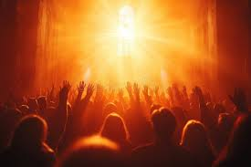
“The cloud of witnesses surrounding us” from the beginning of time through now!
They/we are witnesses of His justice, mercy, and grace.
Because we join the multitudes of believers ...
“let us throw off everything that hinders and the sin that so easily entangles.”

Slide 5
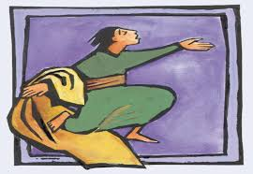
“let us throw off everything that hinders...” Pictured in Mark 10: 46 – 52
Jesus walking near Jericho, Bartimaeus is sitting at roadside.
He hears it is Jesus and shouts, “Have mercy on me!”
The crowd rebuked him – he shouted even louder
Jesus called for him, Bartimaeus threw off his cloak, jumped up and ran to Jesus.
Jesus asked, “What do you want me to do for you?”
“I want to see!”
Jesus said, “Go, your faith has healed you...”
Blind Bartimaeus

Slide 6

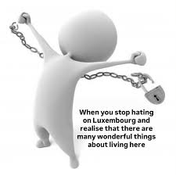
V2 “and the sin that so easily entangles.”
Throw off things that block you from Jesus and throw off sin that so easily entangles.
Throw off transgressions = making choices we know are wrong – STOP – you choose
Throw off what entangles us = infirmities (hurts, insecurities, things that steal our attention away from Christ)
What is stealing your joy? What is your cloak? What is causing you to look away from Jesus?

Slide 7
Bartimaeus jump up and ran to Jesus – see his heart = he knew his need, had faith that Jesus could and would meet his need, dropped what slowed him down (his cloak), jumped up and ran to Jesus.
Recognizing our needs (Blessed are the poor...Matt 5), stopping what blocks us from Jesus’ presence, confessed his need, and Jesus healed him
V1 “...And let us run with perseverance the race marked out for us...”
Perseverance: continue efforts to do or achieve something even though faced with difficulties, failure or opposition...keep going no matter!

Slide 8
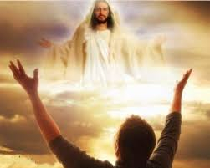
“...the race marked out for us...” Each life has a purpose designed by the Lord!
Jeremiah 29: 11, “ For I know the plans I have for you,” declares the Lord, “plans to prosper you and not to harm you, plans to give you hope and a future.”
“...fixing our eyes on Jesus, ...”
“fixing our eyes on Jesus”

Slide 9
“fixing our eyes on Jesus, the pioneer and perfecter of faith.” = Jesus is the pioneer (a person who is the first person to do something) of our faith
Jesus is the “perfecter” of our faith = It is Jesus Who helps us grow and improve...I Peter 1: 15, “But just as He Who called you is holy, so be holy in all you do; for it is written: ‘Be holy, because I am holy.’”
V2... “For the joy set before Him, He endured the cross, scorning its shame, and sat down at the right hand of the throne of God.”
“For the joy set before Him” = He knew His sacrifice would set us free from things that hinder/block us from Him and the sins that entangle/trap we can throw off!...This was His joy!

Slide 10
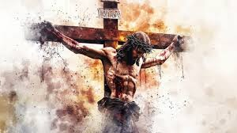
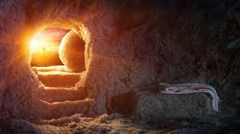
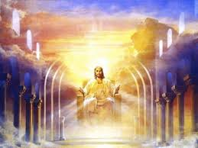
V2 For the joy set before Him (our salvation) he endured the cross, scorning its shame, and sat down at the right hand of the throne of God.

Slide 11
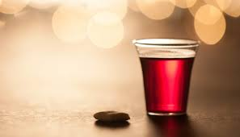
V3 “Consider Him, Jesus, Who endured such opposition from sinners, so that you will not grow weary and lose heart.”
What is your ‘cloak’ – block your time with the Lord?
What do you need to throw off so you can run to Jesus and keep your eyes fixed on Him?
Ponder/think: suffering for our sins was “joy” to Jesus because of our salvation...

Slide 12
Communion

