Slide 1


Discipline vs Punishment
Hebrews 12: 4 - 13

Slide 2
Hebrews 12: 4 - 13
⁴ In your struggle against sin, you have not yet resisted to the point of
shedding your blood. ⁵ And have you completely forgotten this word
of encouragement that addresses you as a father addresses his son?
It says,
“My son, do not make light of the Lord’s discipline,
and do not lose heart when He rebukes you,
⁶ because the Lord disciplines the one He loves,
and He chastens everyone He accepts as His son.”
(Prov. 3:11,12)

Slide 3
⁷ Endure hardship as discipline; God is treating you as His children. For what children are not disciplined by their father?
⁸ If you are not disciplined—and everyone undergoes discipline—then you are not legitimate, not true sons and daughters at all.
⁹ Moreover, we have all had human fathers who disciplined us and we respected them for it. How much more should we submit to the Father of spirits and live!
¹⁰ They disciplined us for a little while as they thought best; but God disciplines us for our good, in order that we may share in His holiness.

Slide 4
¹¹ No discipline seems pleasant at the time, but painful. Later on, however, it produces a harvest of righteousness and peace for those who have been trained by it.
¹² Therefore, strengthen your feeble arms and weak knees.
¹³ “Make level paths for your feet, so that the lame may not be disabled, but rather healed”.

Slide 5
Context: v1 - 3
V4 As you struggle with sin...whether sins you did or sins done against you... Context...
² Fixing our eyes on Jesus... For the joy set before Him He endured the cross, scorning its shame, and sat down at the right hand of the throne of God.
‘the joy set before Him’ = your freedom and forgiveness from sin
‘He endured’

Slide 6
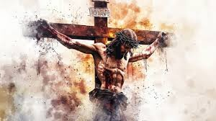
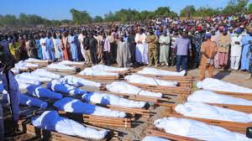
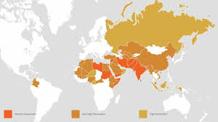
V 4 ...“you have not yet resisted to the point of shedding your blood.”
Nigeria a few months ago...
Worst areas of persecution today

Slide 7
⁵ And have you completely forgotten this word
of encouragement that addresses you as a father addresses his son? It says,
“My son, do not make light of the Lord’s discipline, and do not lose heart when He rebukes you,
⁶ because the Lord disciplines the one He loves,
and He chastens everyone He accepts as His son.”

Slide 8
A father disciplines his children – same the
Father discipline us...
V5 & 6
Do not take His discipline lightly (do not‘think nothing’) of His discipline
Do not lose heart – do not become discouraged – when He rebukes you
The Lord disciplines those He loves and chastens those He accepts as His own child
Ask, “What is the point/lesson of this?”

Slide 9
?Chastens? For for happen?
“To discipline, correct, or train with the goal of moral and spiritual improvement – understood as an act of love from God. Can include: rebukes, instruction, or unpleasant circumstances with the ultimate purpose of purification and bringing the person to a more humble and obedient life.”
The aim is NOT to punish but to correct and refine, set spiritual safety boundaries
End result is a more peaceful and righteous life...restraining a horse – One commentary calls ‘chasten’ a gift from God.

Slide 10
Boundaries are set to protect us not to punish us... Sometimes we feel like our ‘wings are clipped’ – can’t fly
V7 Endure hardships – they are tools to discipline/train us; God is treating us as His children
V8 If we are not disciplined by God – we are not legitimate children
V9 We have all had parents who have disciplined us – when we mature we respect them for guiding us as we grew
V10 God disciplines us for our own good

Slide 11
(V12 & 13 written in medical terms)
V11 It is not pleasant for a while but later discipline produces a harvest of righteousness and peace for those who were trained... Sanctification = growing into being holy as He is holy (I Peter) – growing and becoming righteous...this produces a life of peace
V12 Strengthen your weak arms and knees – arms = your ability to serve and knees = your ability to move on doing what He wants you to accomplish

Slide 12
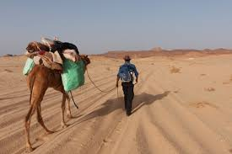
(V12 & 13 written in medical terms)
V13 Make level paths for your feet = make the path obvious and free from obstacles...make ruts going the right way...
So the lame = those broken & give up
May not be disabled = blocked from succeeding
But be healed = those falling away will have hope because you have removed the barriers and obstacles

Slide 13
What do we see?...
The joy of our salvation was the motivation for Jesus to endure the beating and ultimately the crucifixcion
Discipline/training is safety boundaries for our spiritual growth
Now, it’s your turn to make growing in Jesus more walkable for those younger in faith than you

Slide 14
The Bridge Builder
An old man, going a lone highway,
Came at the evening, cold and gray,
To a chasm vast and deep and wide,
Through which was flowing a raging tide.
The old man crossed in the twilight dim;
The sullen stream had no fears for him;
But he turned when safe on the other side,
And built a bridge to span the tide.
“Old man,” said a fellow-pilgrim near, “Your journey will end with the closing day;
You never again will pass this way.
“Your journey will end with the closing day;
You never again will pass this way.
You’ve crossed this chasm deep and wide.
Why build you this bridge at eventide?”
The builder lifted his old gray head.
“Good friend, in the path I have come,” he said,
“There followeth after me today
A youth whose feet must pass this way.
This chasm which has been as naught to me,
To that fair-haired youth may a pitfall be;
He, too, must cross in the twilight dim;
Good friend, I am building this bridge for him.”

Slide 15
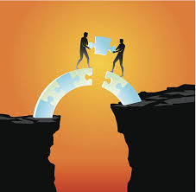

You decide...
Bridge Builder
or
Self-centered?

