Slide 1
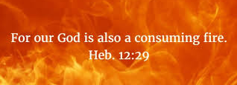
Hebrews 12: 14 - 29

Slide 2
¹⁴ Make every effort to live in peace with everyone and to be holy; without holiness no one will see the Lord.
¹⁵ See to it that no one falls short of the grace of God and that no bitter root grows up to cause trouble and defile many.
¹⁶ See that no one is sexually immoral, or is godless like Esau, who for a single meal sold his inheritance rights as the oldest son.
¹⁷ Afterward, as you know, when he wanted to inherit this blessing, he was rejected. Even though he sought the blessing with tears, he could not change what he had done.

Slide 3
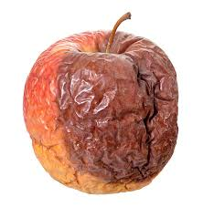
¹⁵ See to it that no one falls short of the grace of God and that no bitter root grows up to cause trouble and defile many.
“See to it...” = As believers, we are responsible to care and to act... encourage each other by words and deeds – when you see a brother or sister have wrong attitude or behavior – approach each other with care and help bring back to right path
“no bitter root...” = Deut. 29:18 says ‘turning away from the Lord produces a bitter poisonous root that produces a
poisonous fruit that spreads and poisons the whole
body’ – think of a rotten apple left in a basket...
‘bitter root’ = idolatry, something (attitude, etc.)
we go to in heart instead of to the Lord...

Slide 4
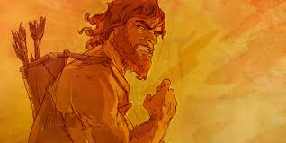
¹⁶ See that no one is sexually immoral, or is godless like Esau, who for a single meal sold his inheritance rights as the oldest son.
Immediate gratification vs Disciplined denial
Birthright = the sacred becomes profane
The Heir = receive 2/3 of everything left; became ‘Chieftain’ of clan; recipient of the Covenant and God’s promises to Abraham; the lineage of Jesus would be through his bloodline-sold for bowl of soup
¹⁷ ...begged for it back with tears ... But could not change what he had done –
Consequences
Gen 25

Slide 5
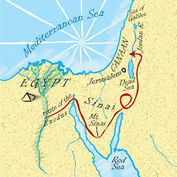
¹⁸ You have not come to a mountain that cannot be touched and that is burning with fire; to darkness, gloom and storm; ¹⁹ to a trumpet blast or to such a voice speaking words that those who heard it begged that no further word be spoken to them,²⁰ because they could not bear what was commanded: “If even an animal touches the mountain, it must be stoned to death.” ²¹ The sight was so terrifying that Moses said, “I am trembling with fear.”
Deut. 9 and Exodus 19
Mount Horeb and Mount Sinia are same
Where God met with Moses and wrote the 10 Commandments
Where Israelites built a golden calf and worshipped it – Moses threw down 10 Commandments
Anything/anyone who touched the mountain was killed – God’s holiness too powerful and pure...

Slide 6
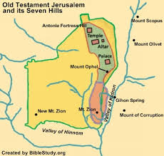
²² But you have come to Mount Zion, to the city of the living God, the heavenly Jerusalem. You have come to thousands upon thousands of angels in joyful assembly, ²³ to the church of the firstborn, whose names are written in heaven. You have come to God, the Judge of all, to the spirits of the righteous made perfect, ²⁴ to Jesus the mediator of a new covenant, and to the sprinkled blood that speaks a better word than the blood of Abel.
Mt Zion – where redemption happened, where Jesus died and rose again – not of fear BUT freedom!
Jesus – the first born, not created but came from the Father – fully God (Colossians 1: 15)

Slide 7
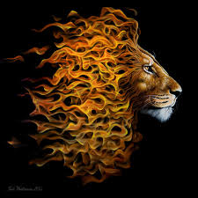
²⁵See to it that you do not refuse Him Who speaks. If they did not escape (OT Israelites) when they refused Him who warned them on earth, how much less will we, if we turn away from Him Who warns us from heaven? ²⁶At that time His voice shook the earth (Mt. Sinai), but now He has promised, “Once more I will shake not only the earth but also the heavens.” ²⁷The words ‘once more’ indicates the removing of what can be shaken – that is, created things – so that what cannot be shaken may remain.
²⁸Therefore, since we are receiving a kingdom that cannot be shaken, let us be thankful, and so worship God acceptably with reverence and awe, ²⁹for our “God is a consuming fire”.

Slide 8
What do we see...
Make every effort to live at peace with everyone and be holy
See to it that no one falls away
Remember Esau...consequences... He was forgiven, but did not get back what he lost
Mt. Sinai & Mt Zion – He is still a consuming fire! He is a holy God!

