Slide 1
The 4 Noted Ladies in Jesus’ Lineage
Matthew 1: 1-16 and Luke 4: 23-38

Slide 2

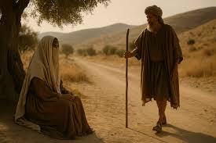
Gen 38 Judah & Tamar Their story: Judah, father of Er, Onan, and Shelah. Tamar marries Er - the Lord puts him to death and also Onan...Shelah is still a child...Judah tells her to wait...many years pass and Judah refuses to give Shelah to Tamar...

Slide 3
Levirate Marriage Law: If a husband dies without a son to carry his name and inheritance, the husband’s brother is required to have a son with his sister-in-law to produce a namesake for the brother who died. This happened twice to Tamar! Er’s brother (Onan) was extremely wicked (as Er was) and God put both of them to death... Tamar is a widow without a son/child

Slide 4
Years past and Shelah is grown but Judah refuses to give him to Tamar. Tamar has lived as a widow for several years... When Judah goes to another town to sheer sheep, Tamar (dressed as a prostitute) meets him. His wife had recently died, he asks to lay with the prostitute (not knowing she is Tamar, his daughter-in-law). Judah gives Tamar his belt and shield as “payment”. Tamar is found pregnant and Judah orders her death...

Slide 5
Tamar, 3 months pregnant, confesses who the father of this child is by showing Judah his belt and shield. V26 Judah immediately stops the penalty of death and declares, “she is more righteous than I...” More ethically right than Judah – fulfilling the Levirate Law at the cost of her life and reputation... Tamar gave birth to twin boys: Zerah and Perez King David is a direct descendant of Perez, whom Jesus is a direct descendant.

Slide 6
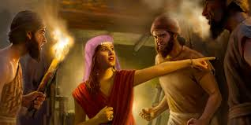
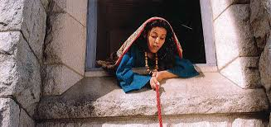
Joshua 2 & 6 – Rahab the prostitute in Jericho Joshua sends 2 spies to Jericho and they go to the prostitute’s house ... Rahab responds by saying, “I know that the Lord has given you this land and that great fear of you has fallen on us...our hearts are melting with fear...we have heard of the Red Sea splitting and you walking on dry land...our hearts melted because the Lord, your God is God!...

Slide 7
Rahab believed in God and had faith that God would spare/save her and her family Josh 6: 25, “...Joshua spared/saved Rahab the prostitute, with her family and all who belonged to her, because she hid the men Joshua had sent as spies to Jericho - and she lives among the Israelites to this day.” Matt 1: 5 tells us that Rahab is the mother of Boaz... Boaz married Ruth...they become the great grandparents of King David...an ancestor of Jesus!

Slide 8
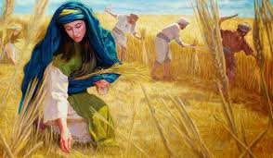
The Book of Ruth – Ruth Time the Judges: religious and moral failure ruled Starts in Bethlehem – “the house of food.” The Family: Elimelek – “My God is King” Naomi – “sweet, my joy” Mahlon – “weakling’ Kilion – “frail person”

Slide 9
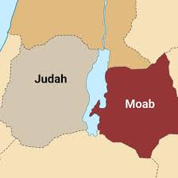
Famine destroys the region of Israel so Elimelek takes his family to Moab Mahlon marries Ruth...Elimelek, Kilion, and Mahlon die... Naomi decides to return to Bethlehem – the famine is done... Ruth states, “...your (Naomi’s) God will be my God...I will return with you...”

Slide 10
Ruth gleans wheat in Boaz’s fields – not knowing he is a relative of Naomi... Kingsman Redeemer: Boaz is touched by Ruth’s sacrifices and noble character, he meets with the town elders asking to become the owner of Elimelek’s property...comes with Ruth as his wife They are married and give birth to Obed... Obed is Jesse’s father... Jesse is King David’s father... King David the promised direct family line of Jesus our Lord and Savior...

Slide 11
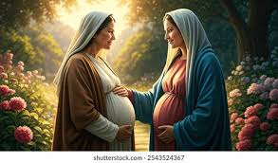
Lineages of Jesus – Matthew’s and Luke’s: Matt 1, starts with Abraham goes to Joseph (the husband of Mary – not the father of Jesus – v16) Identifies Jesus’ legal rightful royal claim as Messiah Luke 4: 23 – 38, starts with Joseph to Adam. Traces Jesus’ lineage through Nathan (Solomon’s brother) – Mary is his descendant...

Slide 12
Joseph is the son-in-law to Heli – Heli is Mary’s father... Mary’s mother is a Levite and father from Judah’s line Her cousin, Elizabeth, a Levite, is John the Baptizer’s mother...Elizabeth is 6 months pregnant when Mary goes to visit with her. (Luke 1 – 2) Gabriel visits Mary, Luke 1:34, “how...I am still a virgin...” v38, “I am the Lord’s servant...May it be to me according to your word...”

Slide 13
We learned... 1) Tamar – do what is righteous no matter the cost, honor the Lord 2) Rahab – heard about God and believed – even at the possible cost of her own life 3) Ruth – serve the Lord and others, live the fruit of the Spirit 4) Mary – Live an obedient life

Slide 14
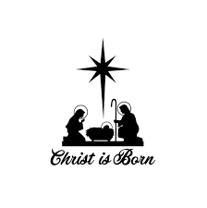
There were many sacrifices bringing us to Christmas and on to Easter – Jesus, our crucified and risen Lord...

Slide 15
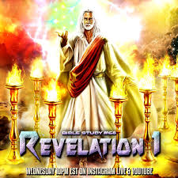
No longer a ‘babe in a manger’ Jesus Christ is our soon coming King Merry Christmas as we celebrate His first coming while looking forward to Jesus’ Second Coming!

