Slide 1
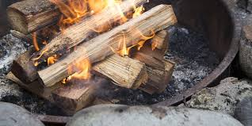
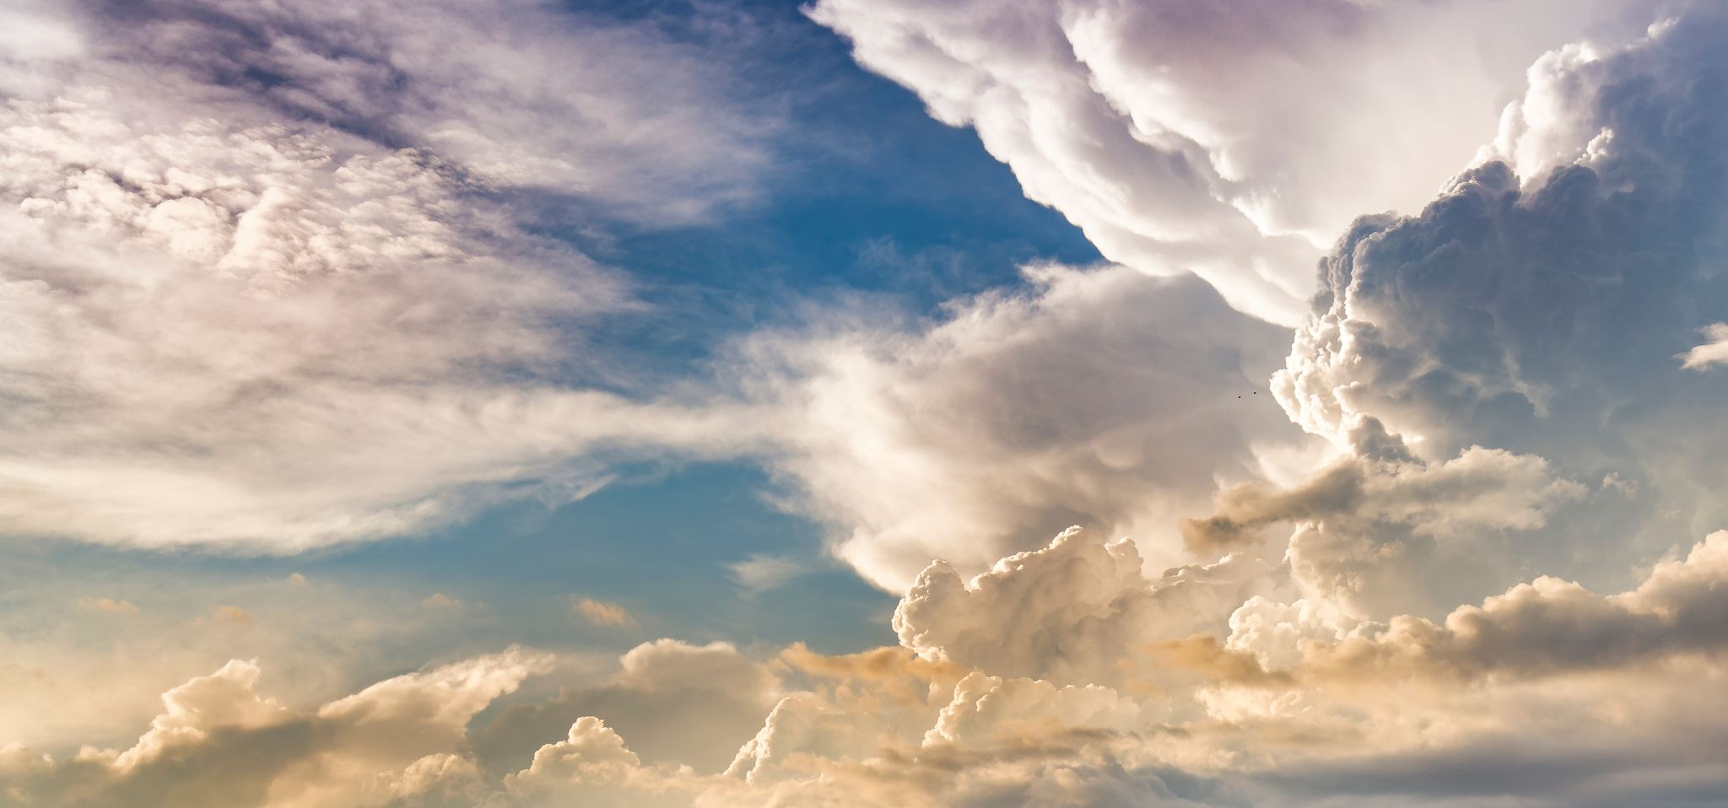
“...like a burning stick snatched from the fire...”
Zechariah 3: 2

Slide 2
Background History:
586 bc Babylon destroys Jerusalem and Solomon’s Temple
539 bc Babylon falls to Persia – King Cyrus
538 bc Zerubbabel (David’s line) – Governor & Joshua – High Priest appointed by King Cyrus (Ezra – the Temple & Nehemiah – Jerusalem wall)
535 bc Temple’s new foundation laid, feasts started again
530 bc Xerxes I (Esther’s story) stops the rebuilding – stopped for 18 yrs
520 bc Darius (new Persian King)
522 bc Zerubbabel & Joshua ask Darius to review Cyrus’ decrees, he blesses Israel with money and protection and encourages the rebuilding of the Temple

Slide 3
Zech 3: 1 – 9
V1 Then he showed me Joshua the High Priest standing before the angel of the Lord, and Satan standing at his (Joshua) right side to accuse him (Joshua).
V2 The Lord said to Satan, “The Lord rebuke you, Satan! The Lord, Who has chosen Jerusalem, rebuke you! Is not this man a burning stick snatched from the fire?”
V3 Now Joshua was dressed in filthy clothes as he stood before the angel.
V4 The angel said to those standing before him (Joshua), “Take off his filth clothes,

Slide 4
V4 continues...Then He said to Joshua, ‘See I have taken away your sin, and I will put fine garments on you.’”
V5 Then I (Zech) said, “Put a clean turban on his head.” So they put a clean turban on his head, while the angel of the Lord stood by.
V6 The angel of the Lord gave this charge to Joshua,
V7 “This is what the Lord Almighty says, ‘If you will walk in obedience to Me and keep My requirements, then you will govern My house and have charge of My courts, and I will give you a place among these standing here.’

Slide 5
V8 “Listen, High Priest (Joshua), you and your associates seated before you, you who are symbolic of things to come, I am going to bring My servant, the Branch (of David)...
V9 And I will remove the sin of this land in a single day...”

Slide 6
V8 – 9 Last week, we looked at the 4 ladies who were in the lineage of King David: Tamar – called a prostitute; Rahab – a prostitute; Ruth – a Moabite widow; and Mary – a yielded virgin. Each obedient to the Lord and who helped Zech 3: 8 become a reality... Jesus, born of a virgin – a branch (from the line) of David!
Each individual carrying scars of life’s unfair treatment; yet each life reflecting God’s grace and mercy.

Slide 7
Here we are...the last Sunday of 2025
Each of you have a stick – a symbol of your life
Fire reshaped the stick...to be what it is today...
Turn to a person you will pray with
Share your fire story...what has changed you this year...how are you different from 2024 ... then pray together...

