Slide 1


Life is just not fair!!!
Ruth 1

Slide 2
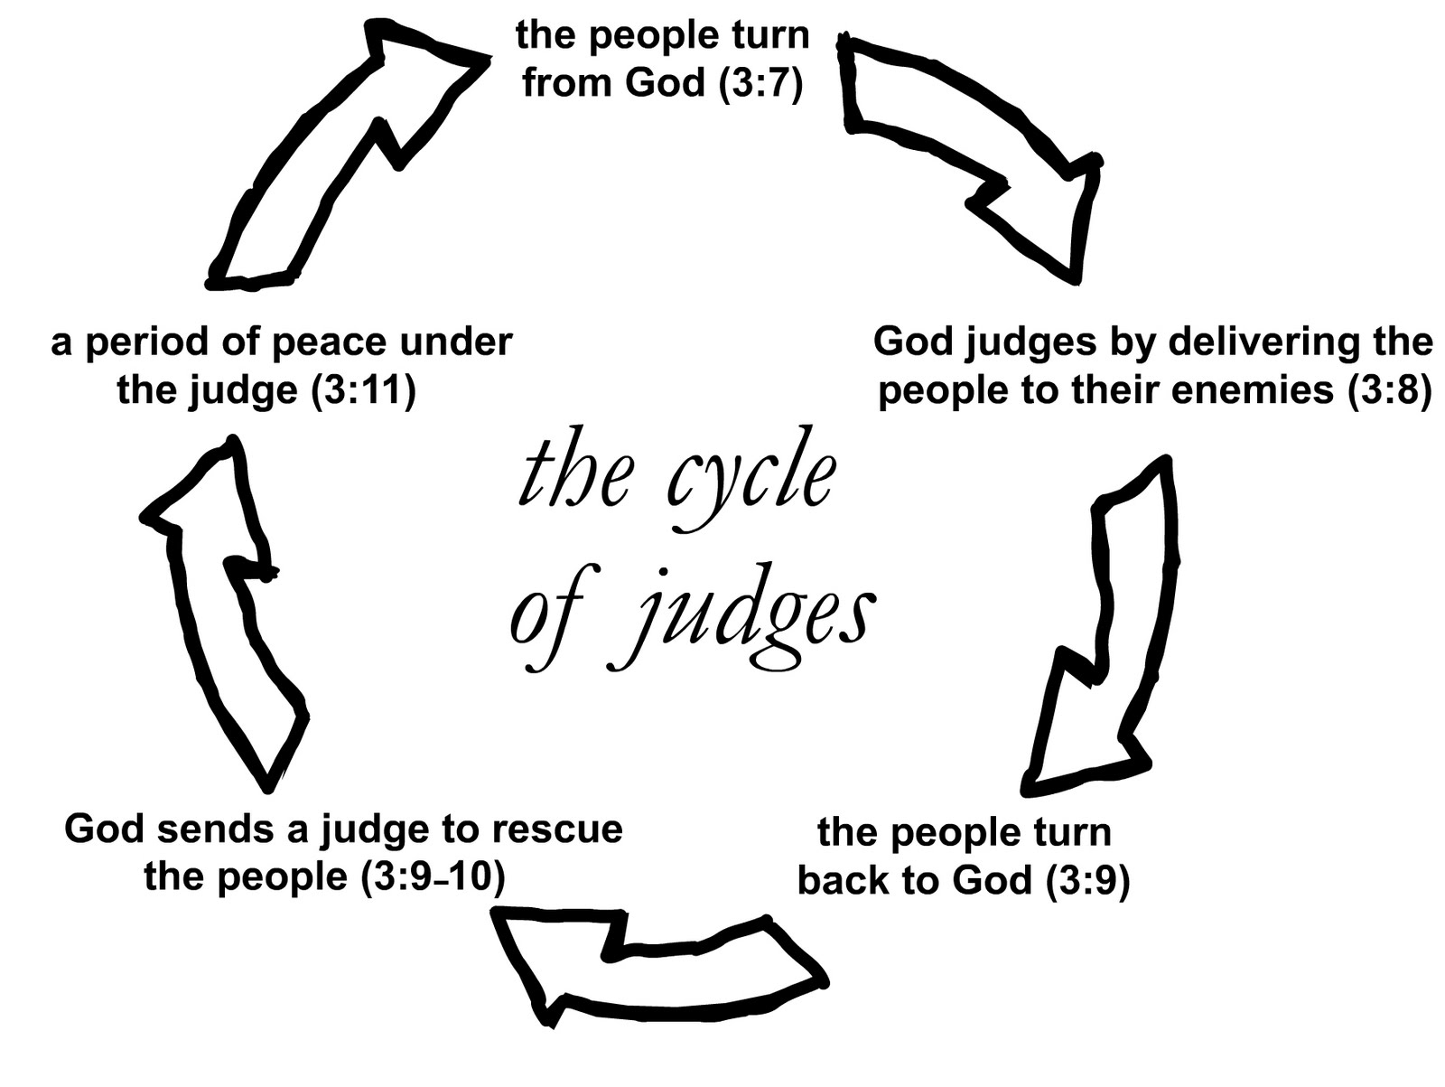
Judge named Ehud – 1284 to 1204bc
#1. Again, when Othneil died, Israel turned away from God (Judges 3:12-30)
#2. 3:12 – 14: God sends King Eglon (the Moabite King) to oppress Israel 18 years.
#3. They cry out to the Lord for help and repented
#4. God sent Ehud (v15-19) who killed King Eglon.
#5. Israel struck down the nation of Moab, Moab was subject to Israel for over 80 years...Israel has peace for 80 yrs. (Ruth)
#1
#2
#5
#3
#4

Slide 3
Ruth 1: 1 “in the times of the judges”... Judges were Tribal Leaders. Israel had 12 ‘states’ from the 12 sons of Jacob. Became 12 states after Joshua helped to bring them into the Promise Land...during Ehud’s 80 years of leadership, we meet:
Elimelech = “My God is King” He is from the royal blood line of Judah. His brother, Salmon, is called, ‘the Prince of the Tribe of Judah’.
Naomi = “Pleasant and beautiful” – her name was not identifying her personality – it was describing the State of Judah’s relationship with God.
Mahlon = “Tender and forgiving” – sometimes interpreted as ‘soft and sickly’
Chilion/Kilion = “To be complete or perfection” - fragile

Slide 4
This family was identified as “Ephrathites”. Ephrath was an early name for Bethlehem. To be called an ‘Ephrathite’ was meant to identify your social status. Deaf World, we say s/he is ‘DEAF’ or ‘Deaf’ or ‘oral’...
Elimelech’s family would be ‘DEAF’ – not physical/culturally Deaf – but a ‘pure bred’
V1&2 A famine consumed the country/State of Judah, Elimelech took his family (Naomi, Malhon, and Kilion) to the neighboring country of Moab. Remember Ehud and the 80 years of peace, Moab subject to Israel
V3 Elimelech dies
V4&5 Malhon marries Ruth and Kilion marries Orpah (Moabite women)

Slide 5
V5 After 10 years, Naomi was left without a husband, without her two sons, and two Moabite daughters-in-law ... No grandchildren...
V6 Naomi learns the famine in Bethlehem is over and the Lord is blessing His people and Naomi decides to return home to Bethlehem
V7-10 Both daughters-in-law start returning with Naomi, however Naomi tells them, “Go back to your mothers’ homes...May the Lord grant that each of you will find rest in the home of another husband.” They wept together and beg to stay with Naomi.
Cultural picture: New blouse from Macy’s = virgin VS a blouse from Good will = a young widow...

Slide 6
Levirate Law expressed:
V11-14 Naomi says, “Why return? I am too old to have another son for you to marry...even if I gave birth today, would you stay unmarried as widows until they grow? No! It is more bitter for me than for you, because the Lord has turned His hand against me!”
They wept together and Orpah left but Ruth clung to Naomi
V15 Naomi said, “Look, your sister-in-law left...”

Slide 7
V16-17 Ruth responds, “Don’t urge me to leave you...
Where you go, I will go
Where you stay, I will stay
Your people will be my people
And your God will be my God
Where you die, I will die and be buried
May the Lord deal with me, be it ever so severely if even death separate you and me.”
V18 Naomi realized that Ruth was determined to go with her and she stopped urging Ruth to leave
V19 They arrived in Bethlehem and the whole town was stirred saying, “Could this be Naomi?”

Slide 8
V20-21 “Don’t call me Naomi (pleasant), call me Mara (bitter) because the Almighty has made my life bitter. I left full but the Lord has brought me back empty...the Lord has afflicted me and brought misfortune upon me.”
V22 Naomi returned from Moab accompanied by Ruth, the Moabite daughter-in-law, arriving during the beginning of the barley harvest.

Slide 9
Life is just not fair!!!
Elimelech and Naomi lived righteous lives
Elimelech, Mahlon, and Kilion die
Naomi goes from a wife and mother of 2 sons to becoming a widow without grandchildren after 10 yrs
Orpah and Ruth go from being wives of the Princes of Judah to ‘used throw away rags’ – widows
Elimelech – “My God is King” to dead/abandoned
Naomi – “Pleasant relationship with God” to “bitter and hopeless”
Does this change Who God is?

Slide 10
No! God’s Word Responds:
Ps 23: 4, “Yes, though I walk through the valley of the shadow of death, I will fear no evil, because You are with me.”
Jeremiah 29:11, “For I know the plans I have for you”, ‘declares the Lord’, “plans to prosper (bless) you and not harm you, plans to give you hope and a future.”
Hebrews 13:8, “Jesus Christ is the same yesterday, today, and forever.”

Slide 11
Yes! Life is just NOT fair!
BUT
Our God is greater! He stays with us no matter what we go through and He is committed to bring us hope and a future!

