Slide 1
“He (our Kinsman Redeemer) will not rest...”
Ruth – Chapter 3

Slide 2
Chapt. 1: “Life is not fair” – God is working even when we don’t understand Chapt. 2: Jehovah Jireh: Our God provides – He is the same yesterday, today, and forever
Chapter 3 He will not rest...
V1 Naomi states her motive: “I must find a home for you, where you (Ruth) will be provided for...” Boaz is our family guardian/kinsman redeemer (2:20):
Kinsman Redeemer/Family Guardian: Role: Legal Obligation: (Lev 25) to protect the vulnerable family
Responsibility: buy back the family land & marry deceased relative’s widow to raise up an heir so the deceased’s name will not be lost
Requirement: be a close relative, willing, and financially able to perform the transactions.

Slide 3
Jewish Encyclopedia (M. Jastrow, B. Eerdmans, and L. Ginzberg): Boaz was 80+ years old and Ruth was in her late 30’s – early 40’s. In their research, they state that Boaz died a few days or the day after their wedding night.
Boaz’s commitment would require him to: 1) Protect and provide for both Naomi and Ruth 2) He would be expected to buy back Elimelek’s land – sold during the famine 3) Marry Ruth to provide a legal heir for Naomi
V2 Naomi continues her instructions to Ruth: Boaz will be winnowing barley on the threshing floor.
V3 Go get cleaned up and go to the threshing floor, be sure no one sees you (Ruth)
V4 Notice where he lies down, then go and uncover his feet and lie down. When he awakes, he will tell you what you must do.
V5-6 Ruth replies that she will do everything Naomi instructs her to do

Slide 4
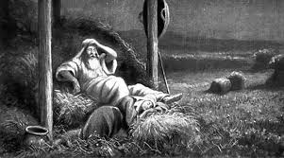
V7-8 Boaz finishes what he is doing, lies down near the pile of barley and falls asleep. Ruth lies down at his feet. In the middle of the night, Boaz wakes up and discovers a woman at his feet...he is ‘startled’ or ‘panics’
V9 Boaz asks, “Who are you?” Ruth responds, “Your servant Ruth, please cover me with a corner of your garment for you are our family guardian.”
V10 Boaz: “The Lord bless you, my daughter. This kindness is greater than what you’ve shown earlier! You could have gone after a younger man”... Boaz is in his 80’s and Ruth in her late 30’s – early 40’s.

Slide 5
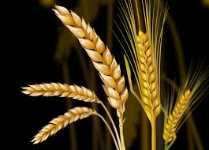
Wheat – no “hair” Barley – seorah = hair...a symbol of awareness of sin. Lev 23 uses a ‘hairy goat’ as the sin offering & barley in the Feasts of First Fruits. I Cor 15, Paul says that Jesus’ sacrifice satisfied the First Fruits Feast through His resurrection
V11-13 Boaz tells Ruth not be be afraid, everyone knows how noble you (Ruth) are, stay until morning and he will talk with the closer family guardian and if he wants to redeem Naomi’s property – then so be it, but if not...I will (Boaz will).
V14 Ruth stayed the night and left early dawn – no one can recognize her...protects their reputation
V15 Boaz poured 6 measures of barley into her shawl, ties it on Ruth, then he goes to town.
6 measures = man’s labor – telling Naomi that her work is complete, Boaz will do the rest...
barley – not wheat – Lev 23 barley is used for the Feast of First Fruits – I Cor 15 = the resurrection
B
A
R
L
E
Y
wheat

Slide 6
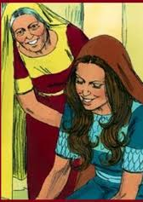
V16-17 Ruth tells Naomi everything, Boaz gave Ruth the barley as a sign for Naomi to ‘rest’... He sent Ruth with the barley so Naomi would not be empty handed...The Lord heard Naomi’s prayers. V18 Naomi said, “Wait...until you find out what happens. For this man (Boaz) will not rest until the matter is settled today.”

Slide 7
Who is your Kinsman Redeemer? He offered Himself for us as our barley sin offering... The rose from the dead, I Cor 15, as the First Fruit of the Resurrection... He will not rest until the fullness of our salvation is completed – when we, too, will be resurrected and live with Him eternally!

