Slide 1
Ruth 4
“It is settled!” (4: 11- 12)
“It is finished!” (John 19:30)

Slide 2
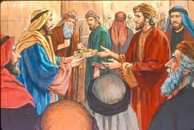
V1-2 Boaz goes to the city gate The family guardian goes pass & Boaz calls him for a meeting Boaz gathers 10 city Elders – official meeting V3-5 Naomi wants to sell Elimelek’s land. Boaz suggests to the Family Guardian – buy the land, you are the closest Redeemer– if you do, so be it; if not, I will...he responds, “I will”...

Slide 3
Terms of Redemption: v3-6
Purchase the land from Naomi
Marry Mahlon’s widow, Ruth, a Moabite
Produce a son so that Mahlon’s name would not be lost in history
The ‘first in line’ tells Boaz, “Then I cannot ... It might endanger my own estate. You redeem it yourself, I cannot do it.”

Slide 4
“It might endanger my own estate...”
Problem: He would have to use his own money from his funds to buy property that would not be his officially...would belong to Ruth’s child in the name of Mahlon
He already had a wife and did not want to disturb that marriage

Slide 5
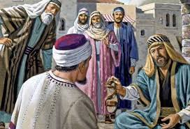
Legal Transactions Settled
V7-10 Sandles were exchanged and Boaz announces, “You are my witnesses ... I will take Ruth, Mahlon’s Moabite widow as my wife, so his name will not disappear...”

Slide 6
The Elders rejoice (v11-12)
“We are your witnesses. May the Lord make the woman coming into your home like Rachel and Leah, who built the House of Israel. May you have the standing of Ephrathah and may you be famous in Bethlehem...may your family be like that of Perez, Tamar and Judah’s son.”

Slide 7
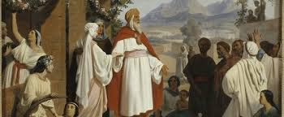
V13-18 Boaz took Ruth as his wife and the Lord allowed her to conceive a son...Obed, the father of Jesse, Jesse the father of David.
Jewish Encyclopedia says Boaz died either on their wedding night or a few days later...

Slide 8
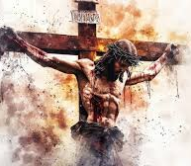
Boaz was determined to not rest until this matter – Naomi and Ruth’s situation be redeemed... John 19:30 records another Kinsman Redeemer Who determined to not rest until all was finished... Jesus cried, “It is finished”...

Slide 9
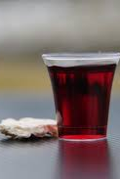
Communion

