Slide 1


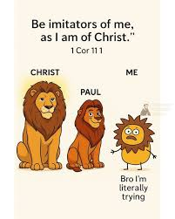

Imitate (copy) Christ I Thessalonians Chapter 1

Slide 2
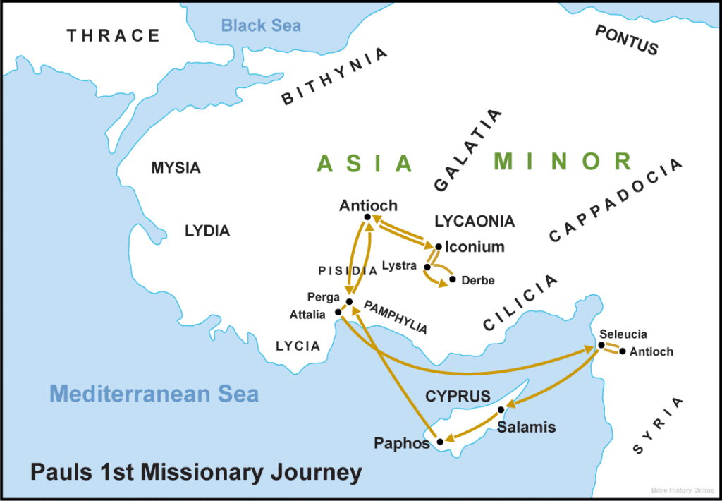
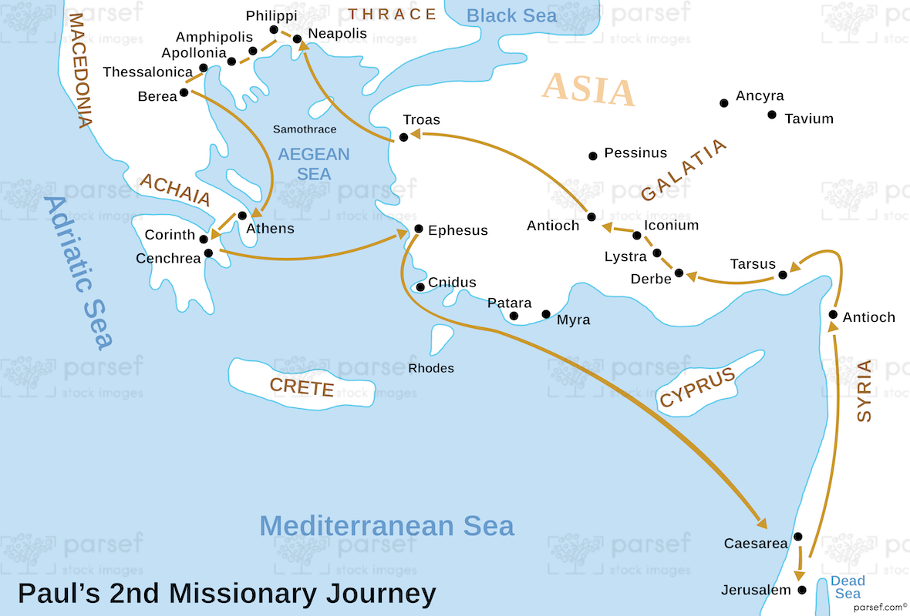
Background:
Paul wrote I Thessalonians after his 2nd Missionary in 51 ad while in Corinth – town named Thessalonica – in Macedonia (Greece area)
Church was mostly non-Jews/ Gentiles
Silas & Timothy with Paul
Silas sent with Paul (Acts 15:22)
Timothy joined in Lystra (Acts 18), mother-Jewish, father-Greek, met Paul during Paul’s 1st Journey
z

Slide 3
When Paul, Silas, and Timothy preached in Thessalonica, persecution against them and the gospel hit hard – They fled to Berea.
Persecution hit in Berea, Paul fled to Athens, Silas went to Philippi and Timothy stayed in Thessalonica
Paul went to Corinth, Silas and Timothy rejoined him
Paul wrote I Thessalonians from Corinth (51ad)

Slide 4
Theme: Encouragement during persecution and eschatology – end times
Purpose:
Encourage new believers; praise their courage in persecution; and give assurance as to the future of believers who die before Jesus’ 2nd coming

Slide 5
V1 Grace and peace to you: Grace = undeserved, unearned love and
Peace = knowing He is in control no matter circumstances
V2 We are always thankful for you and constantly pray for you
Essentials for Intercessory Prayer (Emily Franklin):
Thank God – praise time
Cleanse your heart (Ps 51...“search me, Lord...”)
Invite the Holy Spirit
Focus – remove distractions
Rebuke the enemy
Ask the Holy Spirit to speak to you
Wait to hear from Him – a verse, a thought, etc...write it down
End in praise

Slide 6
V 3 Faith produces good works
Love prompts your willingness to service
Hope in Jesus inspires endurance
V4 “Brothers and sisters” = 28xs and you are loved and chosen by God!
V5 How do we know? “The Word came to you with power and deep conviction in the Holy Spirit.”

Slide 7
V6 You watched our lives, you imitated our lives and the life of Jesus – you followed our examples You welcomed His Word - with joy - in the midst of severe persecution V7 You became a model to all believers V8 His message ‘rang out’ from your lives, everyone knew about your changed life! V9 We didn’t have to explain or share about your life...they already “heard” about your faith in Jesus!
z

Slide 8
V10 They (non-believers) tell us how you’ve changed – turned away from idols; they tell us you now serve Jesus; and they tell us you are waiting for Jesus to return!
This is what we see...

Slide 9
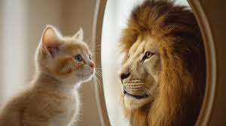
This is what He sees!
We know we ARE loved by God!
Do non-believers notice you not same as before or you not same as others who not believe in Jesus?
Do we pray (in heart tears) for others?
Does your faith produce good works; love prompts service; and hope inspire others to keep their faith in Christ?

