Slide 1
Persecution Expected, Worth it – Because of You!
I Thessalonians; Chapters 2 & 3

Slide 2
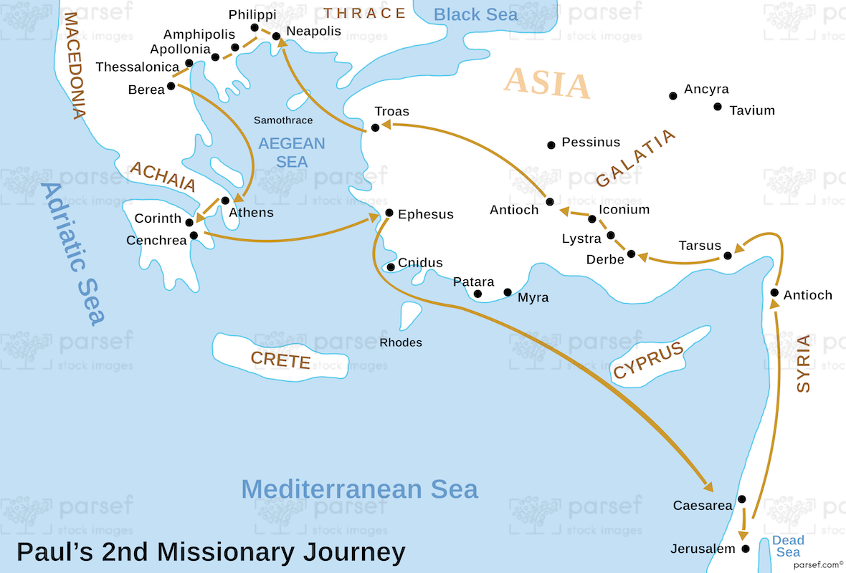
Chapter 2
V1 We were severely persecuted in Philippi
V2 But we DARED to share Jesus with you!
V3-6 Our motives: trick you, mask our financial greed, flatter you, get your praise because of who we are? NO! We spoke words approved by God to be trusted!

Slide 3
V7 We came to you as children: open, innocent, and vulnerable
V8 We came to you as a nursing mother, we cared for you; we shared the gospel and our lives with you no matter the personal cost to us
V9 - 10 You saw that we worked hard, day and night, among you so we would not be a burden to you as we preached His Word. We lived among you holy, righteous, and blameless.
V11-12 We dealt with you as fathers, encouraging, comforting, urging you to live worthy of God, Who called you into His Kingdom

Slide 4
V13 We give thanks daily for you because you accepted His Word – believing His Word IS HIS WORD! V14 You became imitators of Jesus! Even though your own people persecuted you!
V15-16 The persecutors are hostile to everyone, preventing us from preaching the gospel so the Gentiles to be saved. They (the Jewish persecutors) are heaping up their sins against God... His wrath (punishment) has come upon them at last.
Paul may have been referring to what happened in 48 ad when over 3,000 Jews were slaughtered during their Passover Feast in Jerusalem

Slide 5
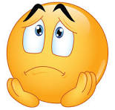

V17 Orphaned!!! Because satan blocked our tries to come to you...
V18-20 “For what is our hope? What is our joy? What is our crown in which we will glory in the presence of our Lord Jesus when He comes?... Indeed, YOU are our glory and joy!”
Glory and joy = source of happiness and proof of Paul’s apostleship

Slide 6
3: 1-2 We couldn’t stand the separation/disconnection any more, so we sent Timothy with this letter
V3-5 I sent Timothy to encourage your faith and to settle any unrest you may have about our persecution...You know persecution ‘true business’ would come!
I could not stand (no patient) the separation anymore, so I sent Timothy to find out how your faith is doing. I am afraid the tempter has tempted you and our work might have been in vain...

Slide 7
V6 BUT Timothy, just now, returned from you and has good news of your faith and love. He told us of your fond memories of us and how you long to see us as much as we long to see you...
V7-9 In spite of all the persecution:
We are encouraged
We now live because you stand for the Lord
How can we thank God enough for you? For all the joy we have in the presence of God because of you?!
V10-11 Night and day, we pray to see you again...asking God to open a way to come to you...

Slide 8
Benediction (v12-13):
¹² May the Lord make your love increase and overflow for each other and for everyone else, just as ours does for you. ¹³ May He strengthen your hearts so that you will be blameless and holy in the presence of our God and Father when our Lord Jesus comes with all his holy ones.

Slide 9
Persecution Expected, Worth it – Because of You!
Persecution is expected – darkness and light cannot live same time together...
Do we love each other as much as Paul loved the Christians in Thessalonica? Do you enjoy being together (F3, etc)?
(Ask yourself) How can I encourage and bless BDAers?
What does the non-believers in our Deaf Community see/view us/BDA?
What ‘picture’ does our Community see of me?

