Slide 1

Keep Growing
&
MYOB!
I Thessalonians 4: 1 - 12

Slide 2
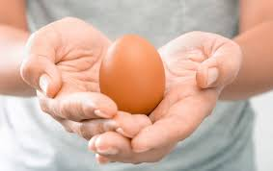
V1 & 2 We instructed you how to live to please God – FACT: you are!
You know our instructions were given by the authority of God and you were obedient to our instructions because they came from God...
Authority – given by God – used to mold, shape, and set His sons and daughters free to grow...sometimes abused by leaders for their own benefit...
  My wise instructor compared God assigned authority to a raw egg...

Slide 3
God appoints and anoints Spiritual Leaders:
Ephesians 4: 11 - 13
¹¹ And He gave some, apostles; and some, prophets; and some, evangelists; and some, pastors and teachers;
¹² For the perfecting of the saints, for the work of the ministry, for the edifying of the body of Christ:
¹³ Till we all come in the unity of the faith, and of the knowledge of the Son of God, unto a perfect man, unto the measure of the stature of the fulness of Christ

Slide 4
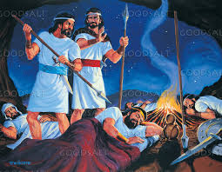
I Samuel 26: 1 - 12
Abishai
King Saul & 3,000 soldiers chased David & his 600 men for years
David and Abishai went to Saul’s encampment while everyone slept
Abishai said, “God has given Saul into our hands to kill!”
David said, “No, ... He will die eventually – naturally or in battle... I will not extend my hand against the Lord’s anointed... take his spear and jug instead...”
David
Saul

Slide 5
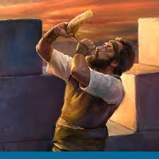
Ezekiel 33: 6
“...If the watchman/shepherd see the enemy coming and does not sound the alarm to warn the people, s/he is responsible...they will die in their sins, BUT I will hold the watchman responsible for their deaths...their blood is on his/her hands!”
El Roi sees!

Slide 6
“We are to strive to be holy”...
Verse 3
“It is God’s will that you should be sanctified”...
Sanctify = set apart for special use or purpose, the process of being set apart and made holy, the process of becoming holy.
How?
V4: avoid sexual immorality; learn to control your body; be holy and honorable (worthy to be respected)
V5: Not in passionate lust
V6: No one should wrong or take advantage of a brother or sister The Lord will punish that!

Slide 7
v7 We are called to be pure and holy
v8 When we reject God’s Word/instruction, we reject God!
V9 You have been taught by God to love each other
V10 The fact is – you DO! ... And we all know you do ... Yet we urge you to do more and more!

Slide 8
V11 Made your ambition (an aggressive goal) be to live in peace... Mind your own business! (MYOB!):
*“just curious”
*watch your “need to know” – not your business
*prayer request or spreading gossip?
*“sharing” about something you heard about someone
Only “share” positive information about someone!

Slide 9
Why?
V12 “So outsiders will respect you! And you can live not dependent on anyone!” Become able to contribute to the Body and your community.
How are you continuing to grow?
How are you giving back to the BDA family?
How are you giving back to our Deaf Community?
Are you respected by non-believers?

Slide 10
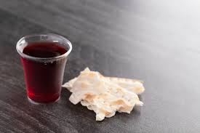
Communion

