Slide 1
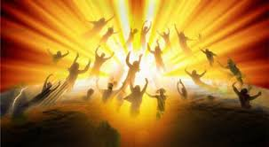
Caught up – YES!
Through Great Tribulation – NO!
I Thess 4:13 – 5:11

Slide 2
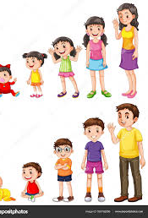


Paul closes this section of I Thess 4 with verse 12, “Strive to live peaceful and holy lives so that the non-believers will respect you.” We closed last week with Paul telling us to MYOB (4: 11)!
The crescendo = the maximum fulfillment: Eph 4 says the goal is to grow into the fullness of Jesus Christ! We measure up to Him ... Here we grow in holiness, then when we enter heaven and the crescendo happens:
I John 3: 2
“We shall be like Him...”

Slide 3
V13, “I don’t want you to be uninformed (ignorant) about those in Christ (believers) who died...we do not grieve as the non-believers grieve...”
V14, “Jesus died and rose again!” Let’s look at I Corinthians 15: 6 – 57:
v6 same time - over 500 people saw Jesus
v13 without a resurrection, our faith is worthless
v15 without Christ’s resurrection, we are liars!
v17 without a resurrection, your faith if futile
v20 BUT Christ has risen from the dead, INDEED!
v54 death is swallowed up in victory
v55 ‘Where, O death, is your victory? Where, O death, is your sting?’
v57 But thanks be to God! He gives us the victory through our Lord Jesus Christ!

Slide 4
II Corinthians 5: 6 – 8 says death brings us immediately into His presence: “while we are in this body, we are absent from the Lord, to be released from this ‘tent’ (mortal prison) means to be present with the Lord...clothed in immortality...” We are birthed into eternity...
Back to I Thess 4
V15, “We who are alive when Jesus returns will not go to heaven before those (believers) who have died (those who have ‘fallen asleep’)

Slide 5
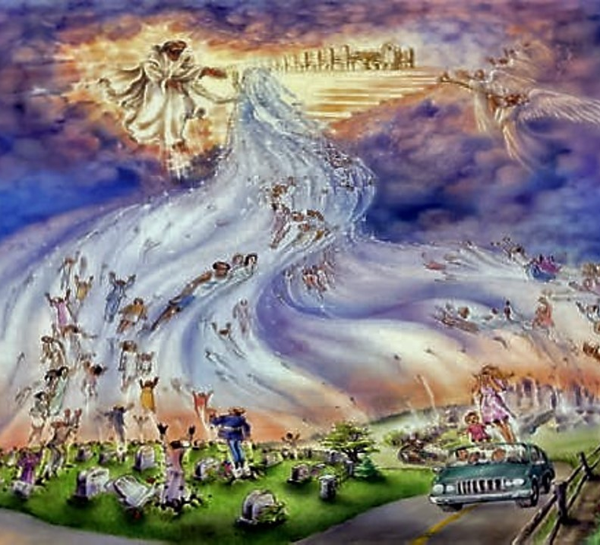
V16, “For the Lord Himself will come down from heaven with a loud command, with the voice of the archangel and with the trumpet call of God, and the dead in Christ will rise first. ¹⁷ After that, we who are still alive and left will be caught up together with them in the clouds to meet the Lord in the air.”

Slide 6
AG.org = official home site, go to Beliefs then 16 Fundamental Beliefs or Position Papers
Rapture – Yes or No?
The Assemblies of God 13th Fundamental Belief says, YES!
“The resurrection of those who have fallen asleep in Christ and their translation (change) together with those who are alive and remain unto the coming of the Lord is the imminent (absolute sure – ‘true business’) and blessed hope of the Church.” I Thess 4:16-17; Romans 8:23; Titus 2:13; and I Cor 15: 51 & 52.
Jesus taught that He will return to the earth (Matt 24; Matt 25; Mark 13; Luke 12)
His return gave comfort to His disciples as the face His crucifixion (Jn 14: 2&3)
When Jesus ascended into heaven, the angels said He will return same way He left (Acts 1)

Slide 7
“Rapture” – the word not in the English Bible, however Webster’s Third New International Dictionary Unabridged defines “rapture” as: “Christ’s raising up of His true church and its members to a realm above the earth where the whole company/group will enjoy heavenly bliss with its Lord.”
*Rapture = caught up in I Thess 4: 17
*One taken and one left = Matt 24: 36-42, Jesus describing the sudden removal of believers...describing what Paul stated in I Thess 4
*Same ‘caught-up’ Greek word used in I Thess 4 is also used to describe the Spirit of the Lord ‘caught-up’ Philip in Acts 8:39 (‘beam me up Scotty!’)
*Look at Enoch in Gen 5: 21-24
*Look at Elijah in 2 Kings 2: 1-13

Slide 8
Is the rapture and Jesus’ Second Coming the same? NO
The rapture: Jesus is come ‘for’ His believers (I Thess 4) – while He stands in clouds
The Second Coming: Jesus is coming ‘with’ His believers (Jesus’ feet actually touch the earth – Zech 14:4; etc.)
Between Rapture and 2nd Coming: The Great Tribulation and rule of the Antichrist to the Abyss = Rev. 6 – 20... Tribulation = wrath of God...I Thess 5: 9, “For God has not appointed us to wrath, but to obtain salvation by our Lord Jesus Christ.”
We believe in the “pre-tribulation rapture”. We will be persecuted by the world BUT will be raptured before the 7 yr Great Tribulation!

Slide 9
Now what?
I Thess 5: 1 – 11
V1 There is no need to know a date!
V2 – 5 You know that His coming will be like a thief in the night! People will say, “peace and safe”...but suddenly destruction will come...Remember, you are children of the Light...darkness will come...
V6-8 Let us be sober (thinking straight); put on faith and love as a breastplate; put on the hope of salvation – your helmet.
V9 For God did not appoint us to suffer wrath but to receive salvation through our Lord Jesus Christ
V10 He died for us so that, whether we are awake or asleep, we may live together with Him
V11 Now, encourage one another, build up each other...

Slide 10
*Expect the Rapture!
*Don’t argue about when the rapture will happen!
*We will NOT experience the Great Tribulation!
*Hallelujah, Jesus IS coming again!

