Slide 1

I Thessalonian’s finale!
I Thessalonians 5: 12 - 28

Slide 2
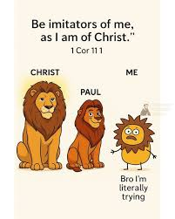
Chapter 1 ...Non-believers Respect You!
Be imitators of us as we imitate Jesus! – now you have become imitators of Jesus yourselves!
Your faith produces good works
Your love produces service and
Your hope inspires others
Non-believers respect you and seen
your changed life

Slide 3
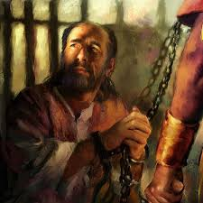
Chapter 2 Persecuted BUT Worth it!
Warning: as you follow and model Jesus, you will be persecuted and mocked
We are able to stand because we see you stand!

Slide 4
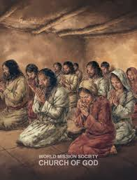
Chapter 3 Night and Day We Prayed
No matter all the persecution...
We are encouraged!
We pray, “May He strengthen you and keep you blameless and holy before the Father when He (Jesus) returns for His followers.”

Slide 5

Chapter 4: 1 – 12 Keep growing and MYOB!
Strive to be sanctified (a process) by obeying His Word
Remember power should be cared for like an egg...hold too tight (control) we crush it; hold too loose we drop it; hold carefully/gently we keep power safe
Your ambitions (aggressive goal) be to live in peace with everyone – MYOB! (v9)

Slide 6
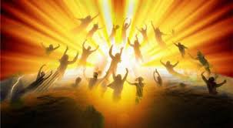

Chapter 4: 13 – 5:11
Expect the RAPTURE!
Don’t argue about when!
We will not go through the Great Tribulation (v9)
Hallelujah, Jesus is coming again!
I John 3: 2, “We shall be like Him!”

Slide 7
5: 12 – 28 Paul’s Final Words in I Thess
V12 & 13 Acknowledge those who work hard, who care and admonishes you...hold them in the highest regard/respect
V14 Urge and warn the idle...those who choose to not help, but criticize those who serve
Encourage the disheartened, help the weak, and be patient with everyone
V15 Make sure no one pays back wrong for wrong (“I owe you”)

Slide 8
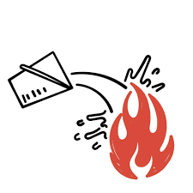
V16-18 Rejoice always, pray continuously, give thanks in every circumstance because this is God’s will for you... GIVE Thanks IN – not for every circumstance! Because it is God’s will you are experiencing what you are going through...as His child, what does He want you to learn from the struggles you are now in?
V19 Do not put out the Spirit’s fire
V20-22 Do not treat prophecies with contempt (disrespect), test them all (does the message line up with His Word?) – keep the good and toss the bad!

Slide 9
V23 – 24 May God sanctify you (progressively clean you up) through and through! May your spirit – your breathe of life; your soul – who you are, character, will, personality; your body- your flesh, bones and blood – all (spirit, soul, and body) be holy and blameless
V25 – 28 Pray for us! Greet everyone with loving care! Read this letter to everyone in the Thess Church. And may God’s grace continue to be yours!

Slide 10
Paul’s message to the Thessalonians and to us:
Encourage the believers: when people look at you, the non-believers see Jesus – you ARE His model/reflection
Strive to live peacefully – not causing arguments – MYOB!
Know He will come for us! We will be raptured!
Know He is coming again and we will be with Him when He returns!
Live expecting His return!

