Slide 1
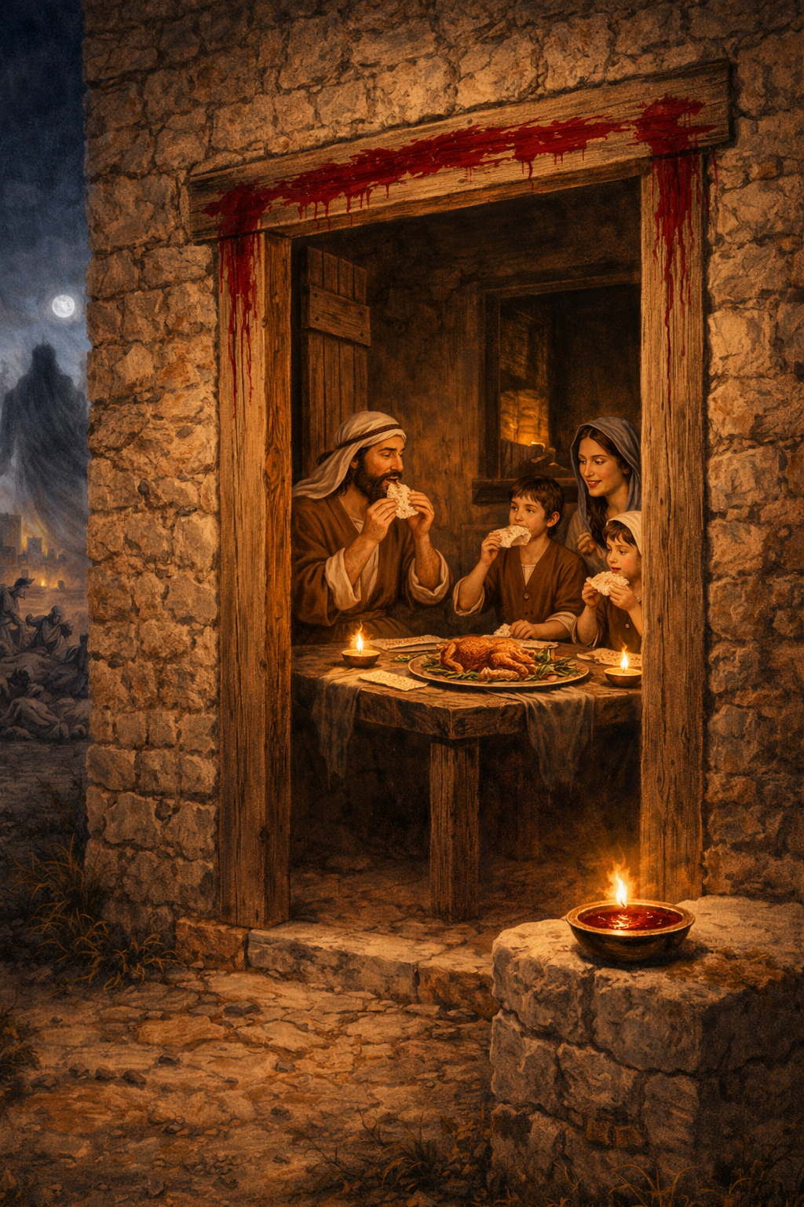
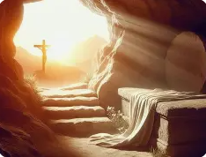

Slide 2
Exodus 12:7-8 NLT
7 They are to take some of the blood and smear it on the sides and top of the doorframes of the houses where they eat the animal.
8 That same night they must roast the meat over a fire and eat it along with bitter salad greens and bread made without yeast.

Slide 3
Exodus 12:12-13 NLT
12 On that night I will pass through the land of Egypt and strike down every firstborn son and firstborn male animal in the land of Egypt. I will execute judgment against all the gods of Egypt, for I am the LORD!
13 But the blood on your doorposts will serve as a sign, marking the houses where you are staying. When I see the blood, I will pass over you. This plague of death will not touch you when I strike the land of Egypt.
Passover = Pasach

Slide 4
Exodus 12:14 NLT
14 “This is a day to remember. Each year, from generation to generation, you must celebrate it as a special festival to the LORD. This is a law for all time.
Exodus 12:24-25 NLT
24 “Remember, these instructions are a permanent law that you and your descendants must observe forever.
25 When you enter the land the LORD has promised to give you, you will continue to observe this ceremony.

Slide 5
Exodus 12:29-31 NLT
29 And that night at midnight, the LORD struck down all the firstborn sons in the land of Egypt, from the firstborn son of Pharaoh, who sat on his throne, to the firstborn son of the prisoner in the dungeon. Even the firstborn of their livestock were killed.
30 Pharaoh and all his officials and all the people of Egypt woke up during the night, and loud wailing was heard throughout the land of Egypt. There was not a single house where someone had not died.
31 Pharaoh sent for Moses and Aaron during the night. “Get out!” he ordered. “Leave my people—and take the rest of the Israelites with you! Go and worship the LORD as you have requested.

Slide 6
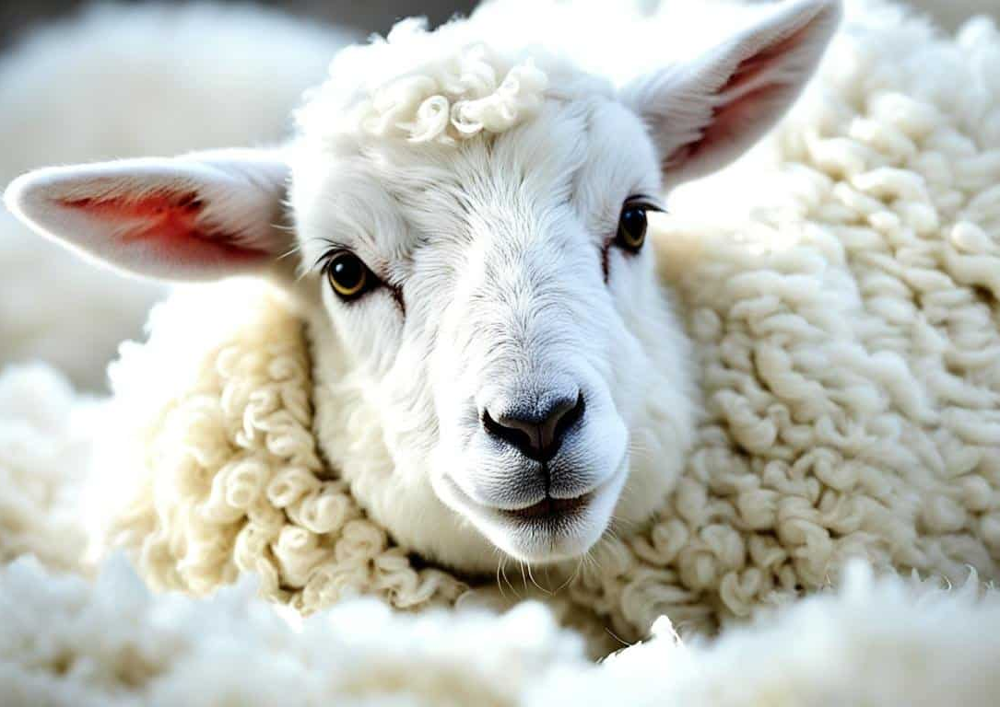
Seven Ways Passover Foreshadows Jesus
1) Lamb without Blemish
Exodus 12:5 NLT
5 The animal you select must be a one-year-old male, either a sheep or a goat, with no defects.
1 Peter 1:19 NLT
19 It was the precious blood of Christ, the sinless, spotless Lamb of God.

Slide 7
Seven Ways Passover Foreshadows Jesus
2) Substitutionary Death
Exodus 12:6b NLT
6 Then the whole assembly of the community of Israel must slaughter their lamb or young goat at twilight.
John 1:29 NLT
29 The next day John saw Jesus coming toward him and said, “Look! The Lamb of God who takes away the sin of the world!
1 Corinthians 5:7b NLT
7 Christ, our Passover Lamb, has been sacrificed for us.

Slide 8
Seven Ways Passover Foreshadows Jesus
3) Blood Applied for Deliverance
Exodus 12:13 NET
13 The blood will be a sign for you on the houses where you are, so that when I see the blood I will pass over you, and this plague will not fall on you to destroy you when I attack the land of Egypt.
Romans 5:9 NET
9 Much more then, because we have now been declared righteous by his blood, we will be saved through him from God’s wrath.

Slide 9
Seven Ways Passover Foreshadows Jesus
4) No Broken Bones
Exodus 12:46 NET
46 It must be eaten in one house; you must not bring any of the meat outside the house, and you must not break a bone of it.
John 19:36 NLT
36 These things happened in fulfillment of the Scriptures that say, “Not one of his bones will be broken,”
Psalms 34:20 NLT
20 For the LORD protects the bones of the righteous; not one of them is broken!

Slide 10
Seven Ways Passover Foreshadows Jesus
5) Freedom through Lamb’s Death
Exodus 12:31 NET
31 Pharaoh summoned Moses and Aaron in the night and said, “Get up, get out from among my people, both you and the Israelites! Go, serve the LORD as you have requested!
Galatians 5:1a NET
1 For freedom Christ has set us free.

Slide 11
Seven Ways Passover Foreshadows Jesus
6) A Meal of Remembrance
Exodus 12:14 NET
14 This day will become a memorial for you, and you will celebrate it as a festival to the LORD – you will celebrate it perpetually as a lasting ordinance.
Luke 22:19 NET
19 Then he took bread, and after giving thanks he broke it and gave it to them, saying, “This is my body which is given for you. Do this in remembrance of me.”

Slide 12
Seven Ways Passover Foreshadows Jesus
7) Timing of the Sacrifice
Exodus 12:6 NLT
6 “Take special care of this chosen animal until the evening of the fourteenth day of this first month. Then the whole assembly of the community of Israel must slaughter their lamb or young goat at twilight.
14th Day of Nisan
Psalms 34:20 NLT
20 For the LORD protects the bones of the righteous; not one of them is broken!

Slide 13
Seven Ways Passover Foreshadows Jesus
1) Lamb without Blemish
2) Substitutionary Death
3) Blood Applied for Deliverance
4) No Broken Bones
5) Freedom through Lamb’s Death
6) A Meal of Remembrance
7) Timing of the Sacrifice

Slide 14
Passover and the Feast of Unleavened Bread
Leviticus 23:4-8 NET
4 “‘These are the LORD’s appointed times, holy assemblies, which you must proclaim at their appointed time.
5 In the first month, on the fourteenth day of the month, at twilight, is a Passover offering to the LORD.
6 Then on the fifteenth day of the same month will be the Feast of Unleavened Bread to the LORD; seven days you must eat unleavened bread.
7 On the first day there will be a holy assembly for you; you must not do any regular work.
8 You must present a gift to the LORD for seven days, and the seventh day is a holy assembly; you must not do any regular work.’”

Slide 15
Nisan (first month of the Jewish year)
13 | 14 | 15 | 16 | 17 | 18 | 19 | 20 | 21
Holy Assembly (Always Nisan 15 and 19)
Feast of Unleavened Bread (Always Nisan 15 to 21)
Passover (Always Nisan 14)

Slide 16
Jesus died the day before Sabbath
Mark 15:42-43 NET
42 Now when evening had already come, since it was the day of preparation (that is, the day before the Sabbath),
43 Joseph of Arimathea, a highly regarded member of the council, who was himself looking forward to the kingdom of God, went boldly to Pilate and asked for the body of Jesus.
Mark gives us the clue that Jesus died the day before Sabbath.

Slide 17
Nisan (first month of the Jewish year)
13 | 14 | 15 | 16 | 17 | 18 | 19 | 20 | 21
Sabbath (Always Saturday)
Holy Assembly (Always Nisan 15 and 19)
Feast of Unleavened Bread (Always Nisan 15 to 21)
Passover (Always Nisan 14)

Slide 18
Feast of Firstfruits
Leviticus 23:9-11 NET
9 The LORD spoke to Moses:
10 “Speak to the Israelites and tell them, ‘When you enter the land that I am about to give to you and you gather in its harvest, then you must bring the sheaf of the first portion of your harvest to the priest,
11 and he must wave the sheaf before the LORD to be accepted for your benefit – on the day after the Sabbath the priest is to wave it.
The Feast of Firstfruits is the day after Sabbath (Saturday).

Slide 19
Nisan (first month of the Jewish year)
13 | 14 | 15 | 16 | 17 | 18 | 19 | 20 | 21
Feast of Firstfruits (Day after Sabbath)
Sabbath (Always Saturday)
Holy Assembly (Always Nisan 15 and 19)
Feast of Unleavened Bread (Always Nisan 15 to 21)
Passover (Always Nisan 14)

Slide 20
The 15 Steps of the Passover Seder
Kadesh (Sanctification)
The Seder begins with the recitation of Kiddush over the first cup of wine . This cup is the “Cup of Sanctification,” linked to God’s promise “I will bring you out” (Exodus 6:6).
Urchatz (Washing the Hands)
Everyone washes their hands ritually (pouring water three times over each hand). This prepares for the dipping that follows and recalls ancient Temple purity practices.

Slide 21
The 15 Steps of the Passover Seder
Karpas (Dipping the Vegetable)
A small piece of a green vegetable (usually parsley, celery, or potato) is dipped in salt water and eaten after the blessing over vegetables. The green vegetable symbolizes spring and hope; the salt water represents the tears of slavery in Egypt.
Yachatz (Breaking the Middle Matzah)
The leader takes the middle of the three matzot (unleavened breads) on the Seder plate, breaks it in half, wraps the larger piece (the Afikomen) in a cloth, and hides it. The smaller piece is returned to the plate. This foreshadows the “hidden” and “revealed” aspects of redemption.

Slide 22
The 15 Steps of the Passover Seder
Maggid (Telling the Story)
The longest and most important step The Exodus story is retold from the Haggadah. This includes: The Four Questions (Ma Nishtana) asked by the youngest child. The story ends with the second cup of wine (Cup of Deliverance / “I will free you”)
Rachtzah (Washing the Hands — with Blessing)
Hands are washed again, this time with the blessing (“Blessed are You… who has sanctified us with His commandments and commanded us concerning the washing of hands”). This prepares for eating the matzah.

Slide 23
The 15 Steps of the Passover Seder
Motzi (Blessing Over Bread)
The leader recites the standard blessing over bread (HaMotzi) while holding the remaining matzot.
Matzah (Blessing and Eating the Matzah)
The special blessing over matzah (“Blessed are You… who has commanded us concerning the eating of matzah”) is recited. Everyone eats a portion of matzah.
Maror (Eating the Bitter Herbs)
Bitter herbs (usually horseradish or romaine lettuce) are eaten after the blessing. This recalls the bitterness of slavery in Egypt.

Slide 24
The 15 Steps of the Passover Seder
Korech (The Hillel Sandwich)
A “sandwich” is made with matzah, bitter herbs, and charoset (a sweet mixture of apples, nuts, wine, and cinnamon that represents the mortar used by the slaves). It follows the practice of combining the bitter and the sweet to remember both suffering and redemption.
Shulchan Orech (The Festive Meal)
The main meal is served and eaten. Traditional foods often include chicken soup with matzah balls, brisket, roasted chicken, vegetables, and other dishes. No leavened bread is present.

Slide 25
The 15 Steps of the Passover Seder
Tzafun (Eating the Afikomen)
The hidden Afikomen (from step 4) is found (often by children), and everyone eats a piece. This is the last solid food eaten — it recalls the Passover lamb and must be consumed before the meal ends.
Barech (Grace After Meals)
The full Grace After Meals (Birkat HaMazon) is recited. The third cup of wine (Cup of Redemption / “I will redeem you”) is poured. This is the cup most commonly associated with Jesus at the Last Supper when He said, “This cup is the new covenant in my blood” (Luke 22:20; 1 Corinthians 11:25).

Slide 26
The 15 Steps of the Passover Seder
Hallel (Songs of Praise)
Psalms of praise (the Hallel — Psalms 113–118) are sung or recited. The fourth cup of wine (Cup of Praise / “I will take you as My people”) is poured. Some traditions also pour a cup for Elijah the Prophet and open the door, hoping for his arrival as a herald of the Messiah.
Nirtzah (Conclusion / Acceptance)
The Seder concludes with a final prayer that our observance be accepted by God. It ends with songs (including “Chad Gadya” and “Who Knows One?”), expressions of hope for future redemption, and the declaration:
“Next year in Jerusalem!” (L’shanah ha’ba’ah b’Yerushalayim)

Slide 27
The Last Supper
Instead of washing hands, Jesus washed their feet.
Instead of blessing the matzah bread, Jesus says, “this is my body, which is given for you”.
Instead of pouring wine as a blessing, Jesus says, “this cup is the new covenant in my blood” (prophesized by Jeremiah 31:31-34).
Instead of remembering the Exodus, Jesus says, “Do this in remembrance of me”.

