Slide 1
”May it be so done to Me if I do not keep
My oath and pledge.”
Genesis 15: 1 - 18

Slide 2
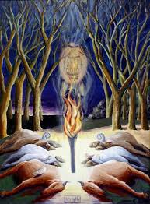
“I know, I know!” Normally, we would be continuing our Sunday morning series and would be starting II Thessalonians...
Twice, in less than a year, the Old Testament image of Abram/Abraham and God having an intimate conversation that leads to God’s making a covenant with Abram - when God asked him to bring a heifer, goat, ram, dove and pigeon to Him to legally seal their covenant...nagging me...
Genesis 15: 1 - 18

Slide 3
Gen 1 & 2: Creation
Gen 3: The Fall of Mankind
Gen 4: The 1st Murder = Cain killed Abel
Gen 5 – 9: Noah
Gen 10: Shem, Ham and Japheth scattered
Gen 11: Tower of Babel (v1-9), God confused their language;
Terah is 70 years old when Abram/Abraham is born, then Nabor and Haran are born. Haran has Lot, dies and Abram takes responsibility for Lot, Terah takes Abram, Sarai, and Lot out of Ur to Harran, dies at 205 yrs old
A quick trip through Genesis needed for context!

Slide 4
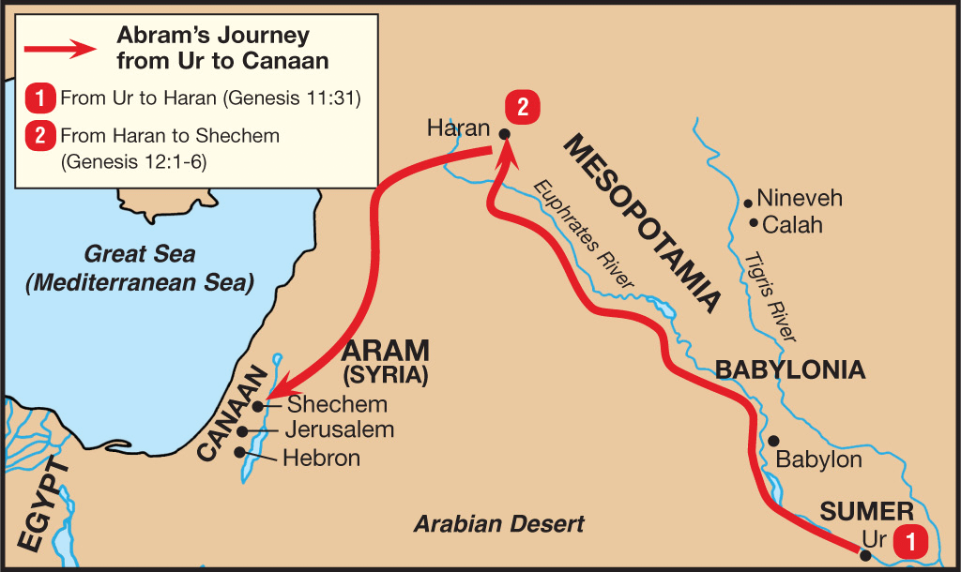
Gen 12 The call of Abram & Abrahamic Covenant:
1) You will be a great nation
2) I will bless those who bless you and punish those who hurt you
3) All people on earth will be blessed through you

Slide 5
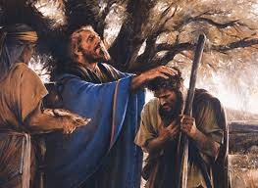
Gen 13 Abraham & Lot Separate...
Gen 14 Abraham rescues Lot and we are introduced to Melchizedek
Melchizedek is the King of Salem and the High Priest of the “Most High God, Creator of all things”... We learned more about him from the Book of Hebrews

Slide 6
Chapter 15
(Abram had two questions for the Lord)
V1 After this, the Word of the Lord came to Abram in a vision,
Do not be afraid Abram. I am
your shield, your very great reward.”
V2 & 3 Q#1. “What else could You give me? I have everything, but You have not given me an heir...a son... Eliezer, my faithful servant will inherit all I have after I am gone."

Slide 7
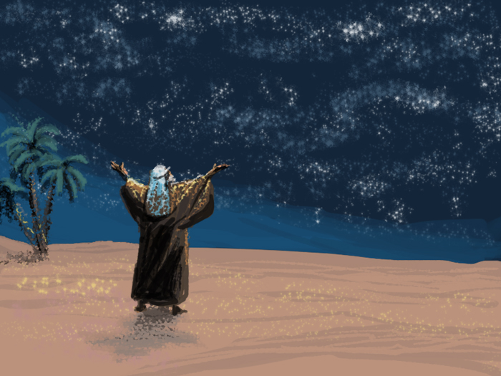
V4-5 God’s response: “Eliezer is not your heir... Come and see”... God shows Abram the vast sky and its stars,
“Look up at the heavens and count the stars – if you can! So shall your offspring (family line) be.”
V6 Abram believed the Lord and He credited it to him (Abram) as righteousness
V7-8 Q#2. Abram asked, “How will I know that I will gain possession of it (the land)?”

Slide 8
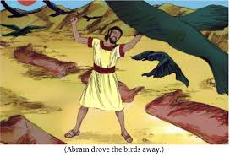
V9 God responds using a familiar ‘Ancient Binding Near East’ land legal practice: the Lord tells Abram to bring Him a 3 yr old heifer (female cow); a 3 yr old female goat; a 3 yr old male ram; a female turtle dove, and a male pigeon.
V10-11 Because the custom was familiar, Abram brought them to the Lord, cut the heifer, goat, ram in half then left the two birds whole. He lined the pieces opposite each other creating a path between the parts. Birds of prey (vultures, etc.) came and Abram fought the birds away...

Slide 9
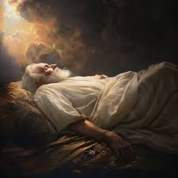
V12 At sunset, Abram fell asleep and a very dark cloud came over him
V13-16 The Lord showed Abram the 400 years of slavery his descendants would experience. God reassures Abram that he would die long before these things would happen. He is delaying His punishment on the Amorites – “their time was not fulfilled”...

Slide 10
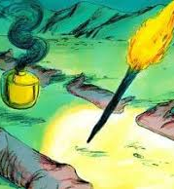
V17-18
When the sun had completely set and it was dark and while Abram was sleeping, a smoking pot and a torch coming from the smoking pot appeared and passed between the pieces of animals.
V18 And on that day, the Lord made a covenant with Abram

Slide 11
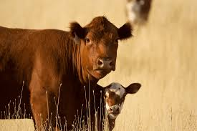
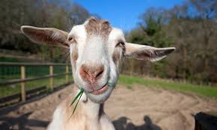
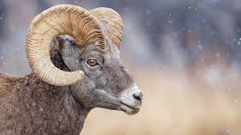
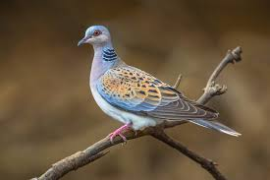
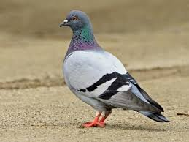
Heifer (female cow) = a peace offering and cleansing
Female Goat = a peace offering and/or sin offering for the everyday people, mandatory for atoning for sin – the scapegoat
Male Ram = a burnt offering for sin, substitutionary offering – sacrificed for the sins of others, offering made for unintentional sins
Turtledove = a burnt offering for those who could not afford a mammal, atoning of sins
Pigeon = a burnt offering representing someone born under the Law ( for the poor)

Slide 12
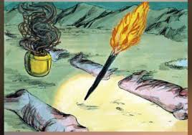
The smoking pot = symbolic of God’s holy presence, His glory. Seen also as the ‘cloud by day’ that guided the Israelites through the desert
Flaming torch that came out of the smoking pot = God’s justice coming from His holiness

Slide 13
As the two people pass through the animal pieces (offering), they agree together:
“May it be so done to me if I do not keep My oath and pledge.”
‘May I be destroyed, my life be in broken pieces, like this sacrifice if I break this agreement.’

Slide 14
Note:
God alone passed through this path
Justice and Truth passed through His holiness – alone
Only God was qualified to commit to this covenant...
Only Jesus could take our debt – breaking the covenant through our disobedience – walking alone – He covered our sins – beaten and broken on the cross so that we can still receive His love, a relationship with Him, and His promise = eternal life...

