Slide 1
Called to be His Children and Heirs of His kingdom...walk worthy!
II Thessalonians 1: 1 - 12

Slide 2
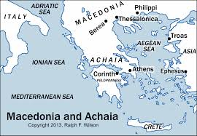
*Written between 51 – 53 ad shortly after Silas and Timothy returned from delivering Paul’s 1st letter to the Thess. Church, Paul – still in Corinth
*Purpose to:
1) encourage persecuted believers
2) correct wrong teaching about Jesus’ return (2nd Coming)
3) exhort believers to be steadfast and to work
*Theme: Eschatology – end times

Slide 3
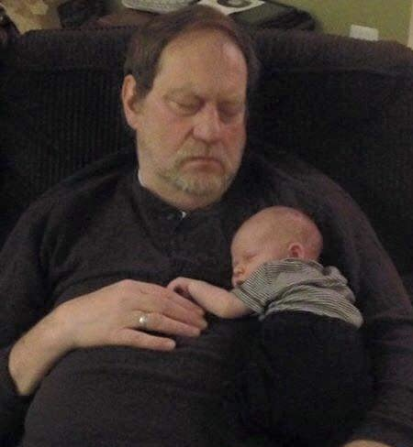
Chapter 1 vv1-2: Paul identifies himself as the writer and Silas and Timothy is with him. Writing to the Church at Thessalonica, he states, from God the Father:
“Grace” = God’s unearned & undeserved favor/love/care
“Peace” = Total well-being & security in God (like a baby in the arms of a loving parent/grandparent) v3: Your faith continues to grow more and more = love for each other is growing more and more...correlated – your faith increases that causes your love for each other to grow

Slide 4
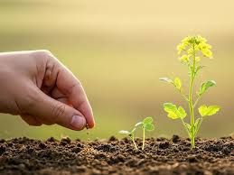
V4 We constantly tell everyone about your growing faith and love because you are persevering through the persecution and trails you are facing!
V5 God’s judgement is just...God is just! And He counts you worthy of the Kingdom of God because you have endured v6 He will “pay back” trouble to those who trouble you... This is not ‘owe owe you’ attitude... God is not a vengeful God ... But this is a ‘reap what you sow’ law of nature God has set in place since creation.

Slide 5
Eschatology introduced: End-times teaching v7 – 10 “He will give relief to you who are troubled, and to us as well. This will happen when the Lord Jesus is revealed from heaven in blazing fire with His powerful angels. ⁸ He will punish those who do not know God and do not obey the gospel of our Lord Jesus.⁹ They will be punished with everlasting destruction and shut out from the presence of the Lord and from the glory of His might ¹⁰ on the day He comes to be glorified in His holy people and to be marveled at among all those who have believed. This includes you, because you believed our testimony to you.”
(Revelation 19)
V 7 The Lord will be revealed
V8 He brings justice
V9 Punishment that shuts out His presence
V10 But we will marvel at His presence

Slide 6
V11 Keeping this in mind, we constantly pray for you that He will make you worthy of His calling
Called to be His children and heirs of His Kingdom
And by His power, He will bring to fullness your every desire for goodness and your every deed prompted by faith v12 We pray the name of our Lord Jesus may be glorified in you and you be glorified in Him...We glorify Him through our obedience ... Accepting Jesus as your Savior and Lord...

Slide 7
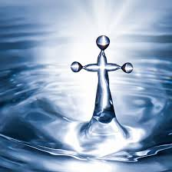
Water Baptism is an act of obedience to Jesus’ example: Romans 6: 1 – 7
“Shall we go on sinning...? No! We are those who have died to sin; how can we live in it anymore? ...all of us who were baptized into Christ Jesus were baptized into His death. We were buried with Him through baptism into death in order that, just as Christ was raised from the dead through the glory of the Father, we too may live a new life...For we know that our old self was crucified with Him so that the body ruled by sin might be done away ... Anyone who has died to sin has been set free from sin...”

Slide 8
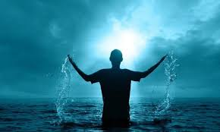
Today, we are having a water baptism service!

