Slide 1

Feast of the Unleavened Bread
Leviticus 23: 6 - 8
And
John 6: 32 - 40

Slide 2
The Seven (7) OT Feasts/Festivals
Spring Feasts:
  Passover (Pesach)
  Unleavened Bread
  First Fruits
  Feasts of Weeks or Pentecost (Shavuot)
Fall Feasts:
  Trumpets (Rosh Hashanah)
  Day of Atonement (Yom Kippur)
  Feasts of Tabernacles (Sukkot)
Memorials established for us to pause, stop, and ponder...

Slide 3
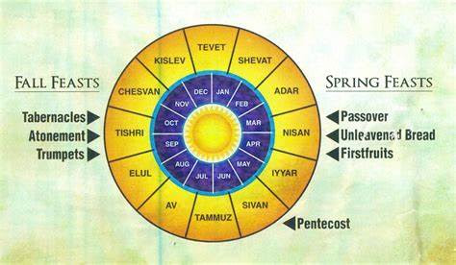
Etc...
#1
#7
#2
#6
#3
#5
#4

Slide 4
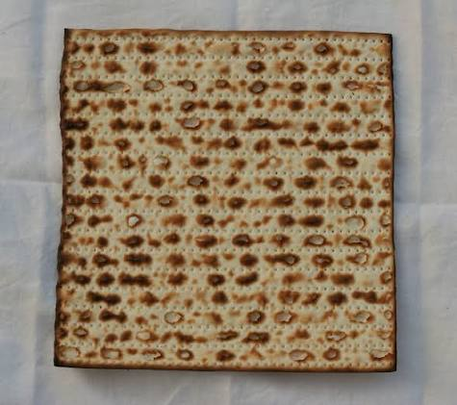
Lev. 23: 4 & 5, “These are the Lord’s appointed festivals, the sacred assemblies you are to proclaim at their appointed times. The Lord’s Passover begins at twilight on the 14th day of the first month.” (month of Nisan)
*The Passover and the Feast of the Unleavened Bread overlaps. Lev. 23: 6, “On the 15th day of that month (the first month-Nisan) the Lord’s festival of Unleavened Bread begins; for seven (7) days you must eat bread made without yeast...”
Today we will look at the Feast of the Unleavened Bread

Slide 5
Lev. 23: 6-8, “On the 15th day of that month (Nisan) the Lord’s unleavened bread begins; for 7 days you must eat bread made without yeast. On the 1st day hold a sacred assembly and do no regular work. For 7 days present a food offering to the Lord. And on the 7th day hold a sacred assembly and do no regular work.”

Slide 6
The Feast of the Unleavened Bread = (Hebrew) Chag HaMatzot
Occurs right after Passover to commemorate the hurried leaving (exodus) from Egypt
(OT) Leaven is symbolic of corruption or evil. Leaven is made from rotten/fermented bread – added to fresh bread dough to cause the new dough to grow/multiply. Yeast/Leaven signifies anything that rots and corrupts physically, morally (inner guidelines of knowing right & wrong), and spiritually.
All leavened items (baking soda and all other fermenting items) were removed from their homes. For 7 days bread eaten must be unleavened.

Slide 7
Themes: Freedom (Passover); Spiritual Purification; and Humility
The 1st and 7th day: Sacred assembly with burnt sacrifices offered for the forgiveness of sin
Yachatz – Breaking of the Bread: During the Passover Meal, 3 separate sheets of matza (made of only flour and water; baked for 15-18mins – no longer) were placed in a linen bag (matza tash). Then the middle matza is removed and broken. One ½ put back in tash, the other ½ is wrapped in linen and hidden – hidden piece is called “afikoman”. The youngest at the family feast would search for it, when found the child gives it to the elder, who give the child a treat. Then he breaks the afikoman in pieces and everyone eats a piece together.

Slide 8
Symbolic of affliction, redemption and final remembrance of the sacrificial lamb...the last thing to be eaten.
Practiced as early as Zechariah’s time and the building of the 2nd Temple around 520 bc...
NT Jews followed the OT feasts’ requirements of the Unleavened Bread. Leaven was symbolic of sin and corruption, however, Jesus did use yeast as the spreading of His Kingdom: Luke 13: 21 & Matt 13: 33... *I am sure this “messed” with the Pharisees’ & Sadducees’ thinking!
Jesus declares Himself: “The Bread of Life” in John 6: 32 - 35

Slide 9
John 6: 32 - 40
“Jesus said to them, ‘Listen truly I tell you, it is not Moses who has given you the bread from heaven, but it is My Father Who gives you the true bread from heaven. For the bread of God is the bread that comes down from heaven and gives life to the world...I am the bread of life. Whoever comes to Me will never go hungry, and whoever believes in Me will never be thirsty. But as I told you...For I have come down from heaven not to do My will but to do the will of Him who sent me...For My Father’s will is that everyone who looks to the Son and believes in Him shall have eternal life....’”

Slide 10
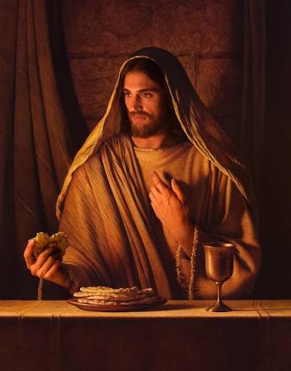
Jesus – the middle of the Trinity
Jesus – broken because of our sins
Jesus – His glory hidden
Jesus – “Found” – accepted as our Savior
Jesus – To be shared with the world!

Slide 11
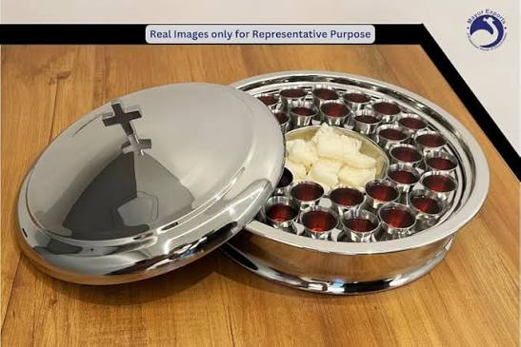
Communion

