Slide 1
BDA belongs to the lord!
I Chronicles 5: 18 - 22

Slide 2
Bethany Deaf Assembly
What an accomplishment celebrated today! After 35⁺ years!
What does it mean to be a General Council Church?
  Self-governing = Deaf culture leaders
  Self-supporting = Financially self supporting
  Self-propagating = able to grow through sharing the gospel – new Deaf Community people saved
Here we are!!! “The Promise Land”!

Slide 3

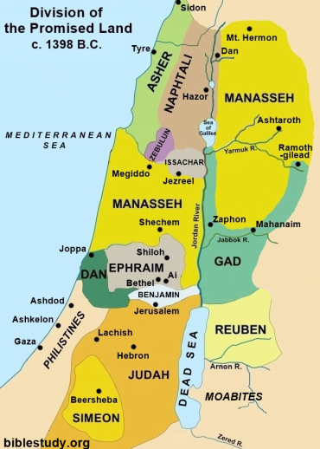
Tribe/State of Reuben
I Chron 5: 18 -22
Reuben – the first son of Jacob

Slide 4
“The sons of Reuben, the first born of Israel (Jacob)...the Reubenites, Gadites, and half the tribe of Manasseh had 44,760 men ready for military service; able-bodied men who could handle the shield and sword, who could use a bow, and who were trained for battle...they were helped in fighting and God delivered their enemies into their hands, because they cried out to Him during the battle. He answered their prayers, because they trusted in Him...and because the battle was God’s (the battle belonged to the Lord).”

Slide 5
In BDA’s 35⁺ years of existence, we have had our battles... Yet, here we are – an indigenous Deaf Church!
Observations and possible parallels to the Reubenites:
Reubenites learned to use their shield – Eph 6 shield of faith
Learned to use their sword – the Word of God
Used their bows – God given talents and abilities - I Cor 12
They trained – Actively used their abilities and participated
They cried out to the Lord – they prayed and
They trusted in the Lord
V22 states, “...the battle was God’s” – battle belongs to God

Slide 6
BDA belongs to the Lord and the battles we will continue to face belong to Him!
Battles? We have new enemies to conquer:
a) Lack of compassion for outsiders and lack of commitment – like old married couples who now coexist – enthusiasm becomes duty/obligation
b) Not catching the urgency, finality, and horror of eternal separation from God
Focusing inwardly only brings death while Focusing outwardly brings life

Slide 7
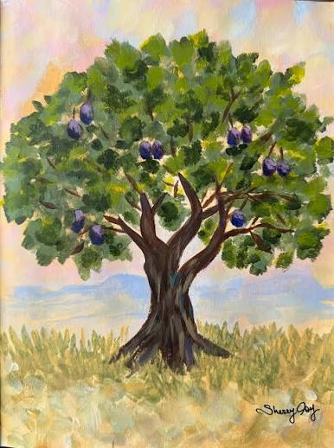
Do you know what Bethany means?
“House of figs” = God’s favor, peace and prosperity
“House of affliction” = a place where the hurting gathered
Bethany was the home of Mary, Martha, and Lazarus – where Jesus wept...

Slide 8
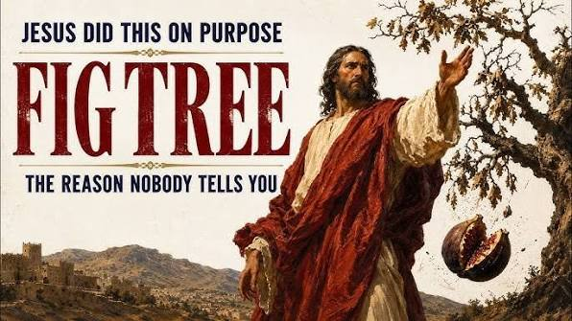
Mark 11: 12 – 14
On His way to Jerusalem, Jesus cursed a leafy fig tree. It was harvest time for figs, yet this tree did not have any fruit. It was full and beautiful on the outside to look at BUT without fruit and worthless to the Kingdom.

Slide 9
What kind of “House of Figs” will Bethany Deaf Assembly be?
Victorious? Conquerors?
Will you be people of prayer?
People of faith?
People of His Word?
People using the bow – actively engaged in BDA’s life? 80/20 become 20/80?
People who trust the Lord?
Will we be a “House of Affliction” where people will come to Jesus for healing?

