Slide 1
The Feast of the First Fruit
Lev. 23: 9 – 14 and I Corinthians 15: 4 - 57

Slide 2
Review...
Keep the Sabbath holy – the foundation of all the feasts
Passover – Jesus the Passover Lamb
Unleavened Bread – Jesus the Bread of Life

Slide 3
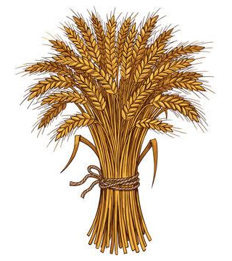
Feast of the First Fruit
Leviticus 23: 9 – 14
“When you enter the land I am going to give to you and you reap its harvest, bring to the priest a sheaf of the first grain. He is to wave the sheaf before the Lord so it will be accepted on your behalf. The priest will wave the day after the sabbath (our Sunday). On the day that you wave the sheaf, you must sacrifice a burnt

Slide 4
Lev. 23: 9 – 14 continued...
V12 “...offering to the Lord, a lamb 1 year old without defect. ¹³Together with its grain offering of 2/10 of an ephah (about 7 lbs) of the finest flour mixed with olive oil...presented to the Lord, a pleasing aroma and a drink offering of a hin (about a quart) of wine. ¹⁴You must not eat any bread or roast or new grain until you bring this offering to the Lord. This should be a lasting ordinance for generations to come, wherever you live.”

Slide 5
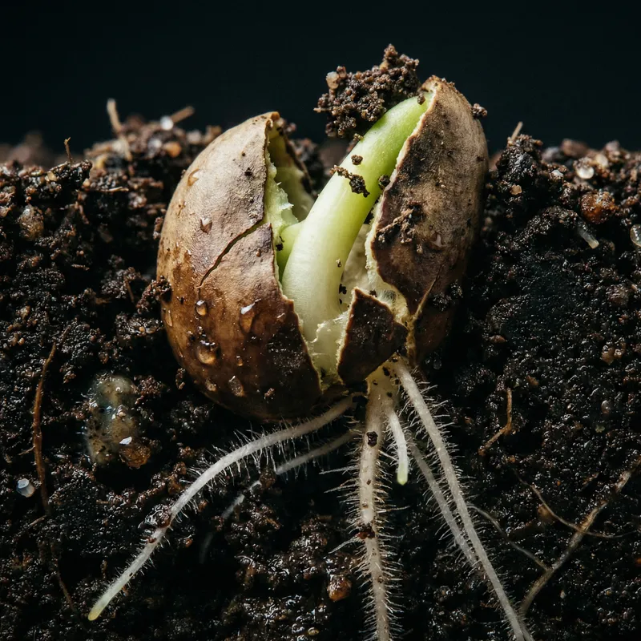
Note:
Seed is sown
The seed dies in the ground
Then ‘germinates life’ – gives birth to a sprout
Then grows to its fullest potential...
John 12: 24

Slide 6
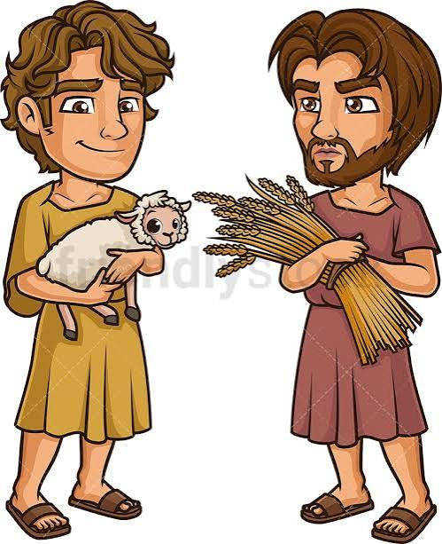
What happened – Cain and Abel?
Gen 4: 1 – 10
Adam and Eve’s 1st born – Cain
Abel – 2nd born, name = breath or vapor
Cain was a ‘farmer’ and Abel was a shepherd
v4The Lord looked with favor on Abel’s offering (a lamb) but not on Cain’s offering (sheaf of wheat)... So Cain was very angry...

Slide 7
V6 “The Lord said to Cain, ‘Why are you angry? If you do what is right, your offering will be accepted...⁷sin is crouching at your door; it desires to have you, but you must rule over it!”
The Lord gave Cain a chance ... But he killed his brother Abel...
V9 The Lord asks Cain, ‘Where is your brother Abel?’ And he states, “Am I my brother’s keeper (babysitter)?”
V10 The Lord responded, “Cain, what have you done?”...

Slide 8
The problem was not the offering...the problem was in the attitude of “obedience”...
Obedience requires faith in the Lord’s ability to provide!
The Feast of First Fruit was symbolic of Thanksgiving and dependence on His provision: bikkweum = Hebrew for “promise to come”
The planting, the watering, the waiting for the harvest or “the promise to come”... Feast of First Fruit

Slide 9
I Corinthians 15: 4 – 57 Jesus is the First Fruit!
V4 – 8 Paul states facts about Jesus’ being seen after He was crucified; the apostles saw Him, 500 people at one time saw Him, and Paul saw Him on the road to Damascus.
V13 – 17 If Jesus did not raise from the dead - our faith would be worthless, we would be liars, and we would be still dead in our sins!
V20 But Christ has indeed been raised from the dead, He is the first fruit – the bikkweum = promise to come...

Slide 10
V22 – 23 For as in Adam all die, so in Christ (Who is raised from the dead) all who belong to Him will be made alive.
V44 – 45 Our bodies sown are natural; it is raised a spiritual body; the first Adam became a living being; the Last Adam (Jesus) a life giving spirit!
V56 – 57 The sting of death is sin (sin itself causes death)...But thanks be to God He gives us the victory through the Lord Jesus Christ!

Slide 11
Romans 8
V37 “...in all these things we are more than conquerors through Him who loves us...”
V28 “And we know that in all things God works for the good of those who love Him, who have been called according to His purpose.”

Slide 12
Jesus – the First Fruit of eternal life
Not only are we born again to have a living relationship with God through Jesus... He makes us more than conquerors... Conquerors over sin and death ... That is our “bikkweum = promise to come”
We know He will never leave or forsake us and that He does all things for the good of those who trust Him... He takes all things that happens and will happen to us and molds it into something that gives us life...

