Slide 1
Feasts of Weeks or
Pentecost
Shavuot
Leviticus 23: 15 – 21
Acts 1 & 2

Slide 2
Review...
Keep the Sabbath holy – the foundation of all the feasts
Passover – Jesus the Passover Lamb
Unleavened Bread – Jesus the Bread of Life
First Fruits – Jesus is the First to be Resurrected

Slide 3
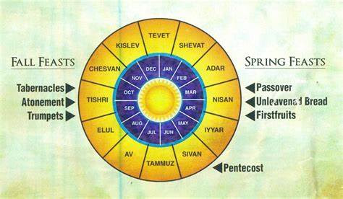
Etc...
#1
#7
#6
#2
#5
#3
#4

Slide 4
Leviticus 23: 15 - 17
¹⁵ “‘From the day after the Sabbath, the day you brought the sheaf of the wave offering, count off seven full weeks. ¹⁶ Count off fifty days up to the day after the seventh Sabbath, and then present an offering of new grain to the Lord. ¹⁷ From wherever you live, bring two loaves made of two-tenths of an ephah of the finest flour, baked with yeast, as a wave offering of firstfruits to the Lord.

Slide 5
Leviticus 23: 18 - 21
¹⁸ Present with this bread seven male lambs, each a year old and without defect, one young bull and two rams. They will be a burnt offering to the Lord, together with their grain offerings and drink offerings—a food offering, an aroma pleasing to the Lord. ¹⁹ Then sacrifice one male goat for a sin offering and two lambs, each a year old, for a fellowship offering. ²⁰ The priest is to wave the two lambs before the Lord as a wave offering, together with the bread of the firstfruits. They are a sacred offering to the Lord for the priest. ²¹ On that same day you are to proclaim a sacred assembly and do no regular work. This is to be a lasting ordinance for the generations to come, wherever you live.

Slide 6

Note:
Pentecost = 50 days (pentagon = 5 points; pente = 5)
Feast of the First Fruit = barley harvest; grain for commoners
Feast of Weeks = wheat harvest; grain for ‘elite’/higher quality
Feast of Tabernacles = olive and grape harvest
The first Feast of Pentecost is said to be celebrated on the day the Lord gave Moses the Laws/10 Commandments
The Sunday after the 1st Fruits starts the Feasts of Weeks

Slide 7
Offerings of the Feast of Pentecost:
7 male lambs completely sacrificed, no parts given to priest
2 loaves of bread baked with yeast waved at the altar, anticipating non-Jews to be worshiping the Lord
1 young bull and 2 rams as burnt offerings
Grain offering with drink (wine) offering – sweet aroma (worship)
1 male goat as a sin offering
2 lambs as a fellowship offering (‘just because want to’ gift) The lambs were wave before the altar before consumed in the altar

Slide 8
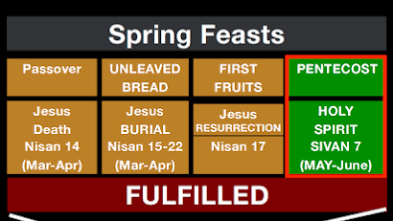
YaChatz

Slide 9
How was the Feast of Pentecost Fulfilled?
Acts 1: 4 & 5
Jesus told His disciples, “Do not leave Jerusalem, but wait for the gift My Father promised, which you have heard (see John 14-16) Me speak about. For John baptized you with water, but in a few days you will be baptized with the Holy Spirit.”

Slide 10
Acts 1: 8 & 9
“But you will receive power when the Holy Spirit comes on you; and you will be My witnesses in Jerusalem, and in all of Judea, and Samaria, and to the ends of the world”.
Then He was taken from them...

Slide 11

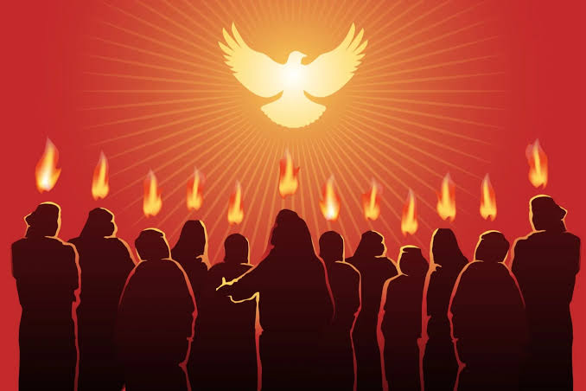
Acts 2: 1 - 12
“When the day of Pentecost came, they were all together in one place. Suddenly a sound like the blowing of a violent wind came from heaven and filled the whole house where they were sitting. They saw what seemed to be tongues of fire that separated and came and rested on each one of them. All of them were filled with the Holy Spirit and began to speak in tongues as the Spirit enabled them... ‘We hear them declaring the wonders of God in our languages’...”
“What does this mean?”

Slide 12
Peter quotes from Joel 2: 28 - 32
“In the last days, God says, ‘I will pour out My Spirit on all people. Your sons and daughter will prophesy, your young men will see visions, your old men will dream dreams. Even on My servants, both men and women, I will pour out My Spirit in those days, and they will prophesy.’”

Slide 13
John 7: 38 Rivers of Living Water
“Jesus stood and said, ‘Let anyone who is thirsty come to Me, and as scripture has said, rivers of living water will flow from within them.’
By this He meant the Spirit, Whom those who believed in Him were to later receive (the day of Pentecost).”

